Slide 1
Supplier Order Collaboration
e2open Steps & Tips Portal Users

Slide 2
STEPS AND TIPS
WHAT IS HAPPENING?
After Onboarding you will receive a system email for registration to get access to the e2open Portal.
  You can register more email addresses if needed
  After registration you can log in to the e2open – Jabil portal at any time to see updated PO and Forecast information
  Jabil Buyer will not release weekly Open Order and Forecast report to you via email
  In the tool you can subscribe all available system email Alerts to get information once Buyer places a new PO or if we have any change in our Forecast. You can see more information about all available Alerts in the next slide
NOTE: Jabil will continue to send PO pdf. copy to you via email from our SAP as our legal & official Purchase Order document!
NEXT STEPS:
Please register your email address(es) to get access to the e2open portal (see registration steps in the next slides)
For more Training information please visit our Supplier Portal: https://www.jabil.com/about-us/supplier/supplier-collaboration.html
You can provide PO and Forecast confirmation directly in the Portal using User Interface, but Excel download/upload option is also available (Please check the training)
  After you send back your confirmation through e2open tool we will have an immediate write-back into our ERP system (SAP)
  In case you receive a system notification/error message that your response was not processed successfully – please check the error notification and make corrections in your confirmation.

Slide 3
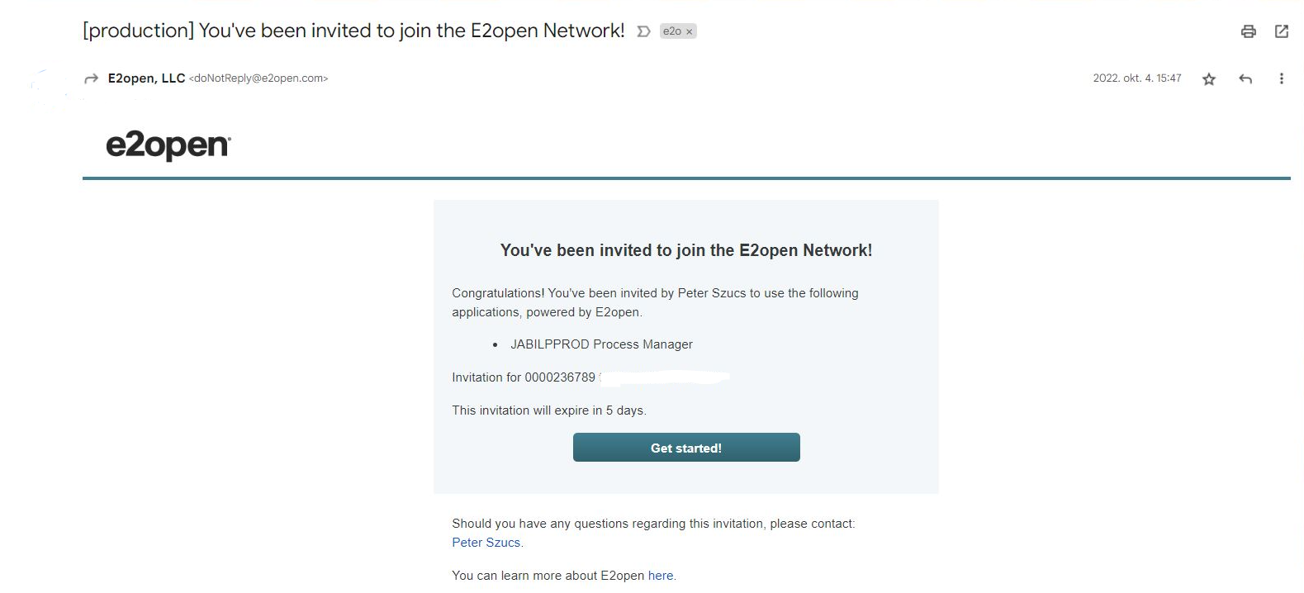
SYSTEM INVITATION EMAIL
After the GO LIVE date, you will receive an invitation email from the system >> Please click on GET STARTED!
1
Click

Slide 4
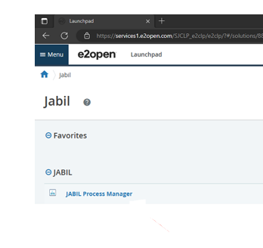
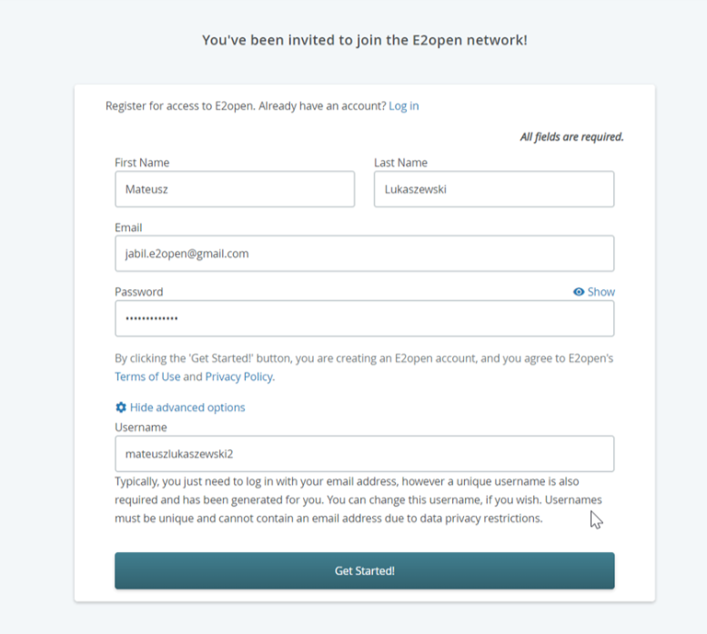
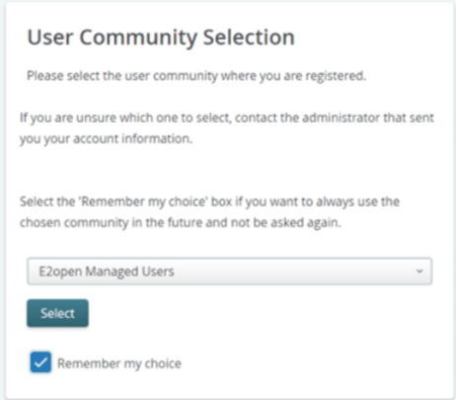
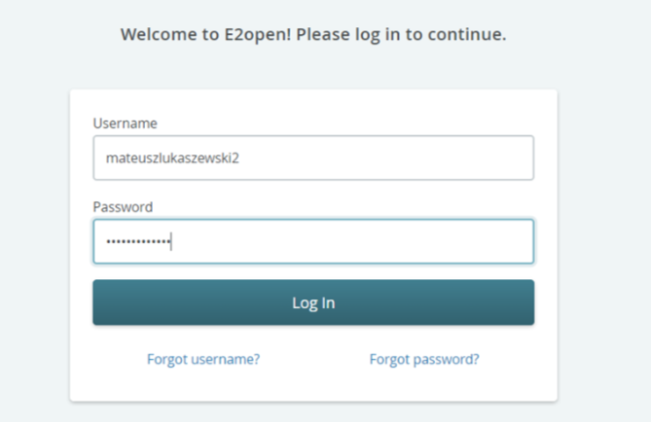
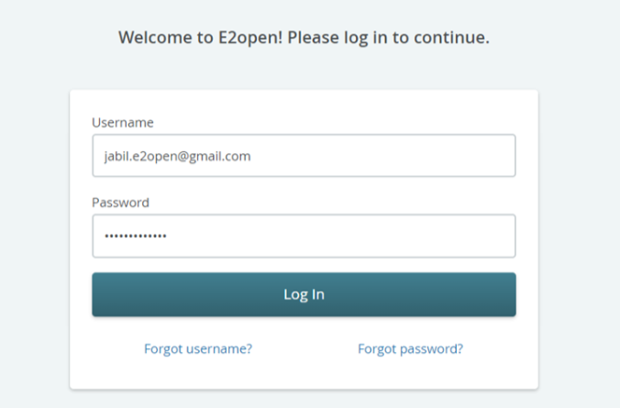
REGISTRATION
REGISTRATION TO THE PORTAL
1. Please follow the registration steps
Note: username by default is „first name”and „Last name„ but the username must be unique (if it already exists in e2open database then you need to adjust it >> Please click on GET STARTED!
2. to log in - you can use email address provided during registration or username
3. After login you will be navigated to e2open page >> Please click on „JABIL Process Manager”
4. Next step from the drop-down list please select E2open Managed Users and tick the checkbox remember your choice
3
Click
1
2
Click
4

Slide 5
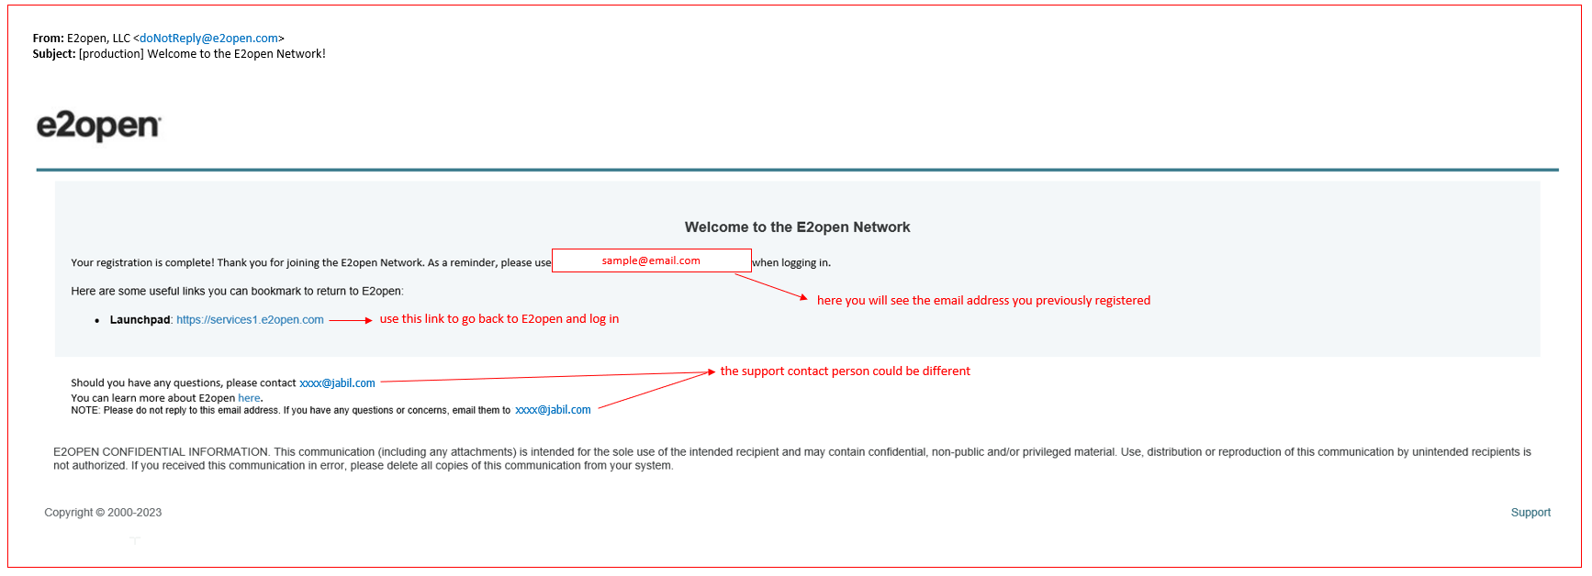
Log in to e2open
After you completed the registration steps the system will send a confirmation email with LINK what you can use for future log in

Slide 6
FIRST STEPS AND TIPS
First time all your existing POs will be NEW or OPEN state! – Please check your previous confirmations (date and & Qty) and resend those through the e2open tool using Excel Download/Upload in the Portal if necessary.
If you have any questions about previously provided confirmation data, please contact your site’s responsible buyer!
In the future you will see updated PO status and valid PO confirmation data
After you send back your confirmation through the e2open tool we will have an immediate write back into our ERP system (SAP).
If you subscribe to any available system Alert in the e2open portal – you will receive consolidated Alerts/Communication for your Vendor code from different plants
  If different Jabil plants are using the same Vendor code – your Alerts will be consolidated
Please review more information about Alert subscription in the next slide

Slide 7
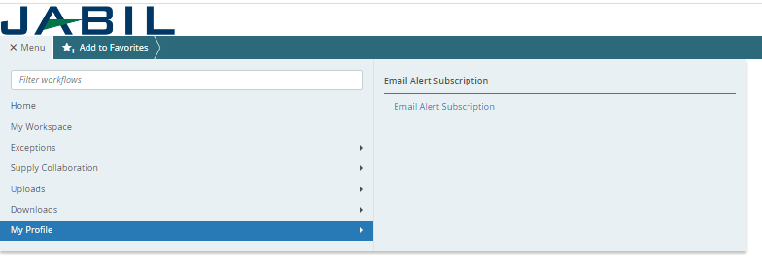
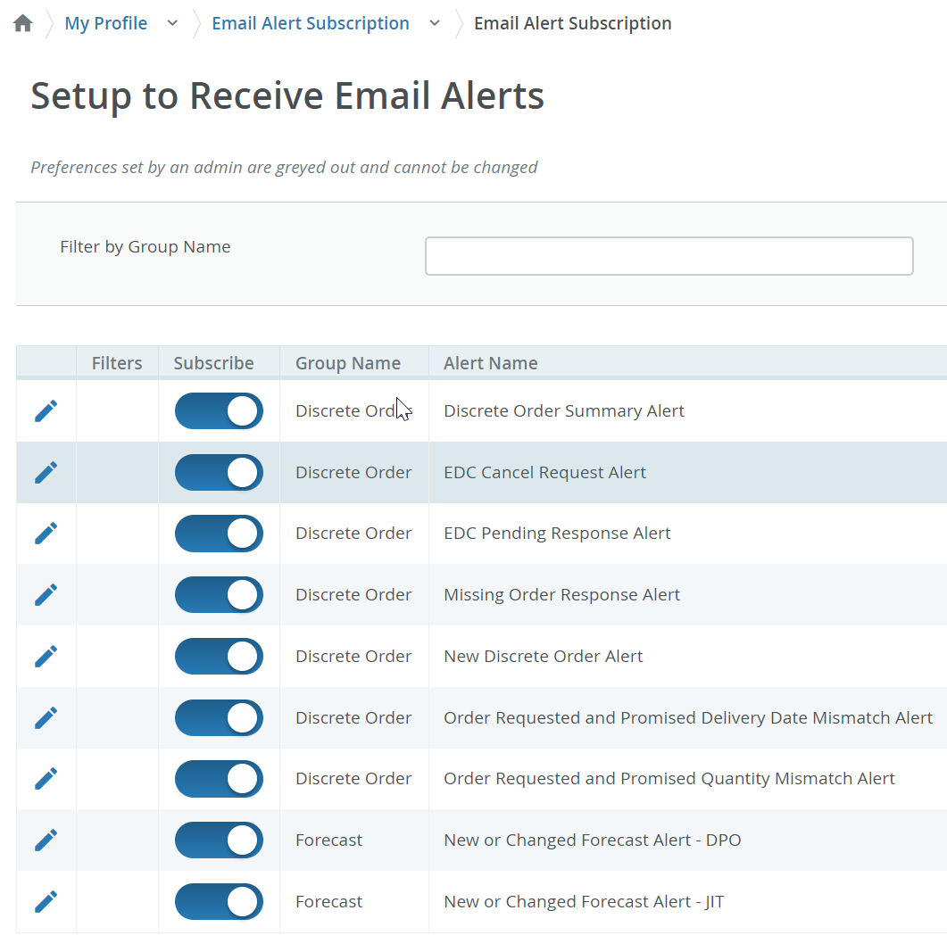
EMAIL ALERT SUBSCRIPTION
Please subscribe to the system Alerts in Menu>> My profile >> Email Alert Subscription
System mail address: donotreply@e2open.com
Please ensure you are not blocking these mail addresses!
Click the pencil icon to set up Filters for Alerts

Slide 8
COMMUNICATION DETAILS
After subscription you will receive below consolidated Alerts for your Vendor code from different plants, based on Communication Period and Alert frequency.
Note: Alerts will be including only those POs that weren't included in the prior email alert!
SYSTEM ALERTS | SYSTEM COMMUNICATION PERIOD | ALERT FREQUENCY AT SUPPLIER
New or Changed Forecast Alert DPO (Discrete Purchase Order) | System release every 6 hours (starting at 0:00:00 UTC) based on Buyer approval | You will receive this Alert once per week, based on Buyer approval
New or Changed Forecast Alert JIT (Just in Time Schedule Agreement)
Summary of Discrete Order Lines | YES
New Discrete Purchase Order | System release twice per day 0:00 UTC and 12:00 UTC | You will receive this Alert twice per day (only if Jabil place new PO to you)
Cancel request Alert | System release every 24 hours (00:00:00 UTC) with a summary | You will receive this Alert once per day (only if Jabil will send PO Cancellation request to you
Cancel Pending Response Alert | After Cancel request Alert where the supplier hasn't responded in next 2 days System release that every 24 hours (00:00:00 UTC) with a summary | You will receive this Alert once per day (only if Jabil sent PO Cancellation request to you but no response back after 2 days)
Order Requested and Promised Date Mismatch Alert​ | System release every 24 hours (00:00:00 UTC) with a summary | You will receive this Alert once per day and no repeating PO data
Order Requested and Promised Quantity Mismatch Alert​ | System release every 24 hours (00:00:00 UTC) with a summary
Missing Order Response Alert | System release every 24 hours (00:00:00 UTC) with a summary
System mail address: donotreply@e2open.com - Please ensure you are not blocking these mail addresses!

Slide 9
PO STATE TRANSITIONS IN e2open
START/END | NEW | OPEN | ACCEPT | ACCEPT W/CHANGES (AWC) | NO COMMIT | CLOSED | CANCELLEED
INITIAL SYSTEM | Change (Jabil)
NEW |  | >Change (Jabil) >MRP buyer update | Accept (Supplier) | AWC (Supplier) | No Commit (Suppl) | Close (Jabil) | Cancel (Jabil)
OPEN |  | Change (Jabil) >MRP buyer update >Cancel Response (Accept/No Commit – Suppl) | Accept (Supplier) | AWC (Supplier) | No Commit (Suppl) | Close (Jabil) | Cancel (Jabil)
NO COMMIT |  | >Change (Jabil) >MRP buyer update | Accept (Supplier) | AWC (Supplier) | No Commit (backend sync up only) | Close (Jabil) | Cancel (Jabil)
ACCEPT |  | >Change (Jabil) >MRP buyer update | Accept (backend sync up only) | AWC (Supplier) | No Commit (Suppl) | Close (Jabil) | Cancel (Jabil)
ACCEPT W/CHANGES (AWC) |  | >Change (Jabil) >MRP buyer update | Accept (Supplier) | AWC (backend sync up only) | No Commit (Suppl) | Close (Jabil) | Cancel (Jabil)
CLOSED |  | Change (Jabil) |  |  |  | Close (Jabil) | Cancel (Jabil)
CANCELLED |  | Change (Jabil) |  |  |  | Close (Jabil) | Cancel (Jabil)
START/END | NEW | OPEN | ACCEPT | ACCEPT W/CHANGES (AWC) | NO COMMIT | CLOSED | CANCELLEED
INITIAL SYSTEM | Change (Jabil)
NEW |  | >Change (Jabil) >MRP buyer update | Accept (Supplier) | AWC (Supplier) | No Commit (Suppl) | Close (Jabil) | Cancel (Jabil)
OPEN |  | Change (Jabil) >MRP buyer update >Cancel Response (Accept/No Commit – Suppl) | Accept (Supplier) | AWC (Supplier) | No Commit (Suppl) | Close (Jabil) | Cancel (Jabil)
NO COMMIT |  | >Change (Jabil) >MRP buyer update | Accept (Supplier) | AWC (Supplier) | No Commit (backend sync up only) | Close (Jabil) | Cancel (Jabil)
ACCEPT |  | >Change (Jabil) >MRP buyer update | Accept (backend sync up only) | AWC (Supplier) | No Commit (Suppl) | Close (Jabil) | Cancel (Jabil)
ACCEPT W/CHANGES (AWC) |  | >Change (Jabil) >MRP buyer update | Accept (Supplier) | AWC (backend sync up only) | No Commit (Suppl) | Close (Jabil) | Cancel (Jabil)
CLOSED |  | Change (Jabil) |  |  |  | Close (Jabil) | Cancel (Jabil)
CANCELLED |  | Change (Jabil) |  |  |  | Close (Jabil) | Cancel (Jabil)
Every PO change trigger PO line and PO Schedule line state change in e2open
NEW state > every new PO , not committed before
OPEN state > every PO where we have PO qty, delivery date or price change
ACCEPTED > every PO what Supplier confirmed back and meet fully with Jabil requested date and qty
ACCEPTED w/CHANGES > every PO what Supplier confirmed back BUT not meet fully with Jabil requested date and qty
CLOSED > every PO where we have no more open qty in SAP or buyer put delivery completed indicator flag
CANCELLED > every PO what Buyer cancel from SAP
Please check change MATRIX here!

Slide 10


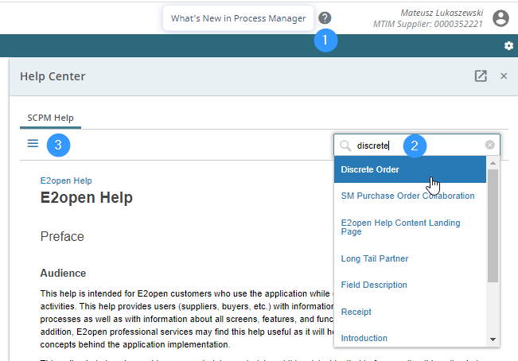
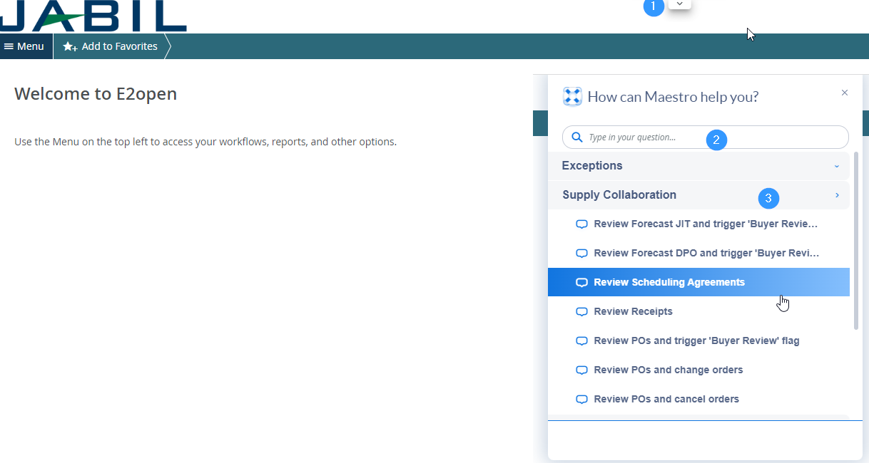
e2open | Online help
BWEBlt – in e2open help center
Maestro add-in helps
You can Open Maestro to click arrow icon
Maestro add-in helps to attain success in real time with interactive, automated, and customized self-help, product tours and announcements right in the applications. The always-on user assistant provides a consistent Help experience in the moment of need.
To launch Maestro hover over arrow icon (1) and click on object.
Type a question in search box (2) or select any topic which you are interested.
This help provides users (suppliers, buyers, etc.) with information about the application concepts and processes as well as with information about all screens, features, and functionalities in the application
Click on question mark icon (1) to open Help Center.
Type in search box phrase on which you need more information (2) or hit 3 lines icon (3) to open menu with all available categories.

Slide 11
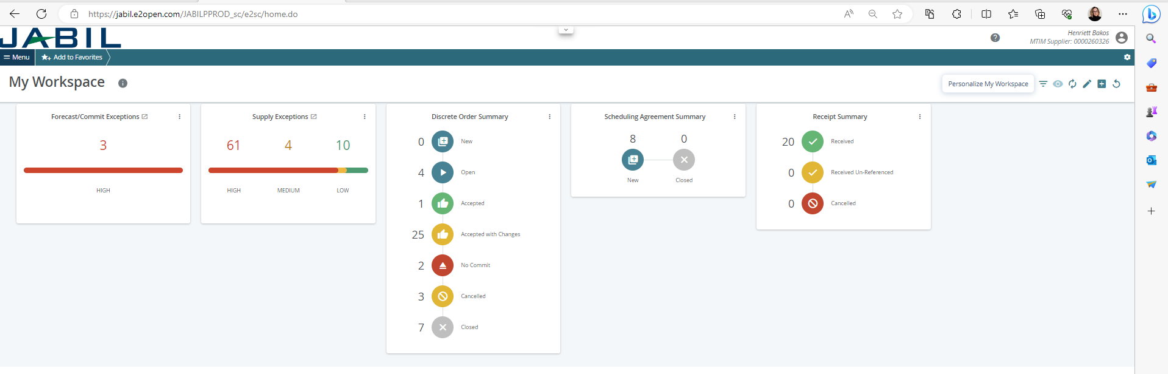
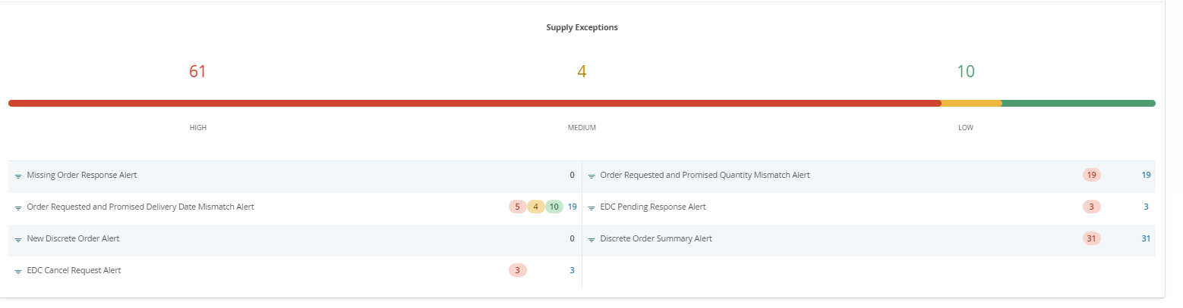
PORTAL SUPPLIERS | MY WORKSPACE
My Workspace gives you an overview of all orders (grouped by state) or exceptions summary.
Data on My Workspace is hyperlinked.
To see detailed information, click on the cards name, e.g., Supply Exception (1) to see the list of the objects (2) which meet these criteria.
1
2
Continue in the next slide

Slide 12
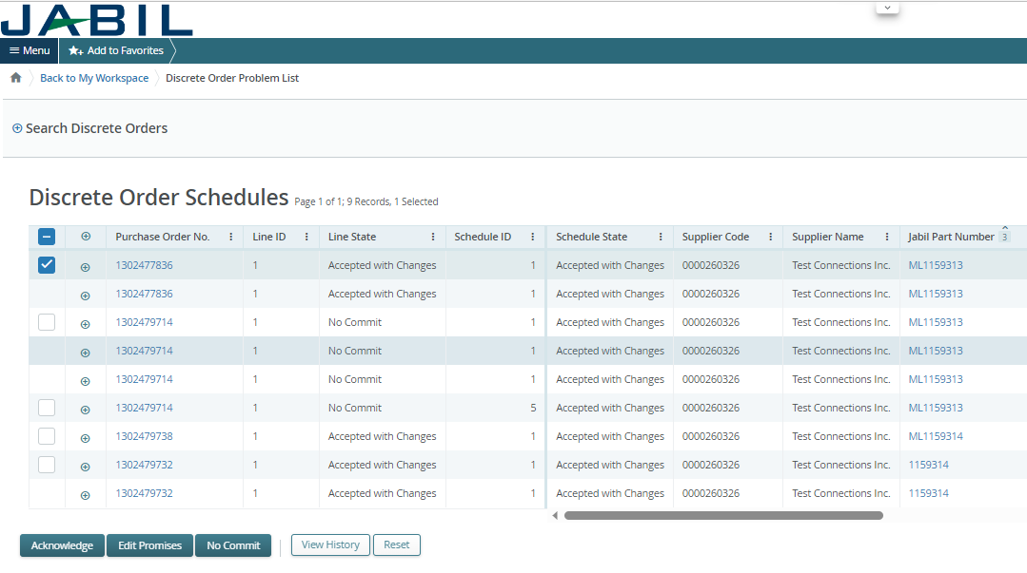
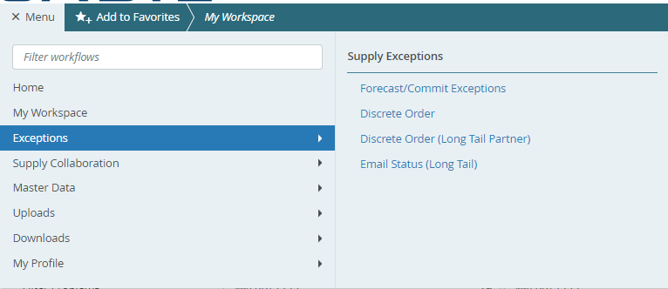
PORTAL SUPPLIERS | MY WORKSPACE | EXCEPTIONS
Object may have multiple Exceptions (count in drill down may be higher).
Data on My Workspace is hyperlinked. Click on the number next to chosen exception (1) to see the list of the objects which meet these criteria.
On new pop-up widow you will see list of all exception with order numbers (2).
Exceptions accessible from multiple places within the system
from Menu
through My Workspace. They are context sensitive and clickable to drill down into details
1
2

Slide 13
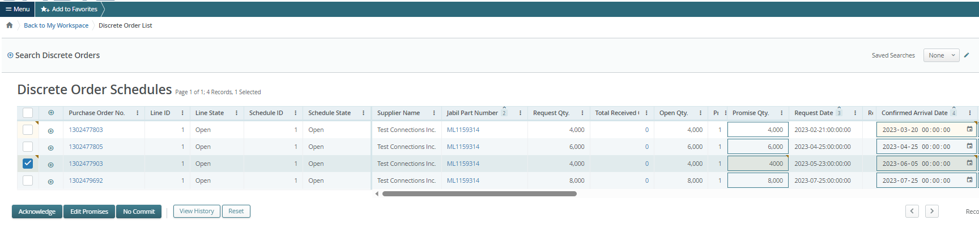
MY WORKSPACE | PO CONFIRMATION
My Workspace gives you an overview of all orders (grouped by state) or exceptions summary.
Data on My Workspace is hyperlinked.
For PO CONFIRMATION please check Discrete Orders with NEW and OPEN status (1)
To see detailed information, click on the number or text, and PO list will open in a new pop-up window (2)
Here you can Acknowledge the Pos with publish PO promise qty and date, or you can EDIT PO confirmation in case of split commit. (3)
For further information about PO confirmation process steps please review slides from page 20.
1
2
3

Slide 14
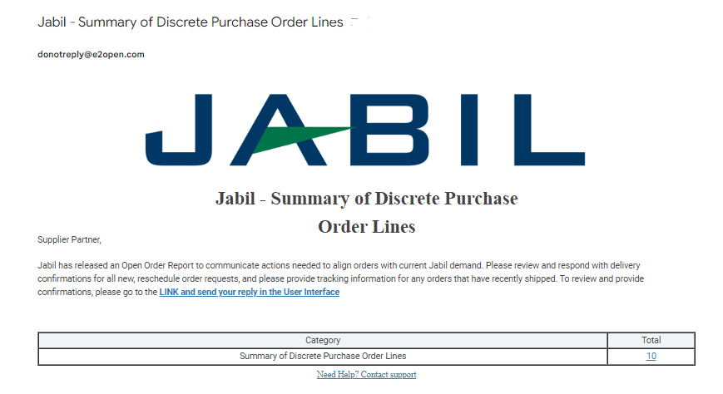
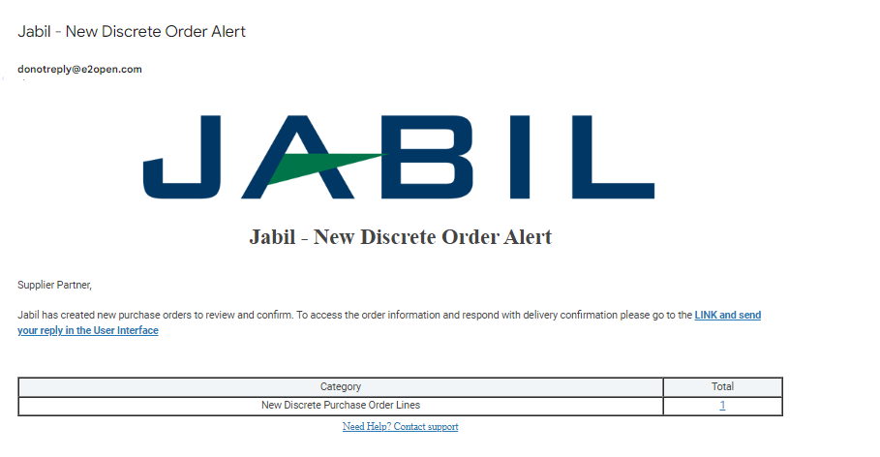
PORTAL SUPPLIERS | NEW PO & OPEN PO DATA
From Email Notification: You will receive this Alert twice per day (only if Jabil place new PO to you)
Please use the link to click and see the PO details

Slide 15
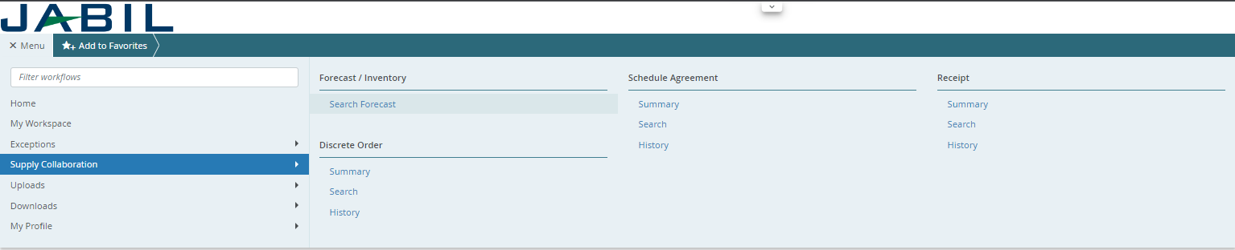
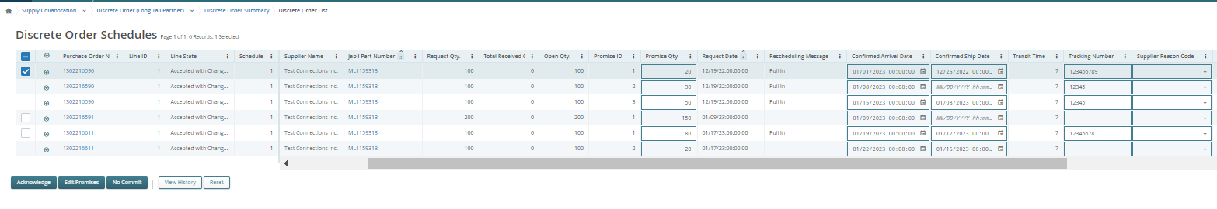
PORTAL SUPPLIERS | NEW PO & OPEN PO DATA
After log in with your password you can search data in the Menu:
Please follow: MENU >> Supply Collaboration >> Summary
1
2
3
Open PO List will pop up

Slide 16
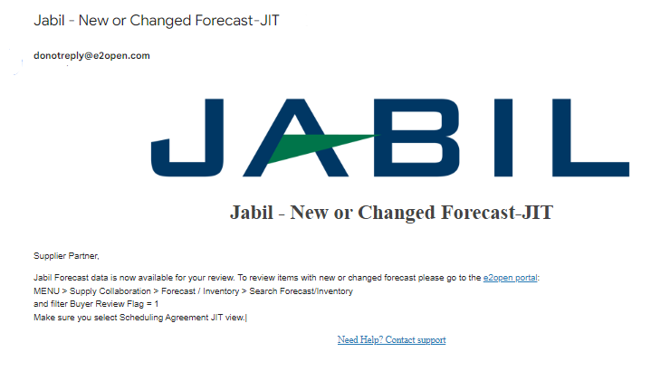
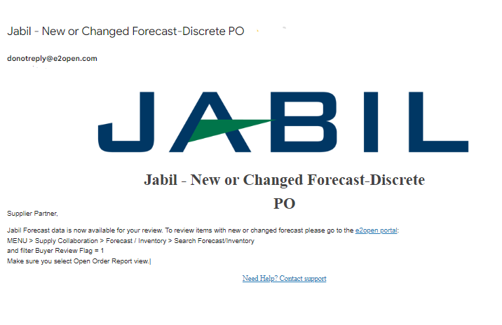
PORTAL SUPPLIERS | FORECAST DATA
From Email Notification: You will receive this Alert once per week, based on Buyer approval, and only if you subscribe to this Alert in the Menu
Please use the link to click and see the PO details

Slide 17
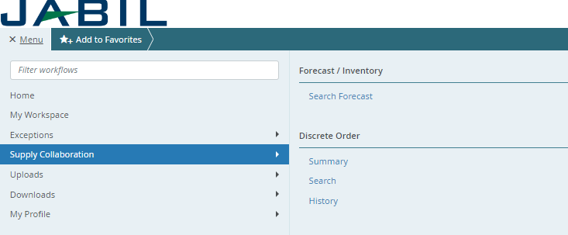
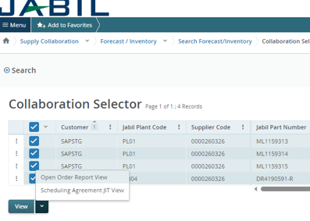
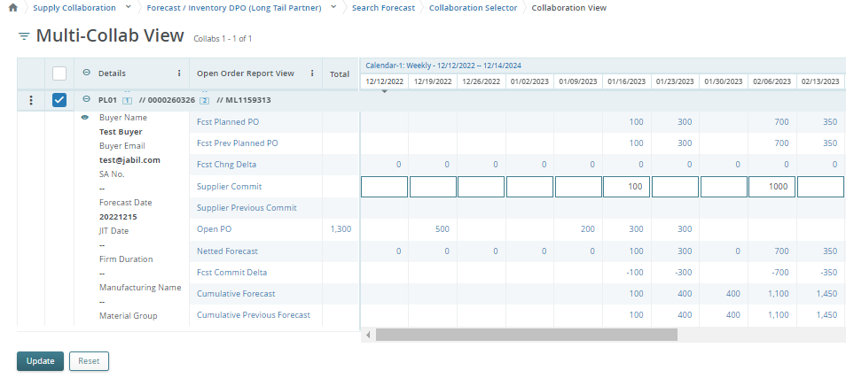
PORTAL SUPPLIERS | FORECAST DATA
1
In the Menu:
Please follow: MENU >> Supply Collaboration >> Search Forecast
Select Materials for Forecast View >>Click the correct View in the list to open details (1)
  Open Order Report view >> to see discrete PO FC data
  Scheduling Agreement JIT View >> to see JIT SA Firm & FC qty data
Click View (2)
1
2
FC data will pop up

Slide 18
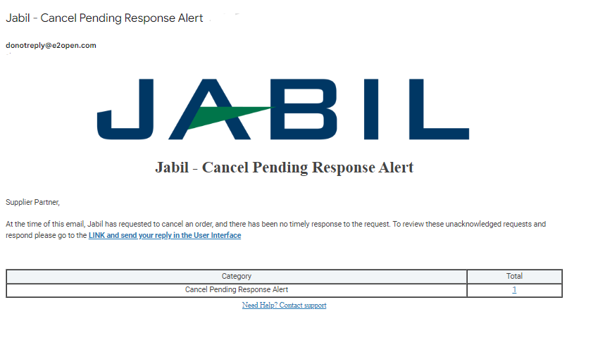
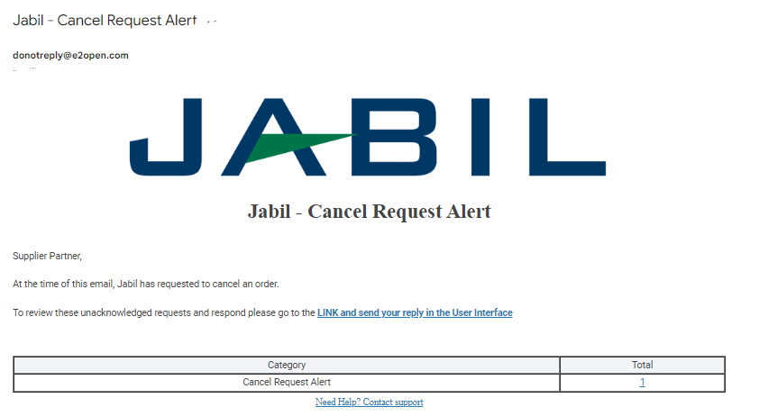
PORTAL SUPPLIERS | CANCEL REQUEST
From Email Notification: You will receive this Alert once per day
(only if Jabil will send PO Cancellation request to you)
Please use the link to click and see the PO details

Slide 19
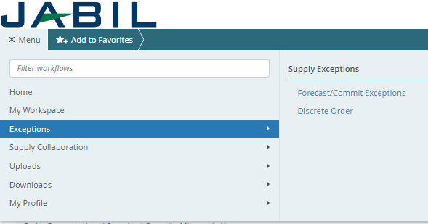
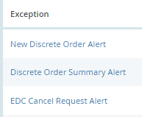
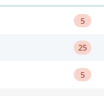
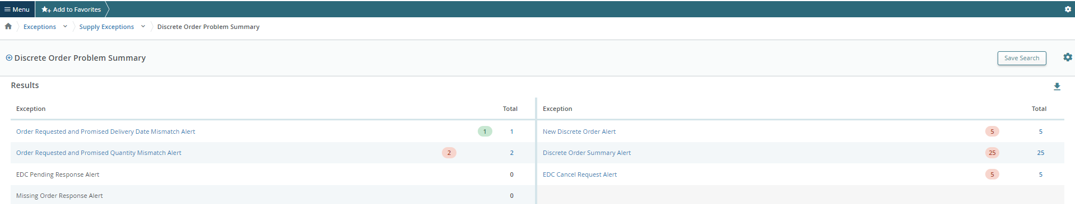
PORTAL SUPPLIERS | CANCEL REQUEST
After log in with your password you can search data in the Menu:
MENU >> Exception>> Discrete Order
1
Click the number and the PO list with Cancel Request will pop up
2
3

Slide 20
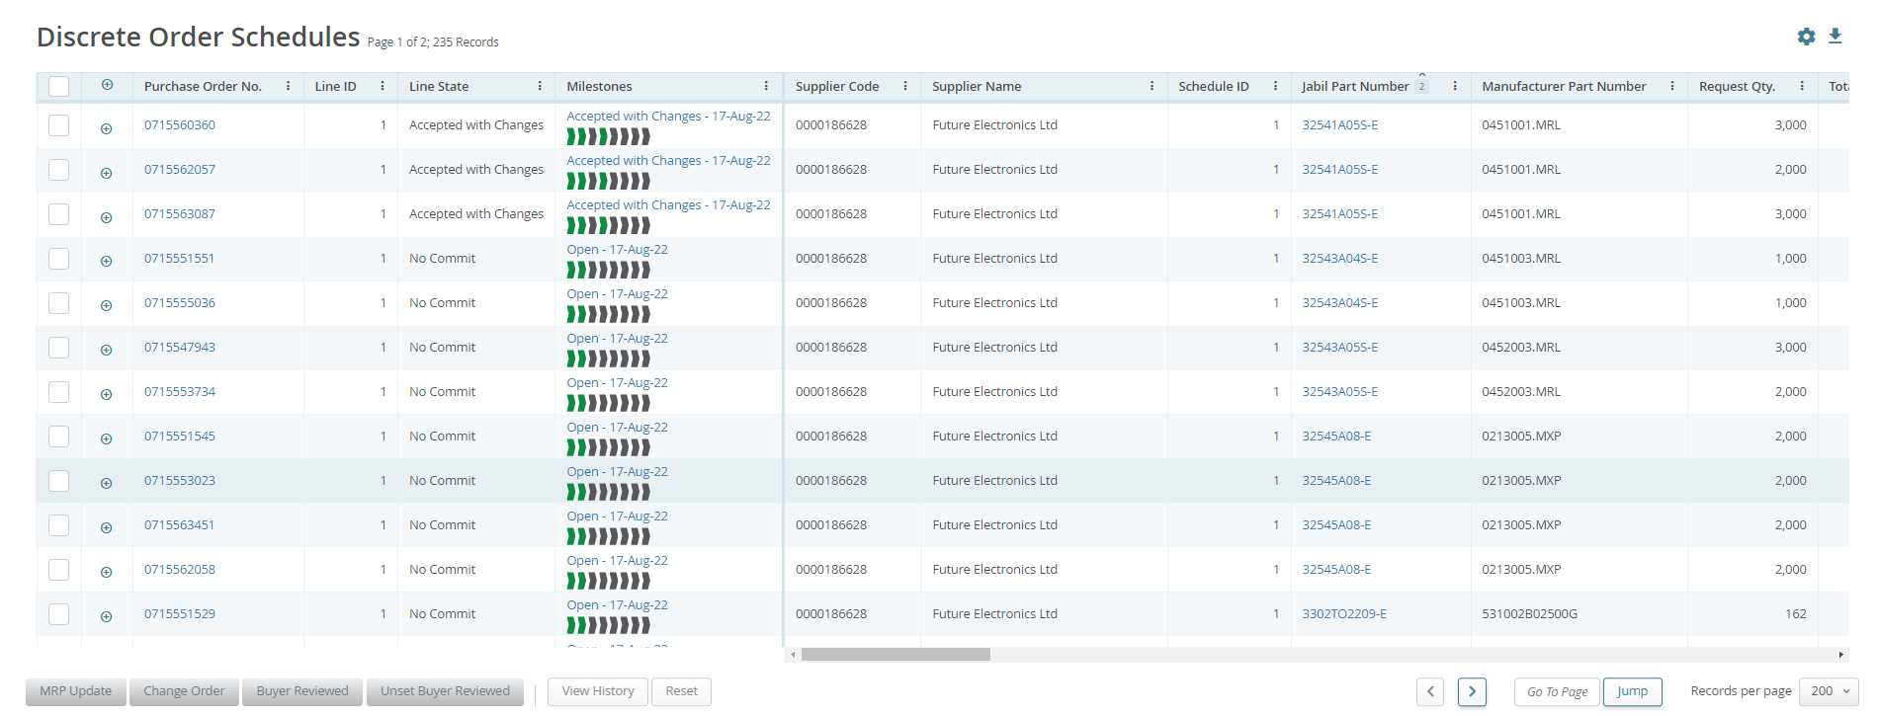
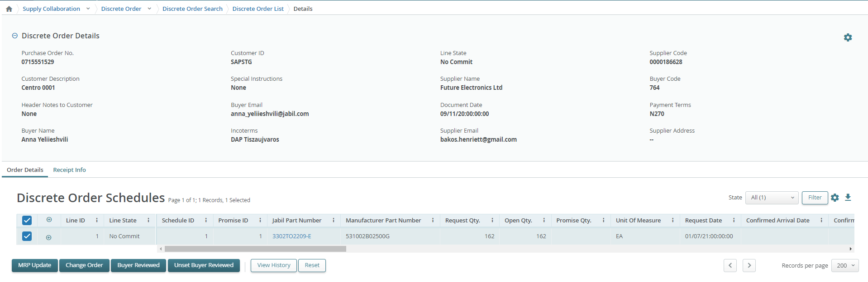
WORKING WITH LISTS
2
On the list pages you are viewing all relevant order, schedule agreements, or receipt among with key fields. You may need to scroll right/left to see all columns (1)
On the top you can see number of pages and listed records (2).
For a list spread over multiple pages, use the Previous Page and Next Page buttons (3), or enter a page number and click Jump to navigate through the list (3)
Expand or collapse details by clicking the + / - button for each row. (4)
Blue text is hyperlinked and clickable to show details
Click the object (Order, Receipt, etc.) number in blue to open the object’s details page. (5)
4
5
1
3
5

Slide 21
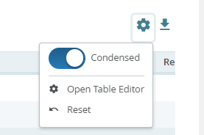
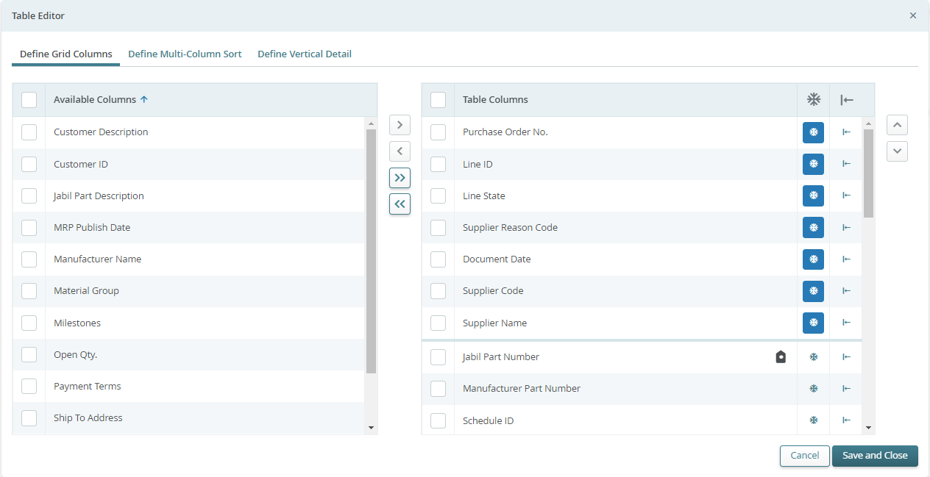
WORKING WITH LISTS | TABLE EDITOR
Table Editor allows you to configure data fields displayed on list and/or their sort order
Open the Table Editor (1) to display/hide additional fields.
To remove, add or reorder columns on your current page view, click the column checkbox next to selected line and then use the right/left or up/down arrow buttons (2)
There is also option to drag and pull the data up and down with the mouse
You can also move the columns left and right directly in the list page with same way
1
2

Slide 22
Visit our Supplier Portal for more Information:
https://www.jabil.com/about-us/supplier/supplier-collaboration.html

