Slide 1
Supplier Order Collaboration
e2open Training - Portal Suppliers

Slide 2





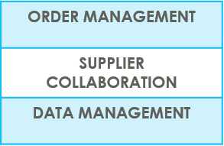
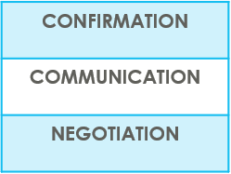

SUPPLIERS IN e2open | OVERVIEW
Supplier Collaboration
Input data
ERP system
Suppliers
Request
System message
Auto Write Back
System message
e2open is Jabil new Collaboration Platform to standardize and digitize our communication, one system for all Suppliers, all Communication methods
Automation of Purchase Order and Reschedule and/or Cancellation System message and Forecast communication to supplier and response write back into ERP system
Improved partnership with our Suppliers thru proactive collaboration
Platform for Suppliers and Buyers for short-term and long-term supply problems to support RISK and Shortage Management
e2open are mapping our Open PO and FC data from our ERP system > summarize it in a user-friendly Interface >then send it out to our Suppliers automatically

Slide 3

SUPPLIERS IN e2open | TYPES OF SUPPLIERS
ACCESS
Portal Registration
Based on Supplier Alert’s Subscription (Filters are available)
Directly on the PORTAL
Portal Suppliers
NOTIFICATION
REPLY
After GO LIVE - Jabil sends invitation email and registration is required
Suppliers have direct access to the e2open Portal - You can register more email addresses if needed
After registration you can log in to the e2open – Jabil portal at any time to see updated PO and Forecast information
The Portal also enables Forecast, PO & Goods Receipts visibility
In the tool you can subscribe all available system email Alerts to get information once Buyer places a new PO or if we have any change in our Forecast. You can see more information about all available Alerts in the next slide
NOTE: Jabil will continue to send PO pdf. copy to you via email from our SAP as our legal & official Purchase Order document!

Slide 4
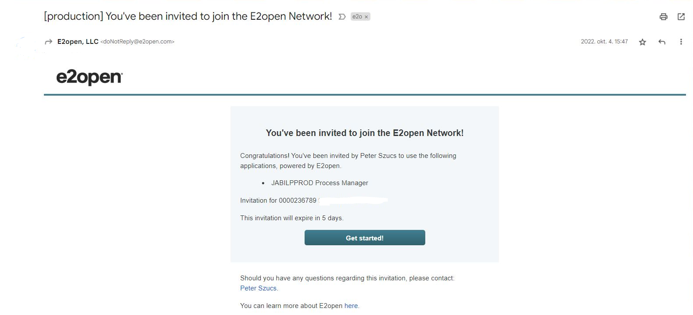
SYSTEM INVITATION EMAIL
After the GO LIVE date, you will receive an invitation email from the system >> Please click on GET STARTED!
1
Click

Slide 5
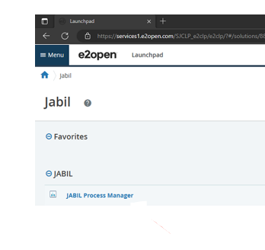
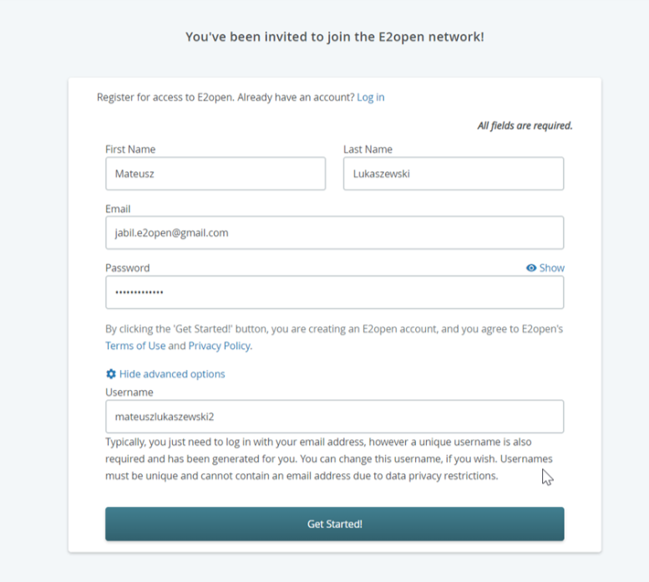
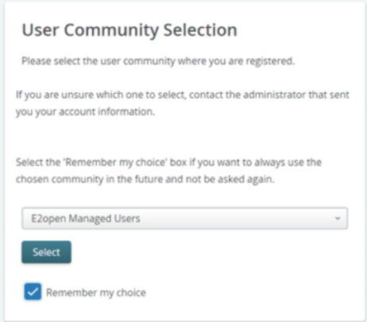
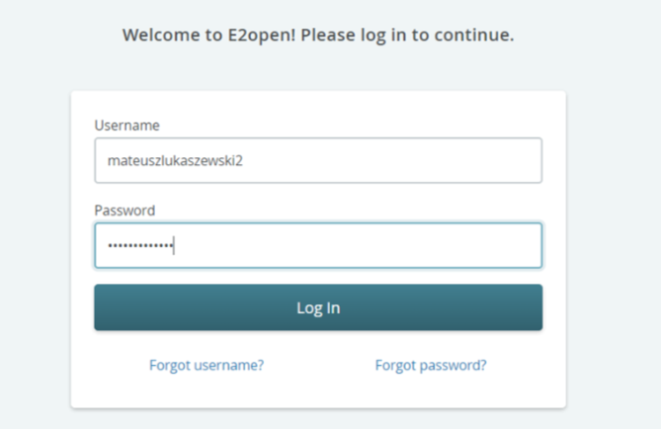
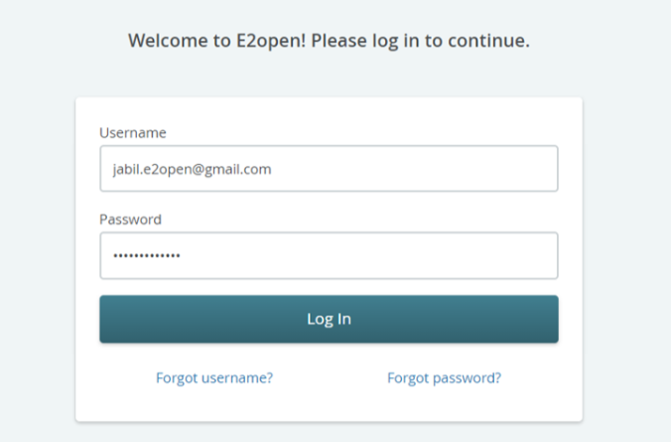
REGISTRATION
REGISTRATION TO THE PORTAL
1. Please follow the registration steps
Note: username by default is „first name”and „Last name„ but the username must be unique (if it already exists in e2open database then you need to adjust it >> Please click on GET STARTED!
2. to log in - you can use email address provided during registration or username
3. After login you will be navigated to e2open page >> Please click on „JABIL Process Manager”
4. Next step from the drop-down list please select E2open Managed Users and tick the checkbox remember your choice
3
Click
1
2
Click
4

Slide 6
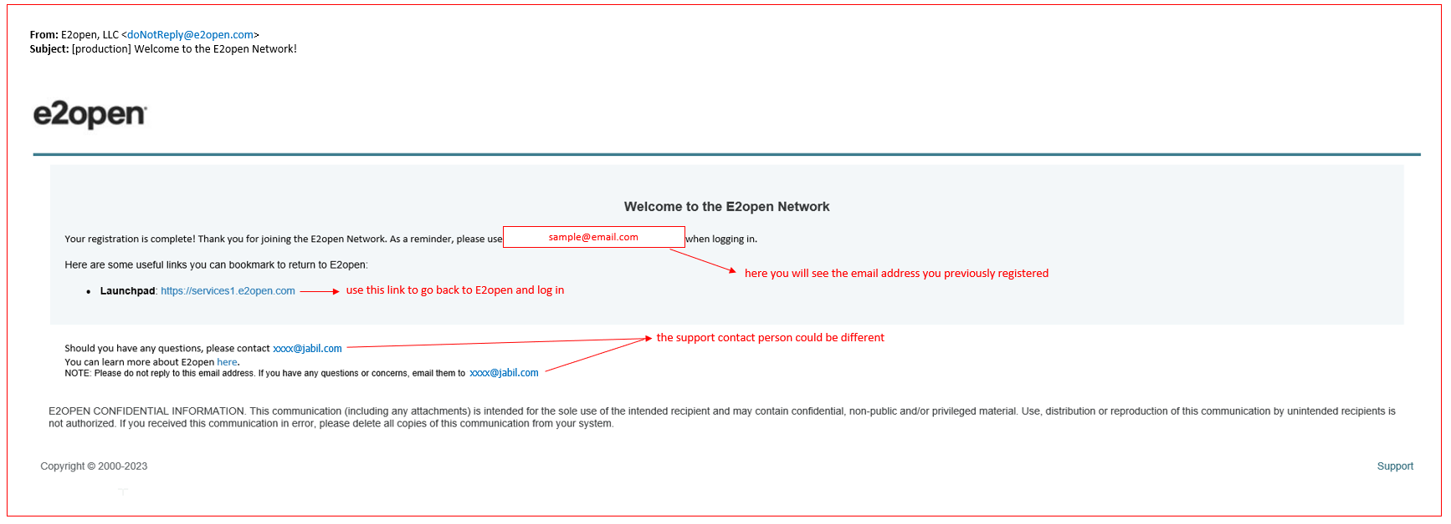
Log in to e2open
After you completed the registration steps the system will send a confirmation email with LINK what you can use for future log in

Slide 7


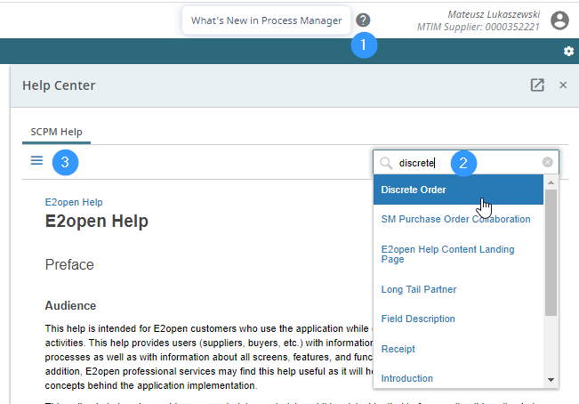
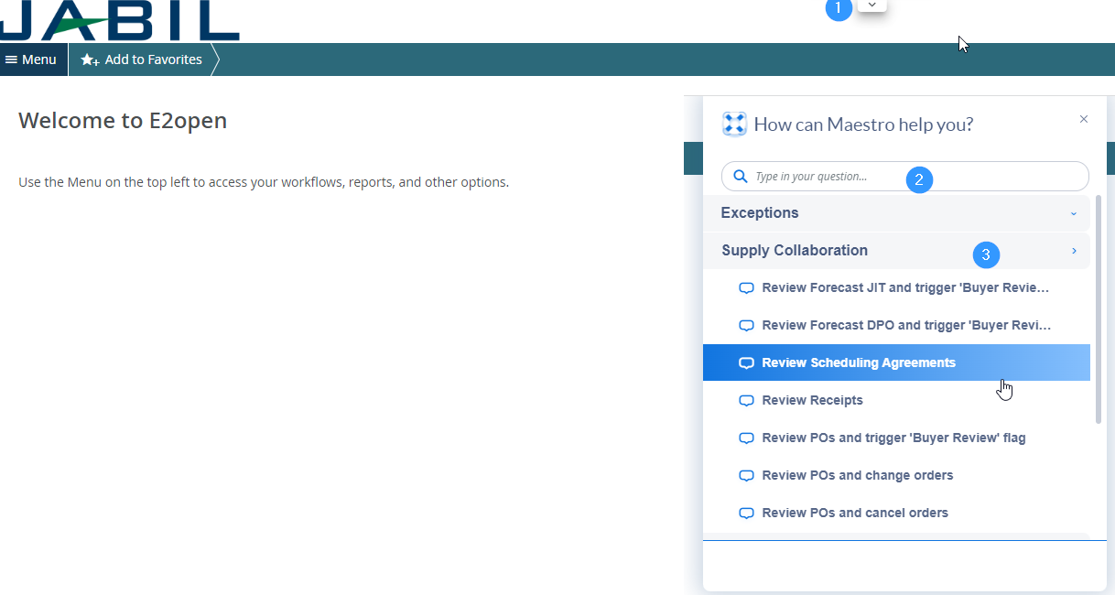
e2open | Online help
Built – in e2open help center
Maestro add-in helps
You can Open Maestro to click arrow icon
Maestro add-in helps to attain success in real time with interactive, automated, and customized self-help, product tours and announcements right in the applications. The always-on user assistant provides a consistent Help experience in the moment of need.
To launch Maestro hover over arrow icon (1) and click on object.
Type a question in search box (2) or select any topic which you are interested.
This help provides users (suppliers, buyers, etc.) with information about the application concepts and processes as well as with information about all screens, features, and functionalities in the application
Click on question mark icon (1) to open Help Center.
Type in search box phrase on which you need more information (2) or hit 3 lines icon (3) to open menu with all available categories.

Slide 8
PORTAL SUPPLIER AVAILABLE EMAIL NOTIFICATIONS
Portal Supplier SYSTEM ALERTS | ALERT FREQUENCY
New or Changed Forecast Alert DPO New or Changed Forecast Alert JIT | Sent to subscribers upon buyer’s approval with details of the forecast that are experiencing the exception, and which were not included in the last email alert
New Discrete Purchase Order | Sent to subscribers new PO list which were not included in the last email alert
Summary of Discrete Order Lines | Sent to subscribers upon buyer’s approval with details of the discrete purchase orders that the role has access.​
Cancel request Alert | Alert is triggered when a discrete order schedule has Cancel requests published by the buyers Sent to subscribers once per day with a summary of the affected discrete order request schedules that the role can access and that weren't included in the prior email alert
Cancel Pending Response Alert | This alert is triggered when a discrete order schedule has Cancel change requests published by the buyers, but the supplier hasn't responded and Cancel request published date is EQUAL or HIGHER than 2 days.​​ Sent to subscribers once per day with a summary of the affected discrete order request schedules that the role can access and that weren't included in the prior email alert
Order Requested and Promised Date Mismatch Alert​ | Sent to subscribers once per day with a summary of the discrete orders weren’t included in the last email alert and the promise date on a discrete order promise schedule doesn't match the request date on its request schedule
Order Requested and Promised Quantity Mismatch Alert​ | Sent to subscribers once per day with a summary of the discrete orders weren’t included in the last email alert and the promise quantity on a discrete order promise schedule doesn't match the request quantity on its request schedule
Missing Order Response Alert | This alert is triggered when a supplier doesn't commit to an order or order change within the agreed upon business schedule
Supplier User receives email notifications
Only one email address per supplier
System mail address: donotreply@services.e2open.com
Please ensure you are not blocking this mail address!

Slide 9
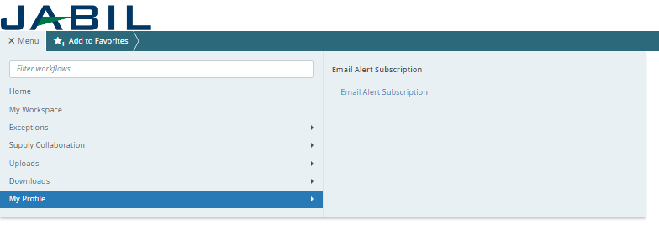
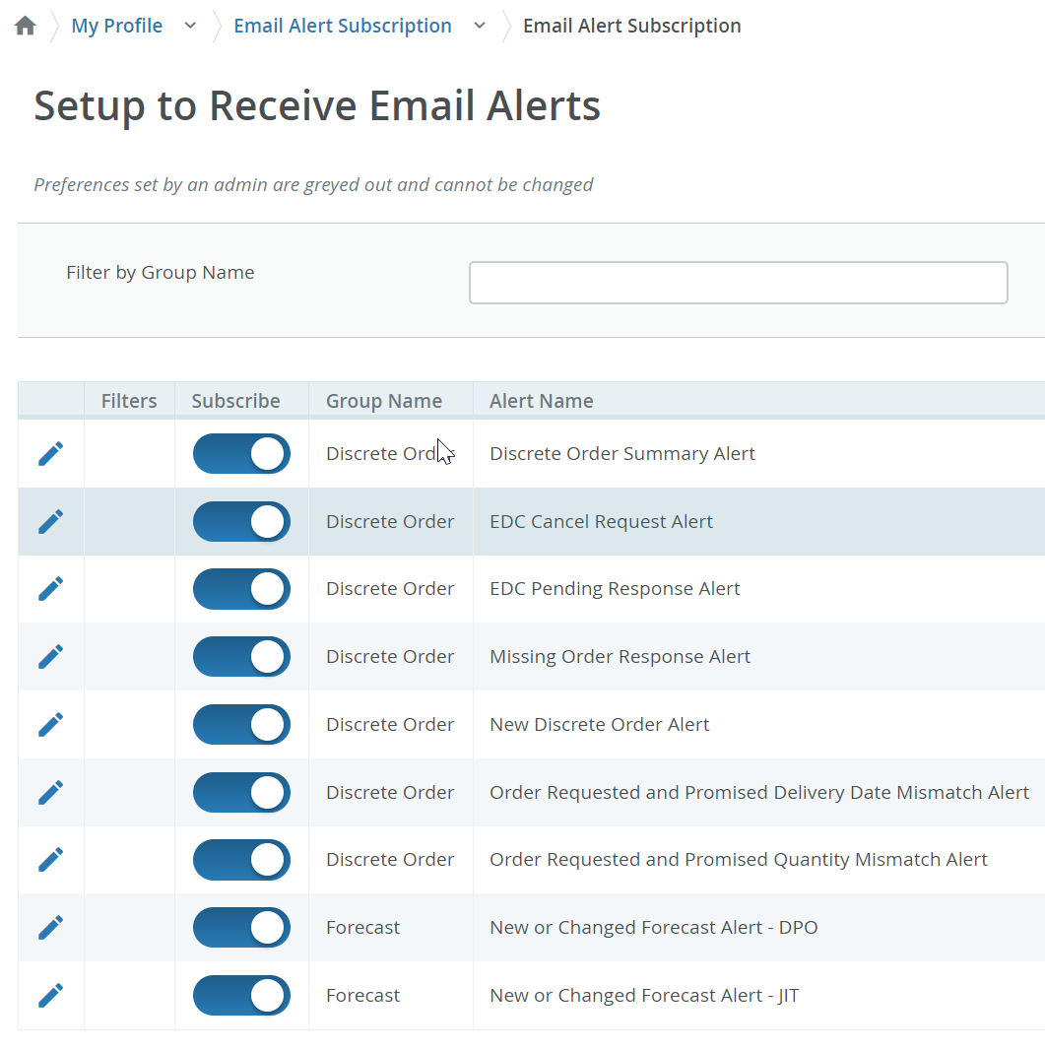
EMAIL ALERT SUBSCRIPTION
Please subscribe to the system Alerts in Menu>> My profile >> Email Alert Subscription
System mail address: donotreply@e2open.com
Please ensure you are not blocking these mail addresses!
Click the pencil icon to set up Filters for Alerts

Slide 10
COMMUNICATION DETAILS
After subscription you will receive below consolidated Alerts for your Vendor code from different plants, based on Communication Period and Alert frequency.
Note: Alerts will be including only those POs that weren't included in the prior email alert!
SYSTEM ALERTS | SYSTEM COMMUNICATION PERIOD | ALERT FREQUENCY AT SUPPLIER
New or Changed Forecast Alert DPO (Discrete Purchase Order) | System release every 6 hours (starting at 0:00:00 UTC) based on Buyer approval | You will receive this Alert once per week, based on Buyer approval
New or Changed Forecast Alert JIT (Just in Time Schedule Agreement)
Summary of Discrete Order Lines | YES
New Discrete Purchase Order | System release twice per day 0:00 UTC and 12:00 UTC | You will receive this Alert twice per day (only if Jabil place new PO to you)
Cancel request Alert | System release every 24 hours (00:00:00 UTC) with a summary | You will receive this Alert once per day (only if Jabil will send PO Cancellation request to you
Cancel Pending Response Alert | After Cancel request Alert where the supplier hasn't responded in next 2 days System release that every 24 hours (00:00:00 UTC) with a summary | You will receive this Alert once per day (only if Jabil sent PO Cancellation request to you but no response back after 2 days)
Order Requested and Promised Date Mismatch Alert​ | System release every 24 hours (00:00:00 UTC) with a summary | You will receive this Alert once per day and no repeating PO data
Order Requested and Promised Quantity Mismatch Alert​ | System release every 24 hours (00:00:00 UTC) with a summary
Missing Order Response Alert | System release every 24 hours (00:00:00 UTC) with a summary
System mail address: donotreply@e2open.com - Please ensure you are not blocking these mail addresses!

Slide 11
PO STATE TRANSITIONS IN e2open
START/END | NEW | OPEN | ACCEPT | ACCEPT W/CHANGES (AWC) | NO COMMIT | CLOSED | CANCELLEED
INITIAL SYSTEM | Change (Jabil)
NEW |  | >Change (Jabil) >MRP buyer update | Accept (Supplier) | AWC (Supplier) | No Commit (Suppl) | Close (Jabil) | Cancel (Jabil)
OPEN |  | Change (Jabil) >MRP buyer update >Cancel Response (Accept/No Commit – Suppl) | Accept (Supplier) | AWC (Supplier) | No Commit (Suppl) | Close (Jabil) | Cancel (Jabil)
NO COMMIT |  | >Change (Jabil) >MRP buyer update | Accept (Supplier) | AWC (Supplier) | No Commit (backend sync up only) | Close (Jabil) | Cancel (Jabil)
ACCEPT |  | >Change (Jabil) >MRP buyer update | Accept (backend sync up only) | AWC (Supplier) | No Commit (Suppl) | Close (Jabil) | Cancel (Jabil)
ACCEPT W/CHANGES (AWC) |  | >Change (Jabil) >MRP buyer update | Accept (Supplier) | AWC (backend sync up only) | No Commit (Suppl) | Close (Jabil) | Cancel (Jabil)
CLOSED |  | Change (Jabil) |  |  |  | Close (Jabil) | Cancel (Jabil)
CANCELLED |  | Change (Jabil) |  |  |  | Close (Jabil) | Cancel (Jabil)
START/END | NEW | OPEN | ACCEPT | ACCEPT W/CHANGES (AWC) | NO COMMIT | CLOSED | CANCELLEED
INITIAL SYSTEM | Change (Jabil)
NEW |  | >Change (Jabil) >MRP buyer update | Accept (Supplier) | AWC (Supplier) | No Commit (Suppl) | Close (Jabil) | Cancel (Jabil)
OPEN |  | Change (Jabil) >MRP buyer update >Cancel Response (Accept/No Commit – Suppl) | Accept (Supplier) | AWC (Supplier) | No Commit (Suppl) | Close (Jabil) | Cancel (Jabil)
NO COMMIT |  | >Change (Jabil) >MRP buyer update | Accept (Supplier) | AWC (Supplier) | No Commit (backend sync up only) | Close (Jabil) | Cancel (Jabil)
ACCEPT |  | >Change (Jabil) >MRP buyer update | Accept (backend sync up only) | AWC (Supplier) | No Commit (Suppl) | Close (Jabil) | Cancel (Jabil)
ACCEPT W/CHANGES (AWC) |  | >Change (Jabil) >MRP buyer update | Accept (Supplier) | AWC (backend sync up only) | No Commit (Suppl) | Close (Jabil) | Cancel (Jabil)
CLOSED |  | Change (Jabil) |  |  |  | Close (Jabil) | Cancel (Jabil)
CANCELLED |  | Change (Jabil) |  |  |  | Close (Jabil) | Cancel (Jabil)
Every PO change trigger PO line and PO Schedule line state change in e2open
NEW state > every new PO , not committed before
OPEN state > every PO where we have PO qty, delivery date or price change
ACCEPTED > every PO what Supplier confirmed back and meet fully with Jabil requested date and qty
ACCEPTED w/CHANGES > every PO what Supplier confirmed back BUT not meet fully with Jabil requested date and qty
CLOSED > every PO where we have no more open qty in SAP or buyer put delivery completed indicator flag
CANCELLED > every PO what Buyer cancel from SAP
Please check change MATRIX here!

Slide 12

PORTAL SUPPLIERS
Keyword(s): Business Deal
Supplier Order Collaboration

Slide 13
PORTAL SUPPLIERS
Supplier will receive invitation from JABIL to register in e2open system
After registration Supplier will have direct access to e2open Portal
Portal users can log in the Portal anytime and review the latest forecast & PO information and Download is also available
Portal users can subscribe for e2open system alerts based on their own preferences
Supplier will be able to edit and provide confirmation for
New and Open PO delivery date and quantity
PO Rescheduling & Cancel request
Forecast date and quantity
in PORTAL directly!

Slide 14

PORTAL SUPPLIERS
OUTLINE
1 | SYSTEM ALERTS SUMMARY
2 | ONLINE HELP
2 | DISCRETE ORDER RESPONSE – NEW + OPEN PO ACKNOWLEDGE EDIT PROMISE NO COMMIT MASS DOWNLOAD-UPLOAD PROCESS
3 | CANCEL REQUEST RESPONSE PROCESS
4 | NEW OR CHANGED FORECAST ALERT COMMIT PROCESS DISCRETE ORDERS COMMIT PROCESS SCHEDULE AGREEMENTS

Slide 15
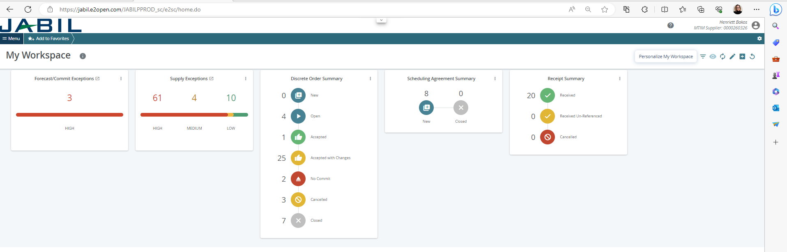
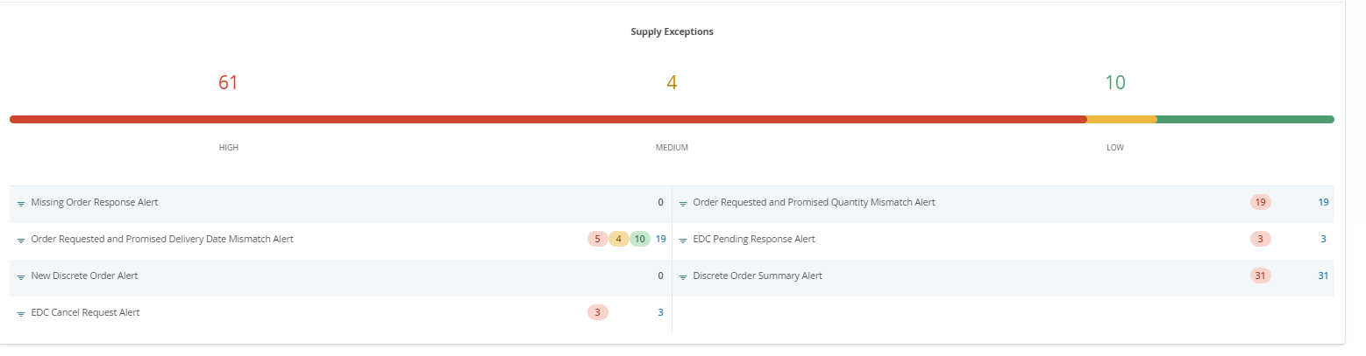
PORTAL SUPPLIERS | MY WORKSPACE
My Workspace gives you an overview of all orders (grouped by state) or exceptions summary.
Data on My Workspace is hyperlinked.
To see detailed information, click on the cards name, e.g., Supply Exception (1) to see the list of the objects (2) which meet these criteria.
1
2
Continue in the next slide

Slide 16
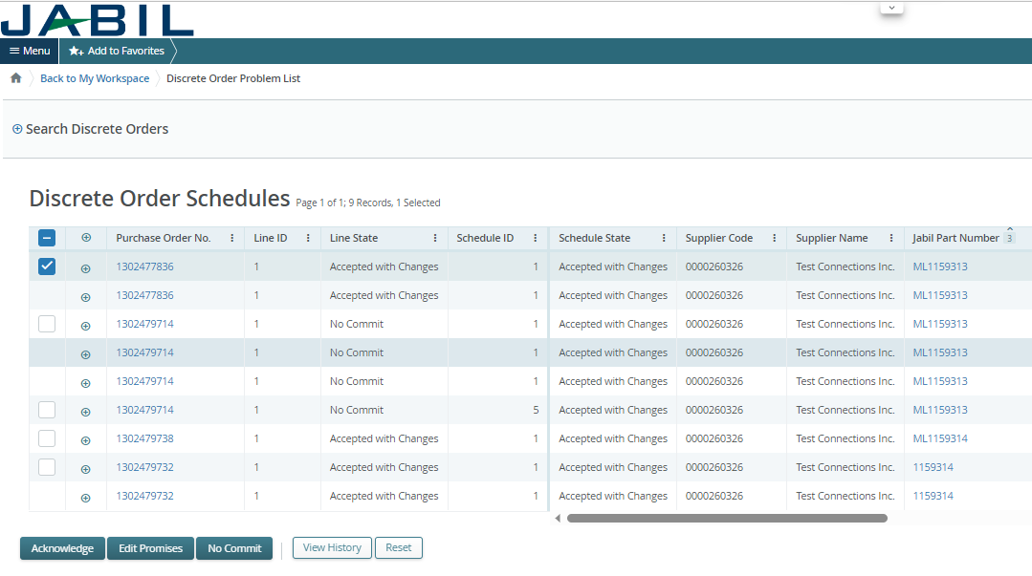
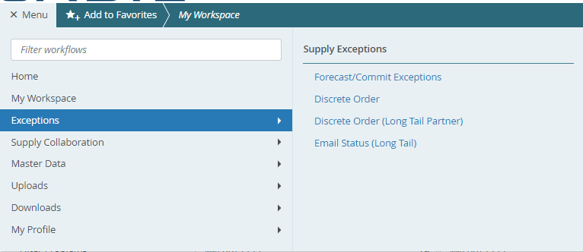
PORTAL SUPPLIERS | MY WORKSPACE | EXCEPTIONS
Object may have multiple Exceptions (count in drill down may be higher).
Data on My Workspace is hyperlinked. Click on the number next to chosen exception (1) to see the list of the objects which meet these criteria.
On new pop-up widow you will see list of all exception with order numbers (2).
Exceptions accessible from multiple places within the system
from Menu
through My Workspace. They are context sensitive and clickable to drill down into details
1
2

Slide 17
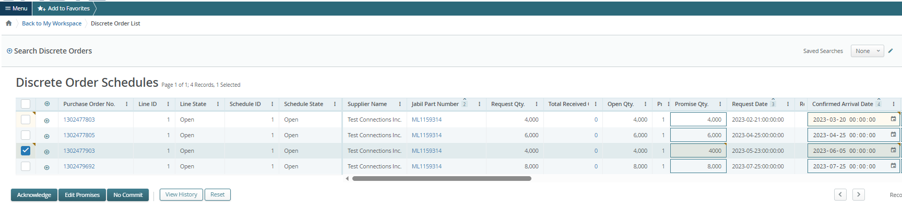
MY WORKSPACE | PO CONFIRMATION
My Workspace gives you an overview of all orders (grouped by state) or exceptions summary.
Data on My Workspace is hyperlinked.
For PO CONFIRMATION please check Discrete Orders with NEW and OPEN status (1)
To see detailed information, click on the number or text, and PO list will open in a new pop-up window (2)
Here you can Acknowledge the Pos with publish PO promise qty and date, or you can EDIT PO confirmation in case of split commit. (3)
For further information about PO confirmation process steps please review slides from page 20.
1
2
3

Slide 18
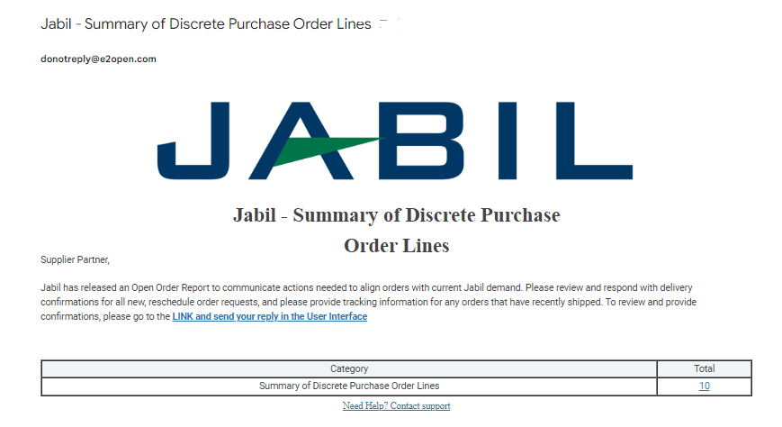
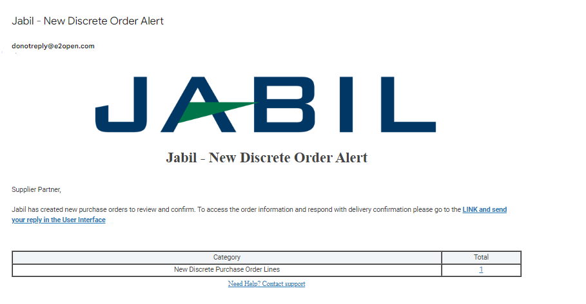
PORTAL SUPPLIERS | NEW PO & OPEN PO DATA
From Email Notification:
Please use the link to click and see the PO details

Slide 19
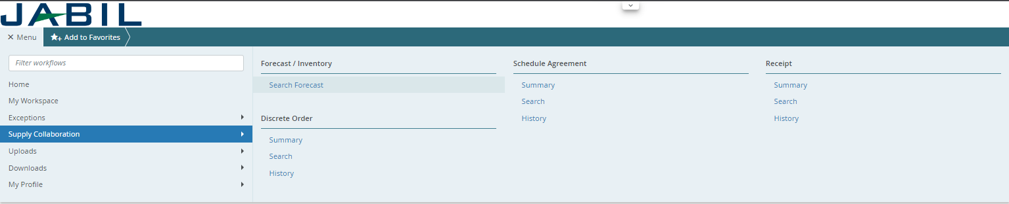
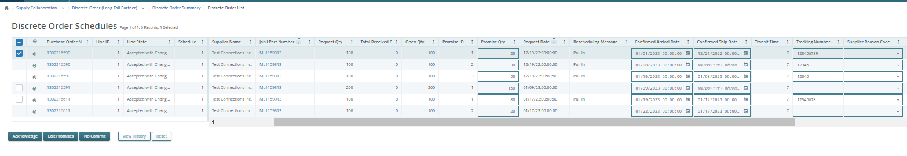
PORTAL SUPPLIERS | NEW PO & OPEN PO DATA
After log in with your password you can search data in the Menu:
Please follow: MENU >> Supply Collaboration >> Search
1
2
3
Open PO List will pop up

Slide 20

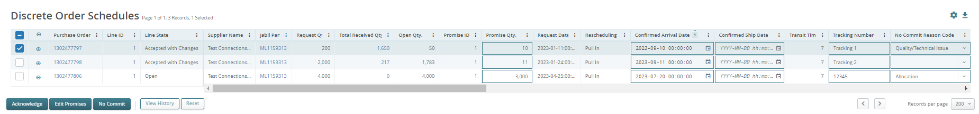
DISCRETE ORDER | SUPPLIER RESPONSE
You must respond to New and Open Discrete Orders. You will have the following options:
Acknowledge
Edit Promises - split the Promise Quantity into multiple Promise Dates
No Commit
You have the possibility to respond by using
User Interface
Excel template Download/Upload
After populating Acknowledge >​
Leave the details as they are and the Discrete Order State transitions into Accepted OR​
Update the Promise Quantity and/or Confirmed Arrival Data/Confirmed Ship Date if needed and the Discrete Order State transitions into Accepted w/ Changes ​
After populating No Commit >​
Discrete Order State transitions into No Commit​
ACKNOWLEDGE
EDIT PROMISE
NO COMMIT
EXCEL UPLOAD
21
22
23
24

Slide 21
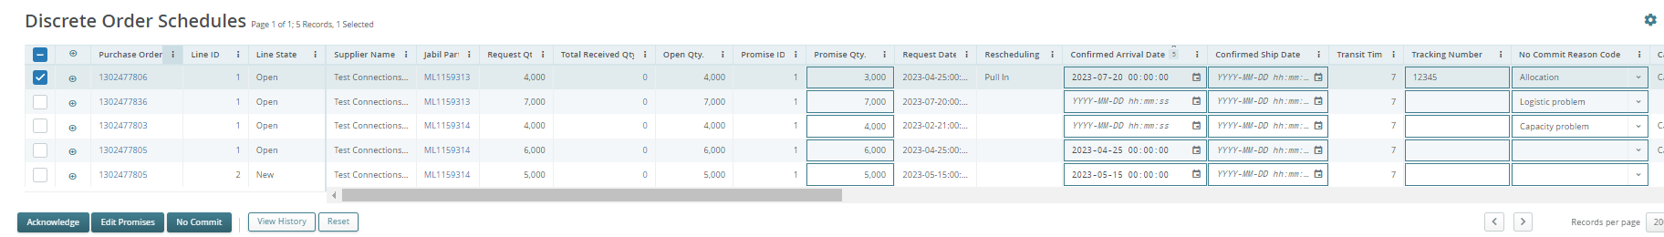
SUPPLIER RESPONSE | ACKNOWLEDGE
We need your feedback on every PO and Schedule Line where status (1) is NEW (recently placed not yet accepted) or OPEN (Jabil made PO Change meanwhile)
Promise qty and Confirmation date are pre-populated fields, that can be updated as needed​
Ensure that Promise qty (2) = Open qty (3) (Less qty confirmation is allowed but overcommit is not allowed!)
Arrival Date (4) : If you cannot confirm it (dock date at Jabil), you can confirm the Ship Date and delete pre-populated Arrival date data.
Note: The system will calculate Arrival Date based on your provided ship date + Transit time (5) information from the next field.
In case of 'confirmation split’ please click “Edit Promises” – see details on the next slide
Tracking Number (6): this information needs to be provided if it’s available in the 'Tracking number' column
1
3
2
4
5
6
7
After Supplier clicks Acknowledge >
Supplier leaves the details as they are and the Discrete Order State transitions into Accepted OR
Suppliers updates the Promise Quantity and/or Confirmed Arrival Data/Confirmed Ship Date if needed and the Discrete Order State transitions into Accepted w/ Changes

Slide 22
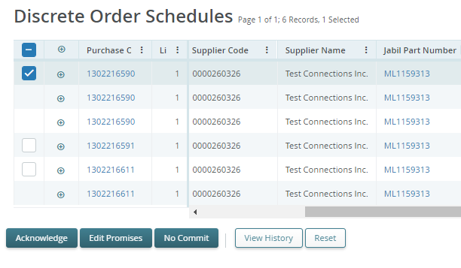
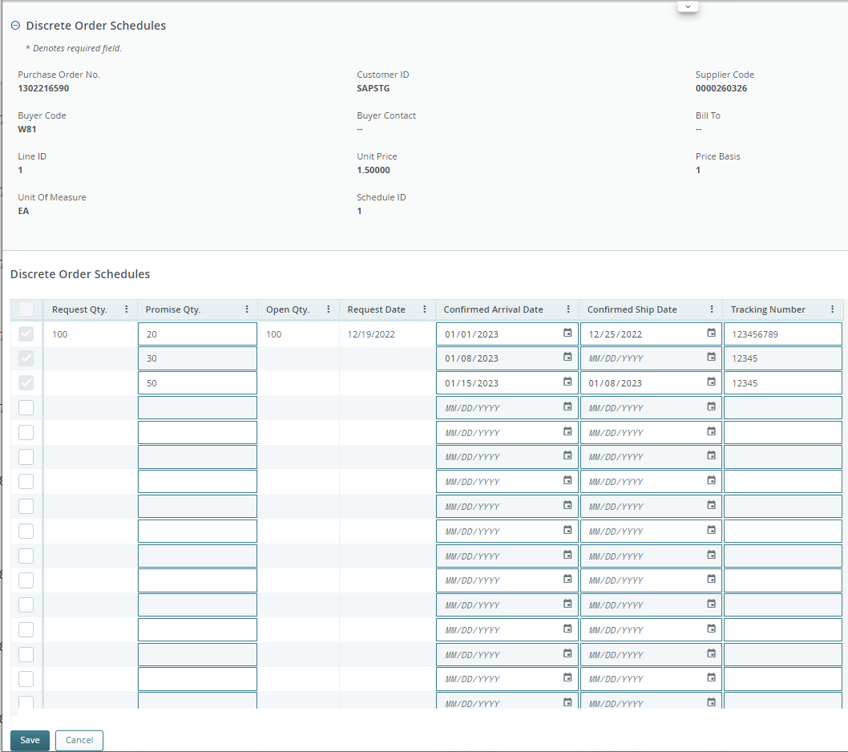
SUPPLIER RESPONSE | EDIT PROMISE
You can split the Promise Quantity into multiple Promise Dates:
Using the action button “Edit Promise” (1) supplier will access the table
where the promised quantity can be split into multiple Promise Dates (Confirmed Arrival Data) (2).
Each Confirmation line can have separate Tracking number information (3) which you can edit here as well
Click the SAVE (4) button after you finished the PO Promise update
2
3
1
After you click Edit Promises >
Update the Promise Quantity and/or Confirmed Arrival Data/Confirmed Ship Date and split PO commit the Discrete Order State transitions into Accepted w/ Changes
4

Slide 23
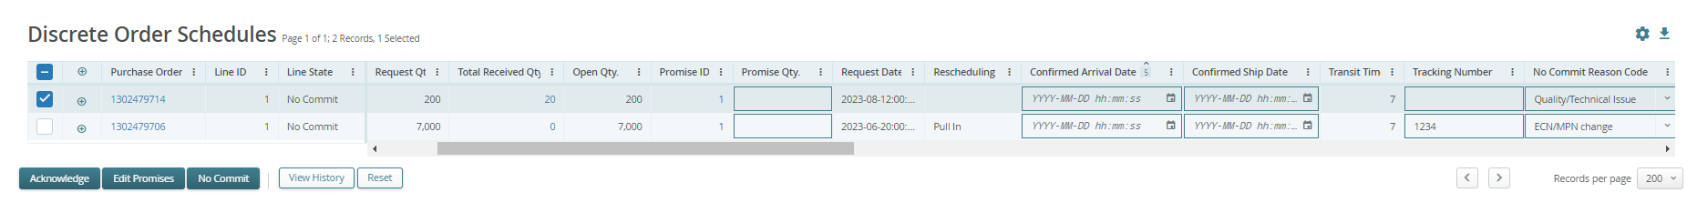
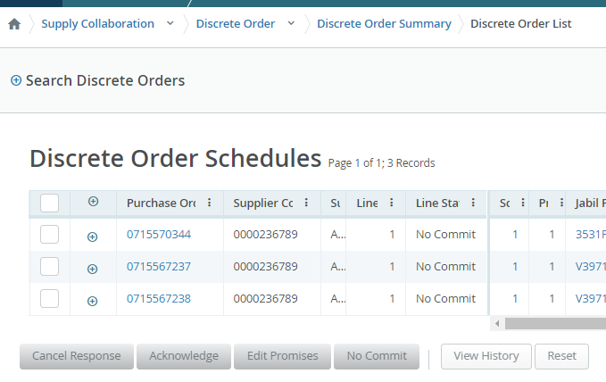
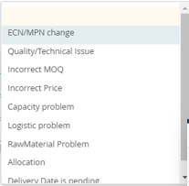
SUPPLIER RESPONSE | NO COMMIT
In case you are unable to meet the JABIL’s needs you can choose “NO COMMIT” as feedback (1), but this case you will be required to provide a No Commit Reason Code value, which can be selected from a dropdown list of predefined values (2)
In this scenario, e2open moves the requested schedule into the No Commit state (3)
2
1
3

Slide 24
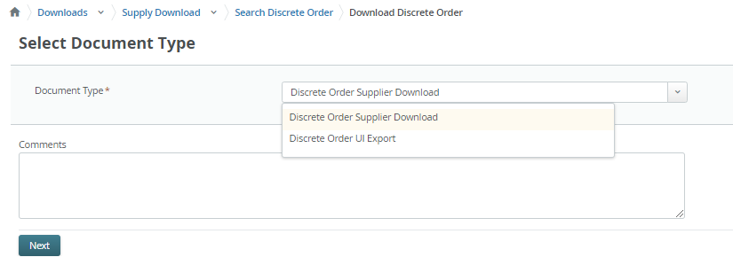
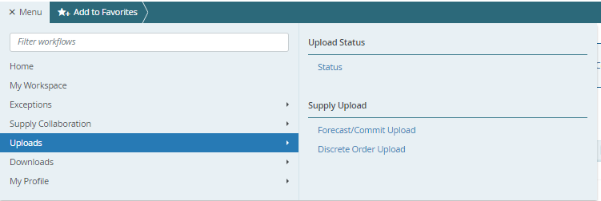
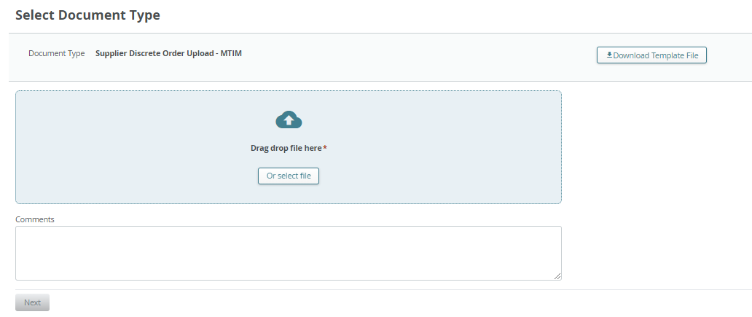
SUPPLIER RESPONSE |VIA EXCEL UPLOAD | PORTAL USERS ONLY
Step 1. Download the template:
Navigate to Menu > Downloads > Discrete Order.
In the Search window, enter search criteria and click Search to Download. On the next screen choose the Document type (1)
Discrete Order Supplier Download)
Discrete Order UI Export: see more information in the next slides (page 26)
and click Next to start downloading the file. (2)
The downloading is in progress. Once the data are downloaded the status changes to Complete.
Step 2. Upload the Data:
Navigate to Menu > Uploads > Discrete order Upload (3)
On the next screen select the saved Excel file via one of the two methods to select the file. Click Next to upload the file. (4)
The uploading is in progress. Once the file is uploaded the status changes to completed.
1
2
3
4

Slide 25
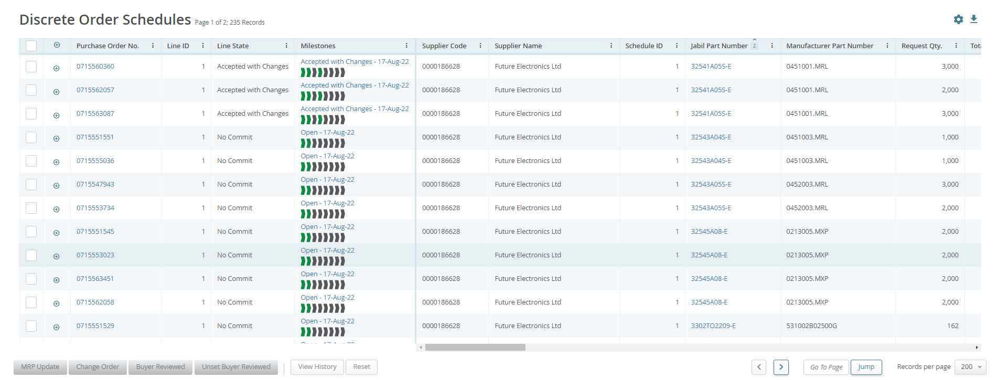
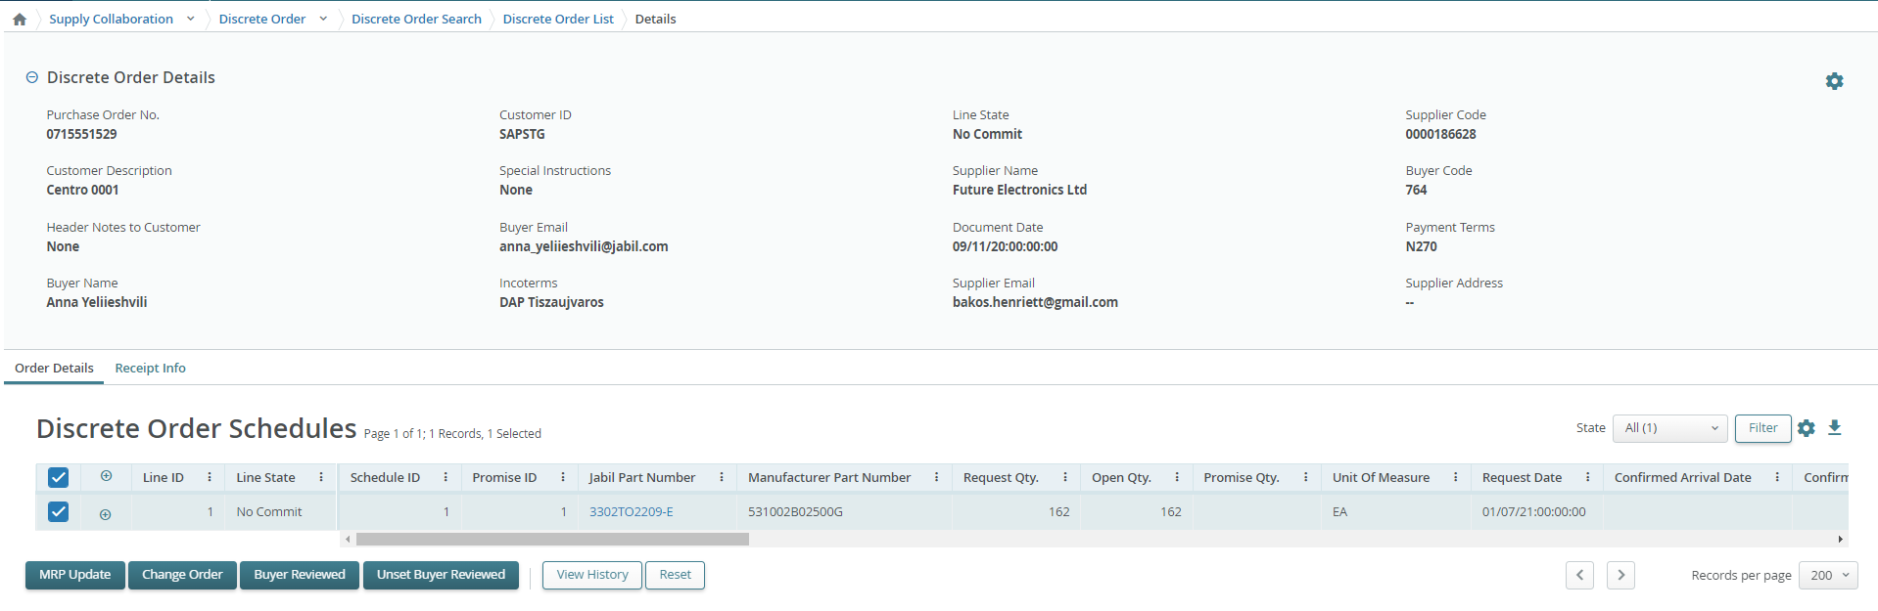
WORKING WITH LISTS
2
On the list pages you are viewing all relevant order, schedule agreements, or receipt among with key fields. You may need to scroll right/left to see all columns (1)
On the top you can see number of pages and listed records (2).
For a list spread over multiple pages, use the Previous Page and Next Page buttons (3), or enter a page number and click Jump to navigate through the list (3)
Expand or collapse details by clicking the + / - button for each row. (4)
Blue text is hyperlinked and clickable to show details
Click the object (Order, Receipt, etc.) number in blue to open the object’s details page. (5)
4
5
1
3
5

Slide 26
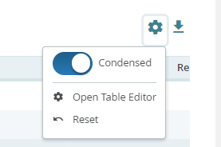
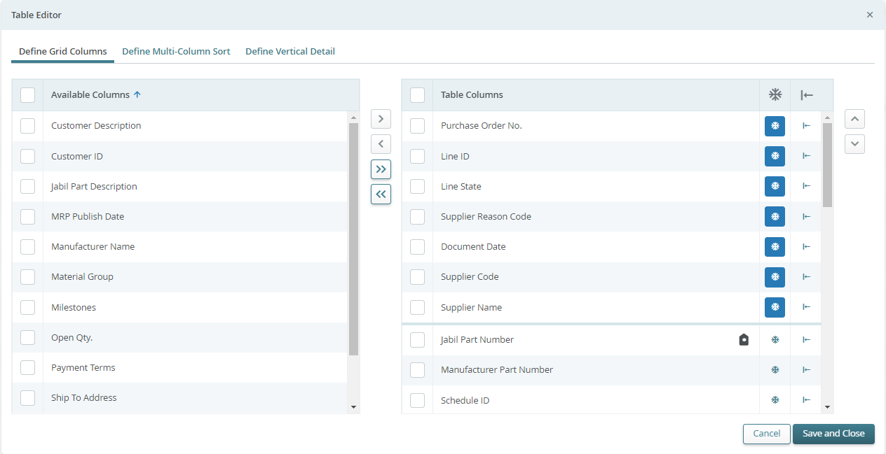
WORKING WITH LISTS | TABLE EDITOR
Table Editor allows you to configure data fields displayed on list and/or their sort order
Open the Table Editor (1) to display/hide additional fields.
To remove, add or reorder columns on your current page view, click the column checkbox next to selected line and then use the right/left or up/down arrow buttons (2)
There is also option to drag and pull the data up and down with the mouse
You can also move the columns left and right directly in the list page with same way
1
2

Slide 27
SUPPLIER RESPONSE |VIA EXCEL UPLOAD | ACKNOWLEDGE
We need your feedback in every PO and Schedule Line where status is NEW (recently placed not yet accepted) or OPEN (Jabil made PO Change meanwhile) (1)
To accept a PO please populate Promise qty and Confirmation date
Ensure that Promise qty (2) = Open qty (3) (Less qty confirmation is allowed but overcommit is not allowed!)
Arrival Date (4) : If you cannot confirm it (dock date at Jabil), confirm the Ship Date (5)
Note: if you keep both date in the file - the system will calculate and overwrite Confirmed Arrival Date based on your provided ship date + Transit time (6) information from next field.
Tracking Number (7): that is information needs to be provided if it's available in 'Tracking number' column
Any further note or message you can share with Jabil in Supplier Comment column! (8) in the attached template
1
1
3
2
4
5
6
7
8

Slide 28
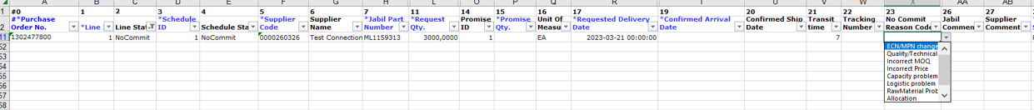
SUPPLIER RESPONSE |VIA EXCEL UPLOAD | NO COMMIT
In case PO confirmation is not possible –leave Promise qty and Confirmed date fields empty (1), choose ‚No Commit Reason Code ' from drop-down list (2)
2
1
1
In case of No Commit – Please choose No Commit Reason Code is from drop down!

Slide 29
SUPPLIER RESPONSE | VIA EXCEL UPLOAD | EDIT PROMISE
In case of 'confirmation split' , copy PO line and place a new line (1) in the Excel and populate Promise qty (2) and Confirmed date (3) information in both lines
Please change Promise ID from 1 to 2...(4)
2
3
1
4

Slide 30
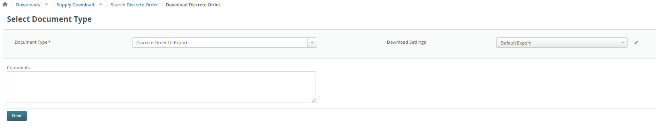
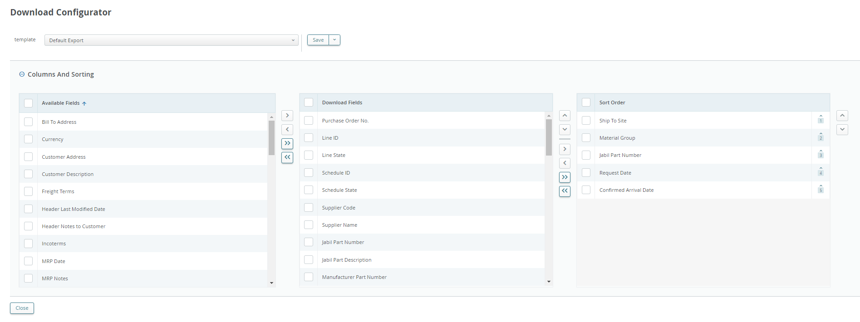
DISCRETE ORDER UI EXPORT
You can export Open PO list in the default layout view we have in the UI
UI export is editable – before you download this file, you can edit in the download configurator which column you want to download
1
2
5
3
4
You can move selected Data fields left and right to be available in this view or no
Also, you can set up sorting here as well
Once you are done with this set up, please SAVE

Slide 31
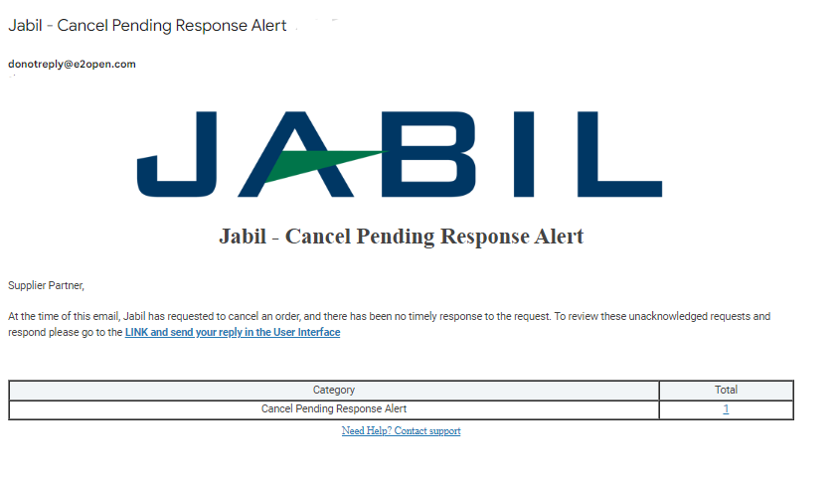
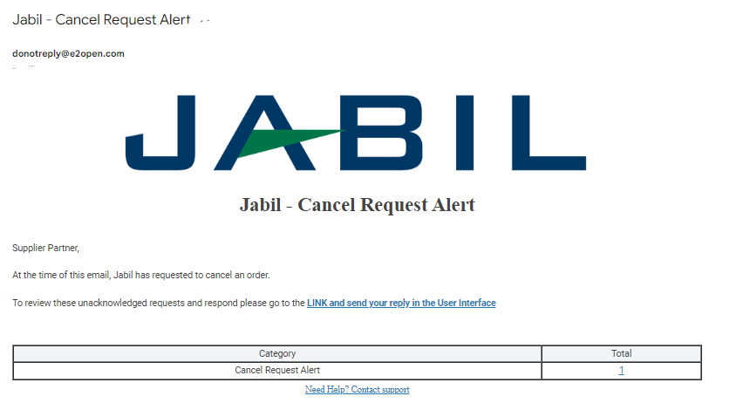
PORTAL SUPPLIERS | CANCEL REQUEST
From Email Notification:
Please use the link to click and see the PO details

Slide 32
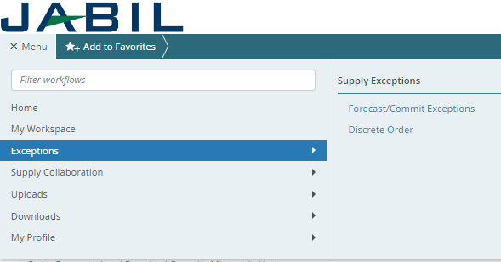
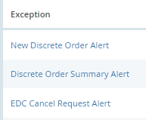
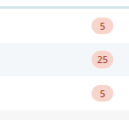
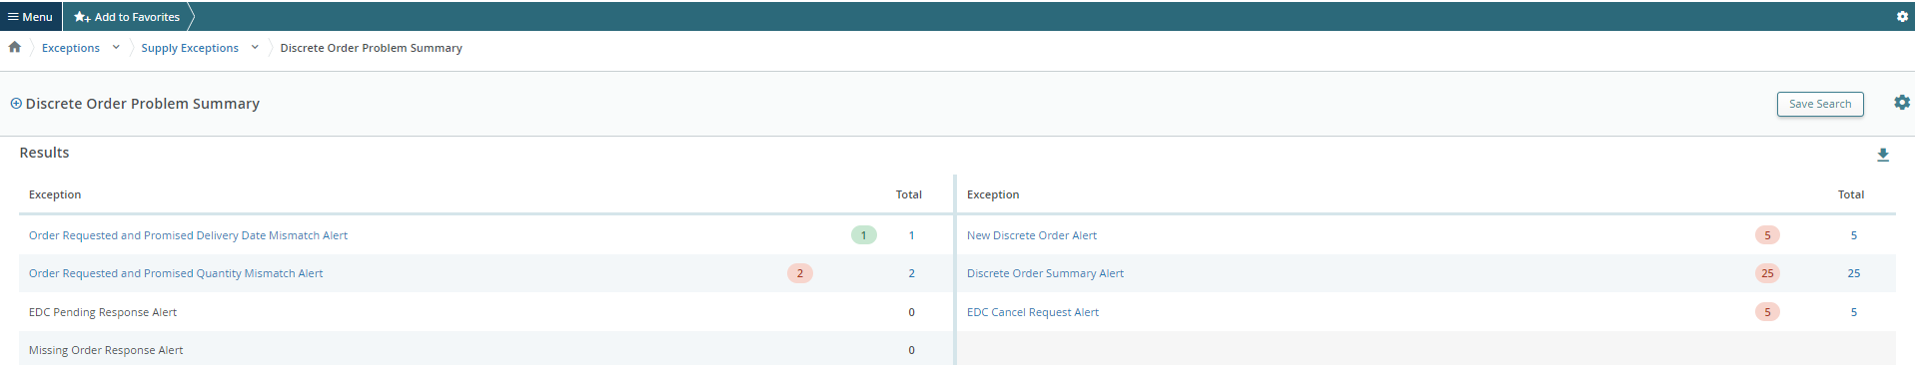
PORTAL SUPPLIERS | CANCEL REQUEST
After log in with your password you can search data in the Menu:
MENU >> Exception>> Discrete Order
1
Click the number and the PO list with Cancel Request will pop up
2
3

Slide 33
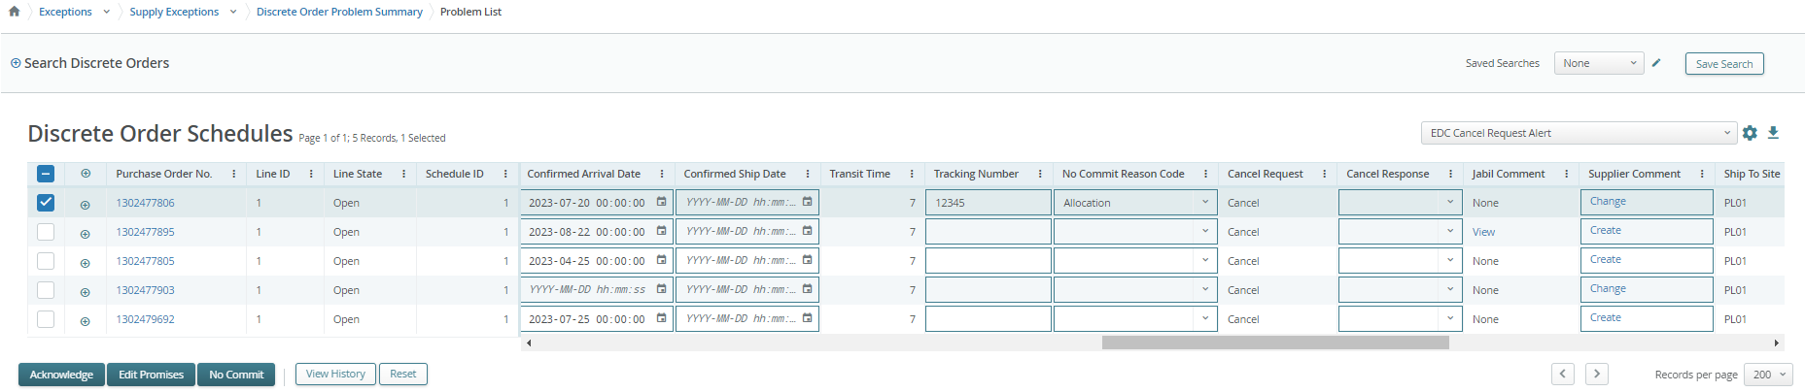
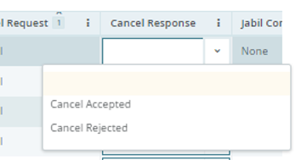
SUPPLIER RESPONSE | CANCELLATION REQUEST
In case cancellation request, you will be required to provide a response to this request.
In column Cancel Request the Buyer cancellation request is visible (1)
Please provide the response by updating the field Cancel Response Type with “Cancel Accepted” or “Cancel Rejected” (2) from drop down list (2) and confirm it using button “Acknowledge” (3).
1
3
2

Slide 34
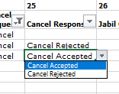
SUPPLIER RESPONSE | VIA EXCEL UPLOAD | CANCELLATION REQUEST
Download and Open Excel Attachment from the email
Please follow below instructions and note that mandatory fields need to be checked and updated​.
In the case of a PO Cancel Request published by Jabil the Line and Schedule status changed to ‚OPEN’ (1) and Cancel Request filed is = ‚CANCEL’ (2)
Cancel Response Type (3): please choose from drop-down list ”Cancel Accepted” or “Cancel Rejected” comment
In case of Cancel Accepted – please publish Promise qty (Cancel qty) (4) and ensure that Promise (Cancel qty) qty is less or equal to Open qty (5)
In case of Cancel Rejection – please publish Promise qty (4) and Promise date (6) information too!
You can send notes or messages to Jabil in ‚Supplier Comment’ column (7)!
1
1
5
4
6
2
3
7
*NOTE: Do not provide Cancel Response against a PO schedule line or promise line where is no Cancel Request!
3

Slide 35
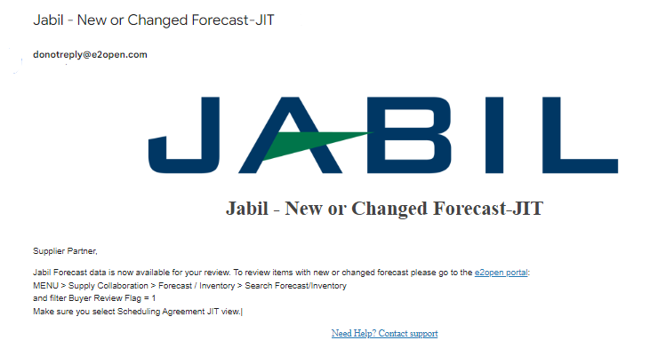
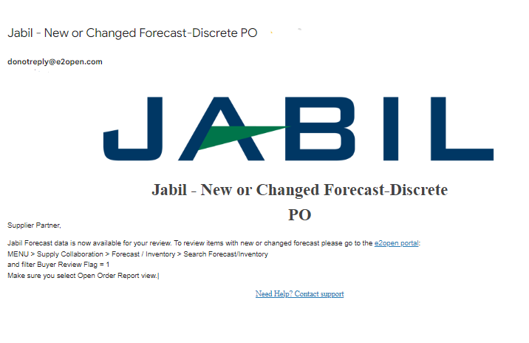
PORTAL SUPPLIERS | FORECAST DATA
From Email Notification:
Please use the link to click and see the PO details

Slide 36



PORTAL SUPPLIERS | FORECAST DATA
In the Menu:
Please follow: MENU >> Exception>> Forecast/Commit
1
3
2
Click the number >>
FC data will pop up

Slide 37
ACTING ON FORECAST | SUPPLIER’S COMMIT | DISCRETE ORDERS
Based on the published forecast, you can respond with a commit date & quantity for each forecast date & quantity.
You can commit using the following ways:
In e2open web portal
Excel Upload.
In order to add the commit please search for the specific collaboration.
By the Supplier Commit field put the committed amount for specific date (1).
Once all data are provided click “Update” (2) button
1
1
2

Slide 38

ACTING ON FORECAST | SUPPLIERS’ COMMIT | SCHEDULE AGREEMENT
In order to add the commit, use Search menu for the specific collaboration
By the Ship Commit field put the committed amount for specific date (1)
Using ATP JIT Field, you can share the available on hand inventory for a material with Jabil. (2)
Once all data are provided click ‚Update’ (3) button.
1
2
3

Slide 39

SUPLIER FORECAST COMMIT | EXCEL DOWNLOAD
You can commit to forecast by uploading an Excel file into the e2open system with commit quantities and dates.
Step 1. Download the template:
Navigate to: Menu > Downloads > Supply Download.
On the next screen choose the Document type (here: Forecast/Commit or Forecast/Commit JIT based on your order type) and click Next to start downloading the file.
1

Slide 40



SUPLIER FORECAST COMMIT | EXCEL DOWNLOAD
From the list choose the Document type
  Forecast Download or Commit Download –> this is a Vertical view
  Forecast/Commit Download –> This is a Horizontal View
2. Click Next
3. In the next window set up Horizon and Data Measures what you would like to see in the downloaded file
1
2
3

Slide 41



SUPLIER FORECAST COMMIT | EXCEL DOWNLOAD
1
In the Search window, enter search criteria and click Search to start downloading the file.
The downloading is in progress.
Once the data are downloaded the status changes to completed
Click the File Name in blue and Open the file
4
2
3

Slide 42


SUPLIER FORECAST COMMIT | EXCEL UPLOAD
STEP 1
For Forecast Commit Excel Upload – please download first the Commit Download data from the menu:
  Menu > Downloads > Supply Download > Forecast Commit or Forecast Commit JIT > Commit Download
In the next step please check the data in the downloaded file: Quantity and Date and correct if needed
Change the value in column Commit Type (3) as follow:
ConsumptionForecast to ConsumptionCommit
JITCurrForecast to ATPJIT
JITFirmCurrForecast to ConsumptionCommitSA
1
3
2

Slide 43


SUPLIER FORECAST COMMIT | EXCEL UPLOAD
Step 2. Upload the Data
Navigate to: Menu > Uploads > Forecast/Commit (1).
Select the saved Excel file via one of the two methods to select the file. Click Next to upload the file (2).
The uploading is in progress.
Once the file is uploaded the status changes to Completed.
1
2

Slide 44
Visit our Supplier Portal for more Information:
https://www.jabil.com/about-us/supplier/supplier-collaboration.html

