Slide 1
Supplier Order Collaboration
e2open email-based Supplier – email with excel attachment notification

Slide 2





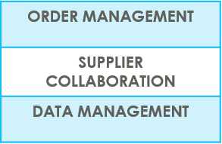
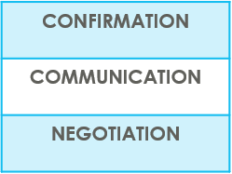

SUPPLIERS IN e2open | OVERVIEW
Supplier Collaboration
Input data
ERP system
Suppliers
Request
System message
Auto Write Back
System message
e2open is Jabil new Collaboration Platform to standardize and digitize our communication, one system for all Suppliers, all Communication methods
Automation of Purchase Order and Reschedule and/or Cancellation System message and Forecast communication to supplier and response write back into ERP system
Improved partnership with our Suppliers thru proactive collaboration
Platform for Suppliers and Buyers for short-term and long-term supply problems to support RISK and Shortage Management
e2open are mapping our Open PO and FC data from our ERP system > summarize it Iin a user-friendly Interface >then send it out to our Suppliers automatically

Slide 3



SUPPLIERS IN e2open | TYPES OF SUPPLIERS
IN e2open WE HAVE 2 TYPES OF SUPPLIERS
Portal Suppliers
Email- based
Suppliers
These suppliers have direct access to the e2open Portal
Jabil sends invitation and registration is required
PO Confirmation is located directly in the Portal
The Portal also enables Forecast, PO & Goods Receipts visibility
These are our email-based suppliers – there is no direct access to e2open portal
No need for registration – everything takes place through email
There is a one-time token access
We offer 3 communication options – see more information on the next slide

Slide 4
SUPPLIERS IN e2open | COLLABORATION OPTIONS
Portal Suppliers
Email-based
Suppliers
ACCESS
Portal Registration
Based on Supplier Alert’s Subscription (Filters are available)
Directly on the PORTAL
Simplified UI link | Excel attachment + UI Link | Email body message
Predefined system email Alerts | Predefined system email Alerts | Predefined system email Alerts
Log in the portal with a simplified UI link from an automated email | Open excel attachment from system email / same as today with weekly OOR or Log in the portal with a simplified UI link from the email | Embedded HTML table from the email body text put commit there (date & qty) and send back
NOTIFICATION
REPLY
NOTE : one time token is expiring after 72 hours

Slide 5

EMAIL- BASED SUPPLIERS
Keyword(s): Business Deal
Supplier Order Collaboration
EMAIL/EXCEL NOTIFICATION

Slide 6
EMAIL-BASED
SUPPLIERS
Supplier will receive system email notification with Excel attachment about
New Purchase Orders
after Jabil place new PO, two times per day/no repeating Alerts
Open PO Summary
once per week /upon Jabil buyer review and release
New or Changed Forecast
once per week /upon Jabil buyer review and release
PO Cancellation request
once per day/no repeating Alerts
Supplier will be able to send confirmation for
New and Open PO
Forecast
PO Cancel request
in reply email with updated Excel attachment
After 72 hours one-time token will be expired!
EMAIL/EXCEL NOTIFICATION

Slide 7

EMAIL | EXCEL ATTACHEMENT NOTIFICATION OUTLINE
1 | SYSTEM ALERTS SUMMARY
2 | DISCRETE ORDER RESPONSE – NEW + OPEN PO ACKNOWLEDGE EDIT PROMISE NO COMMIT
3 | CANCEL REQUEST RESPONSE PROCESS
4 | NEW OR CHANGED FORECAST ALERT COMMIT PROCESS DISCRETE ORDERS COMMIT PROCESS SCHEDULE AGREEMENTS

Slide 8

SUPPLIER ALERTS | EXCEL ATTACHMENT NOTIFICATION
Email-based Supplier SYSTEM ALERTS | ALERT FREQUENCY
New or Changed FORECAST Alert DPO/JIT* | ONCE /WEEK
New Discrete PO | 2 TIMES/DAY Not repeating same PO
Summary of Discrete Order Lines | ONCE /WEEK
Cancel request Alert | ONCE /DAY Not repeating
Cancel Pending Response Alert | ONCE /DAY
*DPO – Discrete Purchase Order
JIT – Just in Time - Schedule Agreement

Slide 9
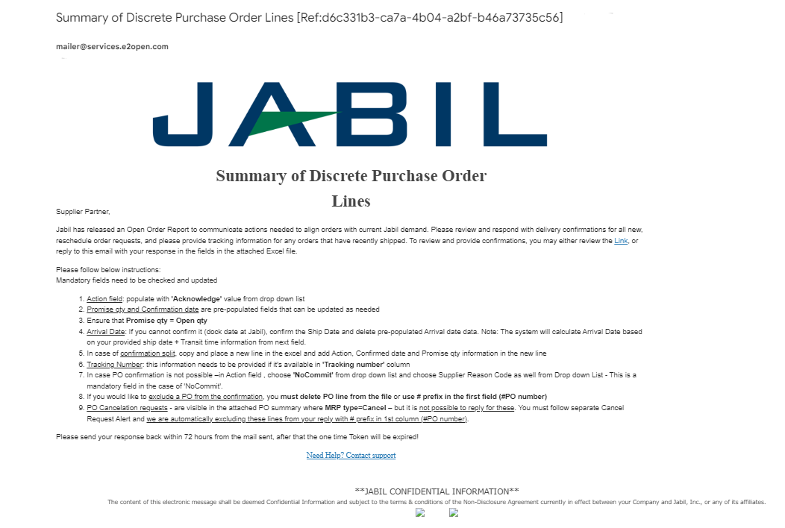
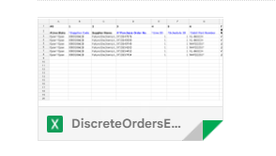
SUPPLIER ALERTS | EXCEL ATTACHMENT NOTIFICATION | STEPS & TIPS
Supplier User receives email notifications WITH Excel attachment
Only one email address per supplier is allowed
The email will arrive from the system email address: mailer@services.e2open.com (1)
IMPORTANT: ensure you are not blocking this mail address!
Email subject will always include reference number (2)– please make sure to not delete this number from your reply back email so we can reference it.
2
1

Slide 10

SUPPLIER RESPONSE | EXCEL ATTACHMENT
You will receive email notification with Excel Attachment.
Only one email address is allowed per supplier code
The notification option is pending from supplier configuration in e2open – and needs to be agreed before we onboard a Supplier in e2open.
Download the Excel file and Open
Update your confirmation in the Excel based on the provided instructions.
Save file and attached into your reply – please do not rename the attachment
Send reply to the original mail address and attach updated Excel file- please do not change Subject
Receive email with Excel attachment:

Slide 11
SUPPLIER RESPONSE | EXCEL ATTACHMENT |RESPONSE OPTIONS
ACKNOWLEDGE
EDIT PROMISE
SPLIT COMMIT
NO COMMIT
Discrete Purchase Orders
PO Cancellation
Request
ACEPT
NO COMMIT
PLANNED ORDERS - COMMIT CONSUMPTION FORECAST (OPTIONAL)
SA – JIT
  FIRM DEMAND COMMIT
  FORECAST COMMIT (ATP – Available To Promise)
Forecast

Slide 12
PO STATE TRANSITIONS IN e2open
Every PO change trigger PO line and PO Schedule line state change in e2open
NEW state > every new PO , not committed before
OPEN state > every PO where we have PO qty, delivery date or price change
ACCEPTED > every PO what Supplier confirmed back and meet fully with Jabil requested date and qty
ACCEPTED w/CHANGES > every PO what Supplier confirmed back BUT not meet fully with Jabil requested date and qty
CLOSED > every PO where we have no more open qty in SAP or buyer put delivery completed indicator flag
CANCELLED > every PO what Buyer cancel from SAP
Please check change MATRIX here!
START/END | NEW | OPEN | ACCEPT | ACCEPT W/CHANGES (AWC) | NO COMMIT | CLOSED | CANCELLEED
INITIAL SYSTEM | Change (Jabil)
NEW |  | >Change (Jabil) >MRP buyer update | Accept (Supplier) | AWC (Supplier) | No Commit (Suppl) | Close (Jabil) | Cancel (Jabil)
OPEN |  | Change (Jabil) >MRP buyer update >Cancel Response (Accept/No Commit – Suppl) | Accept (Supplier) | AWC (Supplier) | No Commit (Suppl) | Close (Jabil) | Cancel (Jabil)
NO COMMIT |  | >Change (Jabil) >MRP buyer update | Accept (Supplier) | AWC (Supplier) | No Commit (backend sync up only) | Close (Jabil) | Cancel (Jabil)
ACCEPT |  | >Change (Jabil) >MRP buyer update | Accept (backend sync up only) | AWC (Supplier) | No Commit (Suppl) | Close (Jabil) | Cancel (Jabil)
ACCEPT W/CHANGES (AWC) |  | >Change (Jabil) >MRP buyer update | Accept (Supplier) | AWC (backend sync up only) | No Commit (Suppl) | Close (Jabil) | Cancel (Jabil)
CLOSED |  | Change (Jabil) |  |  |  | Close (Jabil) | Cancel (Jabil)
CANCELLED |  | Change (Jabil) |  |  |  | Close (Jabil) | Cancel (Jabil)

Slide 13
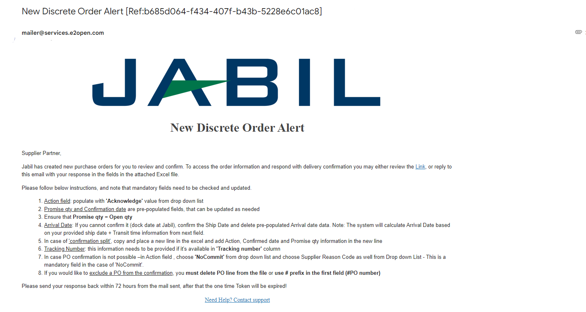

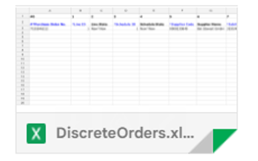
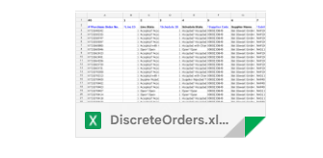
NEW / SUMMARY OF DISCRETE ORDER LINES
ALERT | EXCEL ATTACHMENT

Slide 14

NEW/OPEN ORDER CONFIRMATION | EXCEL ATTACHMENT
You can Download and Open Excel Attachment from the email
You must respond to New and Open (1) Discrete Orders with the following options:
Acknowledge
Edit Promises - split the Promise Quantity into multiple Promise Dates
No Commit
After Supplier populate Acknowledge >​
Supplier leaves the details as they are and the Discrete Order State transitions into Accepted OR​
Suppliers updates the Promise Quantity and/or Confirmed Arrival Data/Confirmed Ship Date if needed and the Discrete Order State transitions into Accepted w/ Changes ​
After Supplier populate NoCommit >​
Discrete Order State transitions into No Commit​
1
1
ACKNOWLEDGE
EDIT PROMISE
NO COMMIT
15
16
17

Slide 15
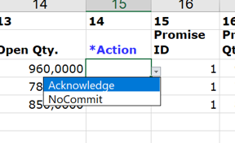
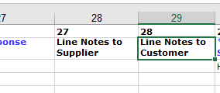
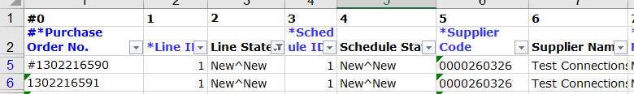
SUPPLIER RESPONSE | ACKNOWLEDGE | EXCEL ATTACHMENT
We need your feedback every PO and Schedule Line where status is NEW (recently placed not yet accepted) or OPEN (Jabil made PO Change meanwhile) (1)
Action field: populate with 'Acknowledge' value from drop down list (2)
Promise qty and Confirmation date are pre-populated fields, that can be updated as needed​
Ensure that Promise qty = Open qty (Less qty confirmation is allowed but overcommit is not allowed!) (3)
Arrival Date (4) : If you cannot confirm it (dock date at Jabil), confirm the Ship Date and delete pre-populated Arrival date data. Note: if you keep both date in the file - the system will calculate and overwrite Arrival Date based on your provided ship date + Transit time (5) information from next field.
Tracking Number (6): that is information needs to be provided if it's available in 'Tracking number' column
If you would like to exclude a PO from the confirmation, you must delete PO line from the file or use # prefix in the first field (#PO number)​ (7)
Any further note or message you can share with Jabil in Line Notes to Customer column! (8) in the attached template
Please send your response back within 72 hours from the mail sent, after that the one-time Token will be expired!
1
1
2
3
4
5
6
7
8
2

Slide 16
SUPPLIER RESPONSE | EDIT PROMISE | EXCEL ATTACHMENT
In case of 'confirmation split' , copy PO line and place a new line (1) in the excel and add Action (2), Promise qty(3) and Confirmed date (4) information in the new line ​
Please change Promise ID from 1 to 2...(5)
CANCEL requests - are visible in the attached PO summary where MRP type=Cancel (6)– but it is not possible to reply for these. You must follow separate Cancel Request Alert and we are automatically excluding these lines from your reply with # prefix in 1st column (#PO number)​.
2
3
4
1
5
6

Slide 17
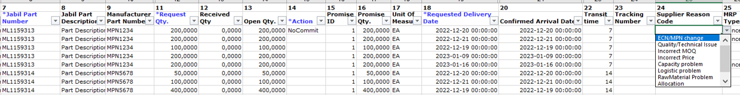
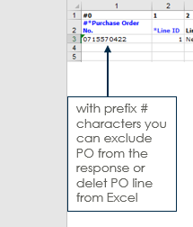
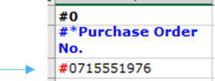
SUPPLIER RESPONSE | NO COMMIT | EXCEL ATTACHMENT
In case PO confirmation is not possible –in Action field , choose 'NoCommit' from drop down list (1) and choose Supplier Reason Code as well from Drop down List (2)
If you would like to exclude a PO from the confirmation, you must delete PO line from the file or use # prefix in the first field (#PO number)​ (3)
2
1
In case of NoCommit – Supplier Reason Code is MANDATORY to choose from drop down!
3
Please send your response back within 72 hours from the mail sent, after that the one-time Token will be expired!

Slide 18
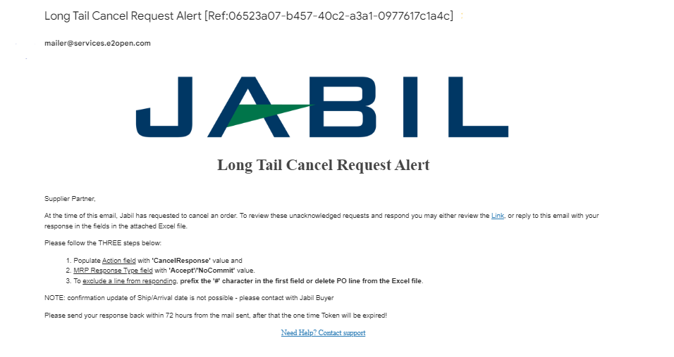
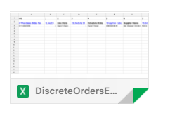
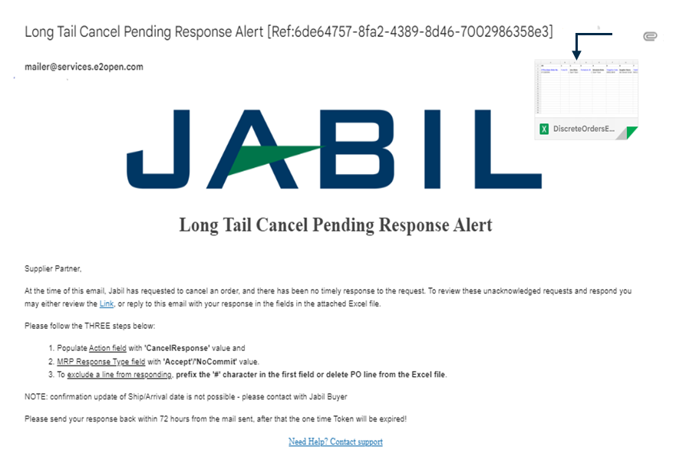
CANCEL REQUEST ALERT | EXCEL ATTACHMENT

Slide 19

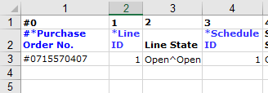
CANCEL REQUEST RESPONSE | EXCEL ATTACHMENT
Download and Open Excel Attachment from the email
Please follow below instructions and note that mandatory fields need to be checked and updated​.
Action field: you can choose from drop down list (1) – ONLY 'CancelResponse' is acceptable
MRP Response Type (2): you can choose from drop down list 'Accept/NoCommit'
You can send notes or messages to Jabil in in Line Notes to Customer column (3)!
You can exclude a line from your response to use # character prefix in first (PO nr.) field (4) or delete line from the file!
NOTE: confirmation update of Ship/Arrival date is not possible - please contact with Jabil Buyer
Promise qty and date are mandatory fields – please do not remove data from here
1
2
Note: In Cancel request Alert– you cannot confirm/update PO delivery date!
In case of ‚No Commit’ of our Cancel request Buyer will make alignment with you about new PO delivery date confirmation (possible PUSH OUT) through separate process and send new PO Requested delivery date information accordingly in weekly PO Summary Alert.
3
4

Slide 20
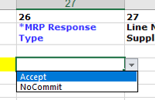
PARTIAL CANCEL REQUEST RESPONSE | EXCEL ATTACHMENT
In case you have multiple confirmation against one PO Line (1) and partial cancellation request against some of them, you can provide Cancelation response only against of those Confirmation lines where you can see the Cancel request: MRP type = Cancel
In column MRP Type the Buyer cancellation request is visible (2)
In ACTION field: populate with 'CancelResponse' value from drop down list (3)
Please provides the response by updating the field MRP Response Type with ‚Accept’ or ‚NoCommit’ (4) from drop down list and save.
*NOTE: you cannot provide Cancel Response against a PO schedule line or promise line where is no Cancel Request in MRP type column! Please exclude this line from your response to use # character prefix in first (PO nr.) field or delete the line from your file (5)
3
1
4
5
2
4

Slide 21
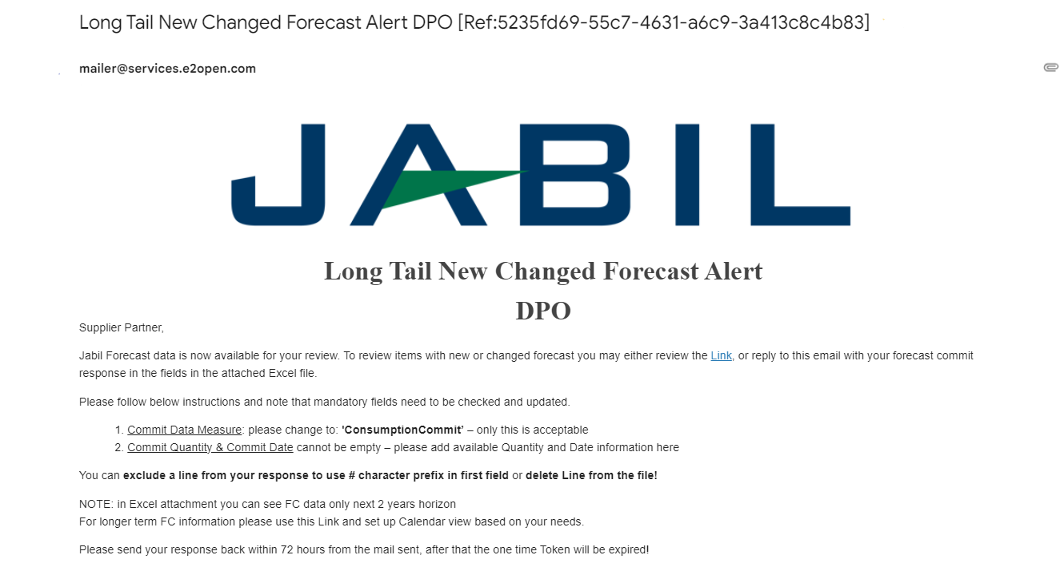
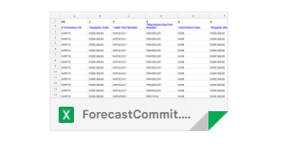
NEW OR CHANGED FORECAST| EXCEL ATTACHMENT + UI LINK | DISCRETE ORDERS
Both Excel & UI LINK is available for Forecast checking
In Excel you can see static Forecast for next 2 years
In UI LINK you can see dynamic Forecast for extended horizon

Slide 22
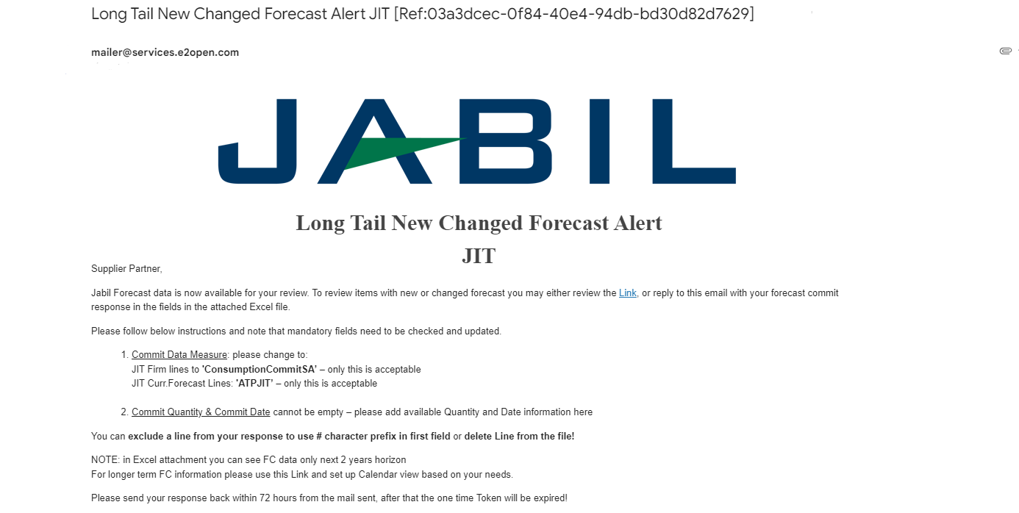
NEW OR CHANGED FORECAST | EXCEL ATTACHMENT + UI LINK | JIT SCHEDULE AGREEMENTS
Both Excel & UI LINK is available for Forecast checking
In Excel you can see static Forecast for next 2 years
In UI LINK you can see dynamic Forecast for extended horizon

Slide 23
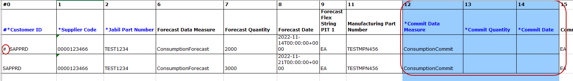
FORECAST RESPONSE | DISCRETE ORDERS | EXCEL ATTACHMENT
Download and Open Excel Attachment from the email!
Please follow below instructions and note that mandatory fields need to be checked and updated​.
Commit Data Measure: You can see ConsumptionCommit’ (1) – ONLY this is acceptable, please do not change!
Commit qty & Commit Date (2): cannot be empty – please add available Quantity and Date information here
You can exclude a line from your response to use # character prefix in first field (3) or delete line from the file!
3
1
2
Note: If you would like to send new FC Commit during the same week, please provide full commit
(entering 0 on the previously entered buckets!)

Slide 24
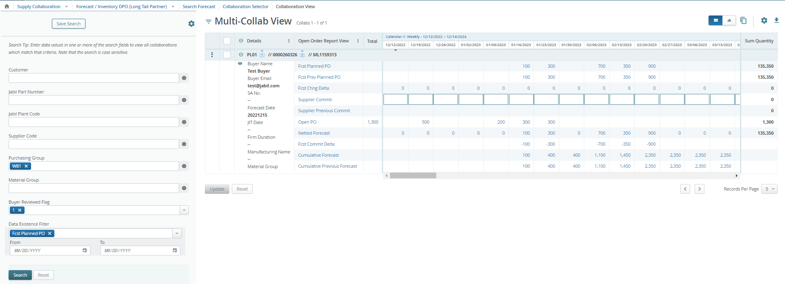
FORECAST RESPONSE | DISCRETE ORDERS | UI LINK
After click the LINK in the email Alert - >you will drive to the e2o tool – simplified UI – where you can see all Jabil Part Number Forecast/Planned PO data what Jabil Buyer released to you
Open PO quantity (2) is scheudled in weeklybuckets based on PO requetsed delivery date!
After click the LINK in the email Alert - >you will drive to the e2o tool – simplified UI – where you can see all Jabil Part Number Forecast/Planned PO data what Jabil Buyer released to you
Open PO quantity (2) is scheduled in weekly buckets based on PO requested delivery date!
Calendar
To change calendar date and view –> click the link (Monthly or QTR-ly view is available too
5
6
4
2
1
3
You can add FC/Planned PO commit data here (1)
Click Open PO number to see open PO details (2) - past due PO data is also including
Netted Forecast = FC Planned PO – Open PO Post FC load (3) – dynamic field – provide actual status update!
Past due demand is consolidated always in the current week Planned PO data (4)
TOTAL is calculated based on full data, independently from Calendar view set up on TOP! (5)
SUM Quantity: is including all demand and PO data based on Calendar view set up on TOP (6)
Click here to open Filter Menu

Slide 25
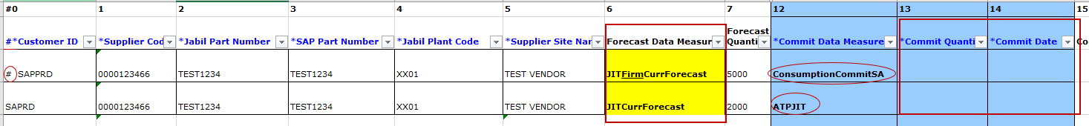
FORECAST RESPONSE | SCHEDULE AGREEMENTS | EXCEL ATTACHMENT
Download and Open Excel Attachment from the email!
Please follow below instructions and note that mandatory fields in BLUE need to be checked and updated​!
Commit Data Measure: you can add against to:
  JIT FirmCurrForecast lines to ‚ConsumptionCommitSA’ (1) – ONLY this is acceptable – Please do not change!
  JIT Curr.Forecast Lines: ‚ATPJIT’(2) – ONLY this is acceptable– Please do not change!
  (ATPJIT means – available to promise Just inTime)
  Commit qty & Commit Date (3): cannot be empty – please add available Quantity and Date information here
You can exclude a line from your response to use # character prefix in first field (4) or delete Line from the file!
3
4
1
2
Note: If you would like to send new FC Commit during the same week, please provide full commit
(entering 0 on the previously entered buckets!)

Slide 26
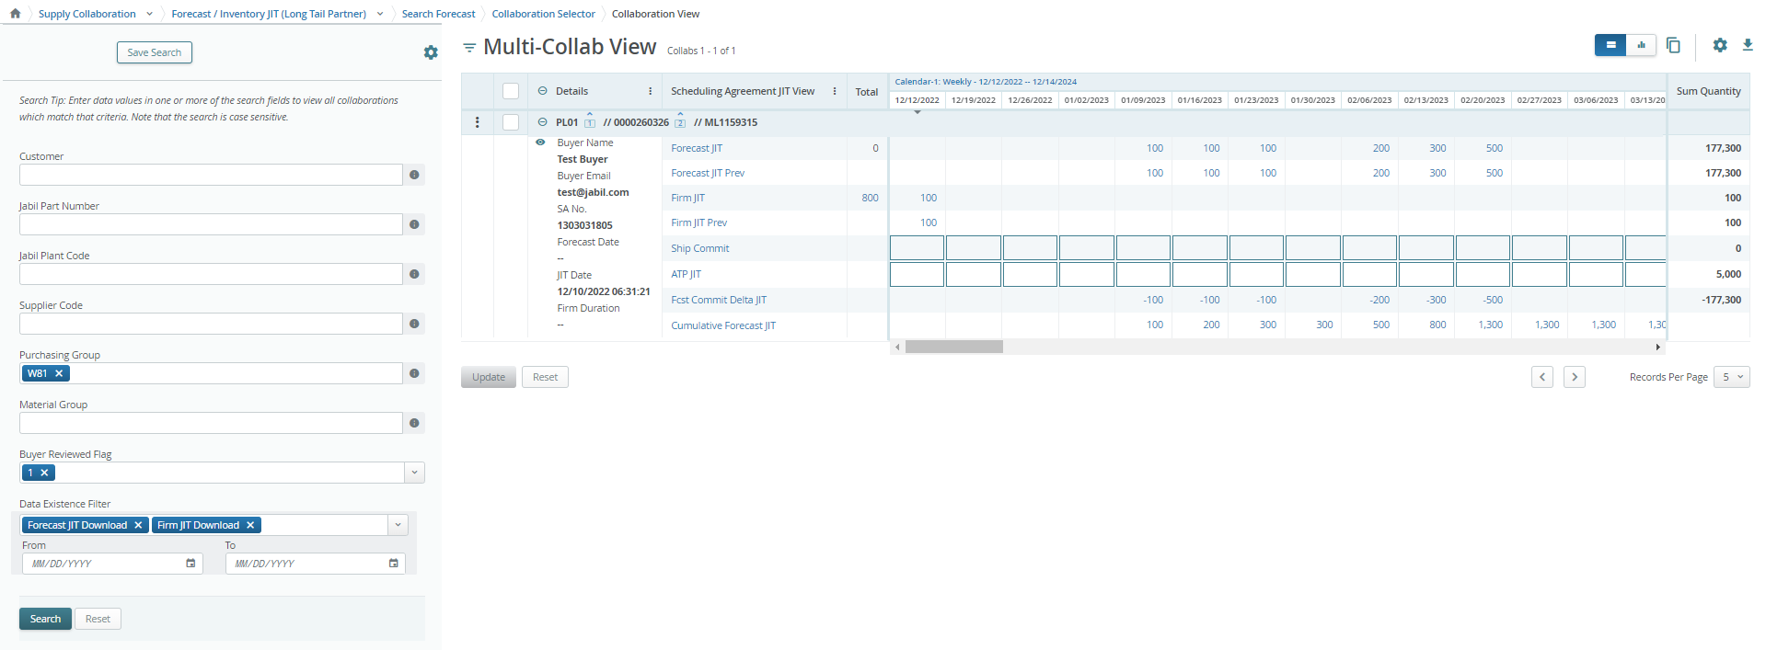
FORECAST RESPONSE | SCHEDULE AGREEMENTS | UI LINK
After click the LINK in the email Alert - >you will drive to the e2o tool – simplified UI – where you can see all Jabil Part Number Forecast/Firm SA data what Jabil Buyer released to you
FIRM JIT quantity (1) is scheudled in weekly buckets based on requested delivery date!
Calendar
To change calendar date and view –> click the link (Monthly or QTR-ly view is available too
5
6
4
1
2
3
SHIPcommit please provide ship quantity confirmation here (2)
ATP JIT (Available to promise –( information about possible available qty in case of demand increase) please populate data here (3)
Click FIRM JIT QTY number to see Firm details (4) - past due PO data is also including
Past due demand is consolidated always in the current week
TOTAL is calculated based on full data, independently from Calendar view set up on TOP! (5)
SUM Quantity: is including all demand and PO data based on Calendar view set up on TOP (6)
Click here to open Filter Menu

