Slide 1
Supplier Order Collaboration
e2open Email-based Supplier – email text notification with embedded table

Slide 2





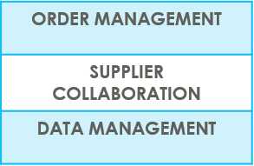
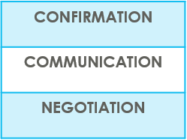

SUPPLIERS IN e2open | OVERVIEW
Supplier Collaboration
Input data
ERP system
Suppliers
Request
System message
Auto Write Back
System message
e2open is Jabil new Collaboration Platform to standardize and digitize our communication, one system for all Suppliers, all Communication methods
Automation of Purchase Order and Reschedule and/or Cancellation System message and Forecast communication to supplier and response write back into ERP system
Improved partnership with our Suppliers thru proactive collaboration
Platform for Suppliers and Buyers for short-term and long-term supply problems to support RISK and Shortage Management
e2open are mapping our Open PO and FC data from our ERP system > summarize it Iin a user-friendly Interface >then send it out to our Suppliers automatically

Slide 3



SUPPLIERS IN e2open | TYPES OF SUPPLIERS
IN e2open WE HAVE 2 TYPES OF SUPPLIERS
Portal Suppliers
Email-based Suppliers
These suppliers have direct access to the e2open Portal
Jabil sends invitation and registration is reqWEBred
PO Confirmation is located directly in the Portal
The Portal also enables Forecast, PO & Goods Receipts visibility
These are our email-based suppliers – there is no direct access to e2open portal
No need for registration – everything takes place through email
There is a one-time token access
We offer 3 communication options – see more information on the next slide

Slide 4
SUPPLIERS IN e2open | YOUR COLLABORATION OPTIONS
You will be onboarded with email communication: set up is Email text with table.
Email-based Suppliers
ACCESS
Simplified WEB link | Excel attachment + WEB Link | Email body message
Predefined system email Alerts | Predefined system email Alerts | Predefined system email Alerts
Log in the portal with a simplified WEB link from an automated email | Open excel attachment from system email / same as today with weekly OOR or Log in the portal with a simplified WEB link from the email | Embedded HTML table from the email body text put commit there (date & qty) and send back
NOTIFICATION
REPLY
NOTE : one time token is expiring after 72 hours

Slide 5
YOUR COMMUNICATION DETAILS
Once you are onboarded into e2open – you will receive below consolidated Alerts for your Vendor code from different plants, based on Communication Period and Alert frequency.
Note: Alerts will be including only those POs that weren't included in the prior email alert!
SYSTEM ALERTS | SYSTEM COMMUNICATION PERIOD | ALERT FREQUENCY AT SUPPLIER
New or Changed Forecast Alert DPO (Discrete Purchase Order) | System release every 6 hours (starting at 0:00:00 UTC) based on Buyer approval | You can receive this Alert once per week, based on Buyer approval
New or Changed Forecast Alert JIT (Just in Time Schedule Agreement)
Summary of Discrete Order Lines | YES
New Discrete Purchase Order | System release twice per day 0:00 UTC and 12:00 UTC | You will receive this Alert twice per day (only if Jabil place new PO to you)
System mail address: mailer@services.e2open.com & donotreply@e2open.com
Please ensure you are not blocking these mail addresses!

Slide 6
PO STATE TRANSITIONS IN e2open
START/END | NEW | OPEN | ACCEPT | ACCEPT W/CHANGES (AWC) | NO COMMIT | CLOSED | CANCELLEED
INITIAL SYSTEM | Change (Jabil)
NEW |  | >Change (Jabil) >MRP buyer update | Accept (Supplier) | AWC (Supplier) | No Commit (Suppl) | Close (Jabil) | Cancel (Jabil)
OPEN |  | Change (Jabil) >MRP buyer update >Cancel Response (Accept/No Commit – Suppl) | Accept (Supplier) | AWC (Supplier) | No Commit (Suppl) | Close (Jabil) | Cancel (Jabil)
NO COMMIT |  | >Change (Jabil) >MRP buyer update | Accept (Supplier) | AWC (Supplier) | No Commit (backend sync up only) | Close (Jabil) | Cancel (Jabil)
ACCEPT |  | >Change (Jabil) >MRP buyer update | Accept (backend sync up only) | AWC (Supplier) | No Commit (Suppl) | Close (Jabil) | Cancel (Jabil)
ACCEPT W/CHANGES (AWC) |  | >Change (Jabil) >MRP buyer update | Accept (Supplier) | AWC (backend sync up only) | No Commit (Suppl) | Close (Jabil) | Cancel (Jabil)
CLOSED |  | Change (Jabil) |  |  |  | Close (Jabil) | Cancel (Jabil)
CANCELLED |  | Change (Jabil) |  |  |  | Close (Jabil) | Cancel (Jabil)
START/END | NEW | OPEN | ACCEPT | ACCEPT W/CHANGES (AWC) | NO COMMIT | CLOSED | CANCELLEED
INITIAL SYSTEM | Change (Jabil)
NEW |  | >Change (Jabil) >MRP buyer update | Accept (Supplier) | AWC (Supplier) | No Commit (Suppl) | Close (Jabil) | Cancel (Jabil)
OPEN |  | Change (Jabil) >MRP buyer update >Cancel Response (Accept/No Commit – Suppl) | Accept (Supplier) | AWC (Supplier) | No Commit (Suppl) | Close (Jabil) | Cancel (Jabil)
NO COMMIT |  | >Change (Jabil) >MRP buyer update | Accept (Supplier) | AWC (Supplier) | No Commit (backend sync up only) | Close (Jabil) | Cancel (Jabil)
ACCEPT |  | >Change (Jabil) >MRP buyer update | Accept (backend sync up only) | AWC (Supplier) | No Commit (Suppl) | Close (Jabil) | Cancel (Jabil)
ACCEPT W/CHANGES (AWC) |  | >Change (Jabil) >MRP buyer update | Accept (Supplier) | AWC (backend sync up only) | No Commit (Suppl) | Close (Jabil) | Cancel (Jabil)
CLOSED |  | Change (Jabil) |  |  |  | Close (Jabil) | Cancel (Jabil)
CANCELLED |  | Change (Jabil) |  |  |  | Close (Jabil) | Cancel (Jabil)
Every PO change trigger PO line and PO Schedule line state change in e2open
NEW state > every new PO , not committed before
OPEN state > every PO where we have PO qty, delivery date or price change
ACCEPTED > every PO what Supplier confirmed back and meet fully with Jabil requested date and qty
ACCEPTED w/CHANGES > every PO what Supplier confirmed back BUT not meet fully with Jabil requested date and qty
CLOSED > every PO where we have no more open qty in SAP or buyer put delivery completed indicator flag
CANCELLED > every PO what Buyer cancel from SAP
Please check change MATRIX here!

Slide 7

Email-based SUPPLIERS
Keyword(s): Business Deal
Supplier Order Collaboration
Email text notification with embedded table

Slide 8
Email-based SUPPLIERS
Supplier will receive system email notification with embedded HTML table about
New Purchase Orders
after Jabil place new PO, two times per day/no repeating Alerts
Open PO Summary
once per week /upon Jabil buyer review and release
including PO Rescheduling and Cancellation requests too
Supplier will be able to send confirmation for
New and Open PO delivery date and quantity
PO Rescheduling & Cancel request
with reply to the email by filling out HTML table in the email body
After 72 hours one-time token will be expired!
EMAIL/TEXT NOTIFICATION

Slide 9

EMAIL/TEXT NOTIFICATION
OUTLINE
1 | SYSTEM ALERTS SUMMARY
2 | DISCRETE ORDER RESPONSE – NEW + OPEN PO ACKNOWLEDGE NO COMMIT
3 | CANCEL REQUEST RESPONSE PROCESS

Slide 10

SUPPLIER ALERTS | EMAIL TEXT NOTIFICATION
Email-based Supplier SYSTEM ALERTS | ALERT FREQUENCY
New or Changed FORECAST Alert | NOT AVAILABLE*
New Discrete PO | 2 TIMES/DAY Not repeating same PO
Summary of Discrete Order Lines | ONCE /WEEK
* ONLY FOR EXCEL TABLE + WEB LINK OPTIONS ARE AVAILABLE

Slide 11
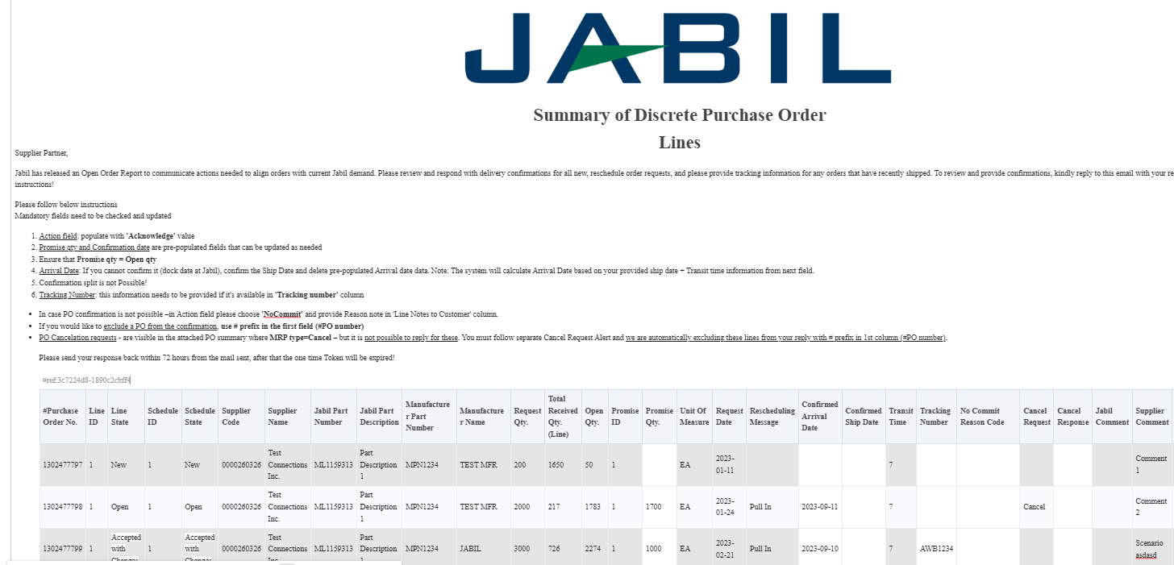
SUPPLIER ALERTS | EMAIL TEXT NOTIFICATION
2
1
Supplier User receives email notifications WITH embedded HTML table in the email body
Only one email address per supplier
System mail address: mailer@services.e2open.com (1)
Please ensure you are not blocking this mail address!
Email subject is always including reference number (2)– please make sure not delete this number from your reply back email!

Slide 12

SUPPLIER ALERTS | EMAIL TEXT NOTIFICATION
You will receive email notifications with embedded HTML table
Only one email address is allowed per supplier code
The notification option is pending from supplier configuration in e2open – and needs to be agreed before we onboard a Supplier in e2open.
Email link is time-sensitive and valid for 72 hours!
Open the email and click Replay to respond to the collaboration request
After Click you will be able to edit the table. Reply to the email by filling out HTML table in the email body . Please follow the instruction from the email
After your updates click Send to release PO confirmation to Jabil.
Do not change Subject!
Receive email with embedded table:

Slide 13

SUPPLIER RESPONSE | EMAIL TEXT | RESPONSE OPTIONS
Discrete Purchase Orders
ACKNOWLEDGE
NO COMMIT
PO Cancellation Request
CANCEL ACCEPTED
CANCEL REJECTED

Slide 14
PO STATE TRANSITIONS IN e2open
Every PO change trigger PO line and PO Schedule line state change in e2open
NEW state > every new PO , not committed before
OPEN state > every PO where we have PO qty, delivery date or price change
ACCEPTED > every PO what Supplier confirmed back and meet fully with Jabil requested date and qty
ACCEPTED w/CHANGES > every PO what Supplier confirmed back BUT not meet fully with Jabil requested date and qty
CLOSED > every PO where we have no more open qty in SAP or buyer put delivery completed indicator flag
CANCELLED > every PO what Buyer cancel from SAP
Please check change MATRIX here!
START/END | NEW | OPEN | ACCEPT | ACCEPT W/CHANGES (AWC) | NO COMMIT | CLOSED | CANCELLEED
INITIAL SYSTEM | Change (Jabil)
NEW |  | >Change (Jabil) >MRP buyer update | Accept (Supplier) | AWC (Supplier) | No Commit (Suppl) | Close (Jabil) | Cancel (Jabil)
OPEN |  | Change (Jabil) >MRP buyer update >Cancel Response (Accept/No Commit – Suppl) | Accept (Supplier) | AWC (Supplier) | No Commit (Suppl) | Close (Jabil) | Cancel (Jabil)
NO COMMIT |  | >Change (Jabil) >MRP buyer update | Accept (Supplier) | AWC (Supplier) | No Commit (backend sync up only) | Close (Jabil) | Cancel (Jabil)
ACCEPT |  | >Change (Jabil) >MRP buyer update | Accept (backend sync up only) | AWC (Supplier) | No Commit (Suppl) | Close (Jabil) | Cancel (Jabil)
ACCEPT W/CHANGES (AWC) |  | >Change (Jabil) >MRP buyer update | Accept (Supplier) | AWC (backend sync up only) | No Commit (Suppl) | Close (Jabil) | Cancel (Jabil)
CLOSED |  | Change (Jabil) |  |  |  | Close (Jabil) | Cancel (Jabil)
CANCELLED |  | Change (Jabil) |  |  |  | Close (Jabil) | Cancel (Jabil)

Slide 15
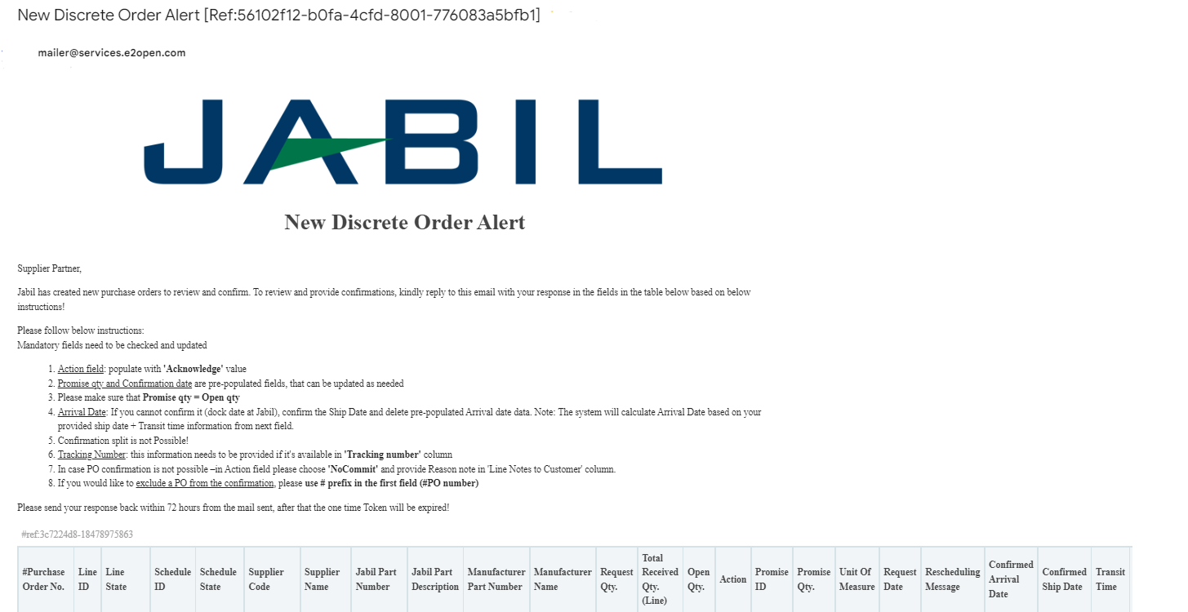
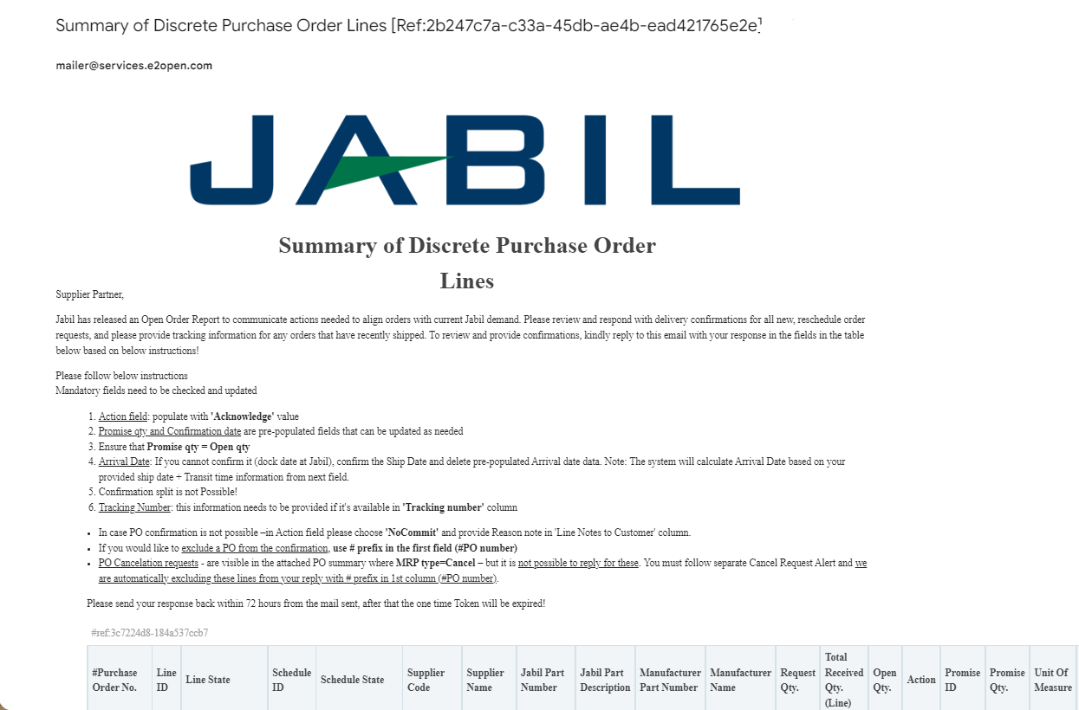
NEW / SUMMARY OF DISCRETE ORDER LINES ALERT | EMAIL TEXT RESPONSE

Slide 16
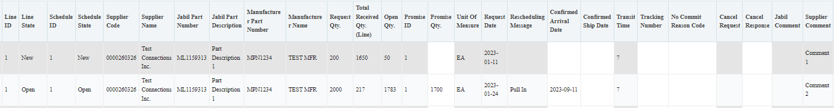
NEW/OPEN ORDER CONFIRMATION | EMAIL TEXT
After clicking REPLY to the email you will be able to edit data in the HTML table.
You must respond to New and Open Discrete Orders (1). You will have the following options:
  Acknowledge PO with Promise qty and Confirmed Arrival date (2)
  No Commit if you leave promise qty and date fields empty (3)
After Acknowledge >​
Update the Promise Quantity and/or Confirmed Arrival Date/Confirmed Ship Date if needed and the Discrete Order State transitions into Accepted OR​ Accepted w/ Changes ​(in case promise qty and/or date is different from Jabil requested qty and date!)
After you populate NoCommit >​
Discrete Order State transitions into No Commit​
1
1
3
3
ACKNOWLEDGE
2
2
NO COMMIT
17
18

Slide 17
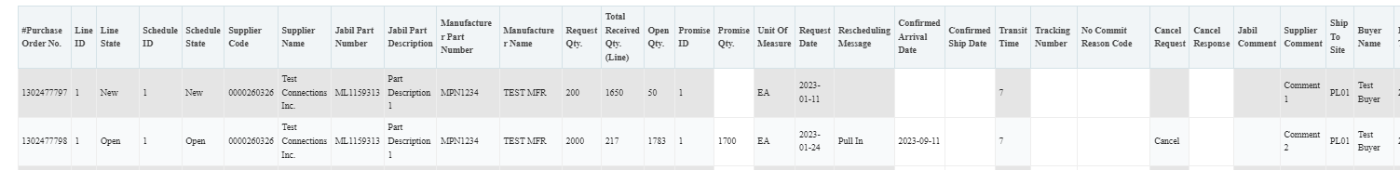
SUPPLIER RESPONSE | ACKNOWLEDGE | EMAIL TEXT
New and Open PO details are available in the email body text!
We need your feedback on every PO and Schedule Line where the status is NEW (recently placed not yet accepted) or OPEN (Jabil made PO Change meanwhile) (1)
To accept a PO please populate the Promise qty and Confirmation date
Ensure that Promise qty = Open qty (Less qty confirmation is allowed but overcommit is not allowed!) (2)
Arrival Date (3): If you cannot confirm it (dock date at Jabil), confirm the Ship Date (4)
Note: You do not need to populate both dates in the file! – as the system will handle that and will calculate the Arrival Date based on your provided ship date + Transit time information from the next field (5).
Tracking Number (6): if PO is shipped you can provide tracking number in this column
You can share any further note or message with Jabil in the Supplier Comment column! (7) in the table
Please send your response back within 72 hours from the mail sent, after that the one-time Token will be expired!
1
1
2
2
3
4
5
6
7

Slide 18
SUPPLIER RESPONSE | NO COMMIT | EMAIL TEXT
In case PO confirmation is not possible – leave the Promise qty and Confirmed date fields empty (1), and share No Commit Reason Code ' (2)
1
2
After you populate No Commit >
Discrete Order State transitions into No Commit
Please send your response back within 72 hours from the mail sent, after that the one-time Token will be expired!

Slide 19

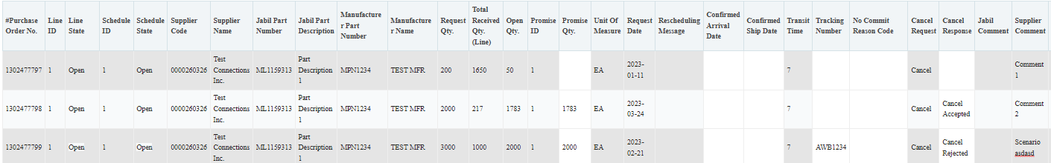
CANCEL REQUEST RESPONSE | EMAIL TEXT
Jabil PO Cancel requests are available in embedded table in the email text kindly reply to this email with your response in the fields in the table below based on the THREE STEPS below:
In the case of a PO Cancel Request published by Jabil the Line and Schedule status changed to ‚OPEN’ (1) and Cancel Request field is = ‚CANCEL’ (2)
Cancel Response Type (3): Please type ’Cancel Accepted or Cancel Rejected’ comment
In case of Cancel Accepted– please publish Promise qty (Cancel qty) (4) and ensure that Promise (Cancel qty) qty is less or equal to Open qty (5)
In case of Cancel Rejection – please publish Promise qty (4) and Promise date (6) information too!
You can send notes or messages to Jabil in ‚Supplier Comment’ column (6)!
*NOTE: Do not provide Cancel Response against a PO schedule line or promise line where is no Cancel Request!
1
1
5
4
6
2
3
6

Slide 20
Visit our Supplier Portal for more Information:
https://www.jabil.com/about-us/supplier/supplier-collaboration.html

