Slide 1
Supplier Order Collaboration
e2open introduction

Slide 2
WHY e2open?
AUTOMATED ORDER EXCHANGE – Reduce buyer’s data handling tasks
  Automated open PO Summary communication to our Suppliers based on Buyer review
  Automated Forecast Planned Order and Schedule Agreement forecast and firm demand communication to our Suppliers based on Buyer review
  Automated SAP write back of PO confirmed delivery date & qty
  Automated New PO and PO Cancel request communication to our Suppliers every day
  Automated reminders for PO Cancellation
  Automated alerts for quantity and/or date misalignment - based on Supplier commit (PORTAL users only)
  MORE CONFIRMATION OPTIONS FOR SUPPLIERS – Make PO Commit process more flexible
  Supplier be able to provide Ship date commit, and Arrival date commit too
  Supplier be able to provide Tracking number information
  Supplier can send Forecast commit against to Discrete Orders and Schedule Agreements too and e2o can store it
  Supplier can send Ship date and qty commit against JIT SA – firm demand and e2o store data
DATA MANAGEMENT - Provide timely supply status visibility
  Daily FC data refresh for Planned Orders and weekly FC Data refresh for Schedule Agreements
  Automated & Prioritized Problem list summary view of POs which require Buyer action
  Database in e2o for exception Vendor contact – centralized solution
  Full PO History view is available in e2o

Slide 3





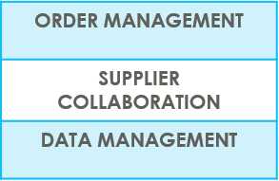
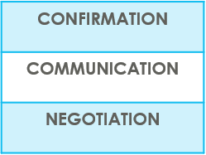

SUPPLIERS IN e2open | OVERVIEW
Supplier Collaboration
Input data
ERP system
Suppliers
Request
System message
Auto Write Back
System message
e2open is Jabil new Collaboration Platform to standardize and digitize our communication, one system for all Suppliers, all Communication methods
Automation of Purchase Order and Reschedule and/or Cancellation System message and Forecast communication to supplier and response write back into ERP system
Improved partnership with our Suppliers thru proactive collaboration
Platform for Suppliers and Buyers for short-term and long-term supply problems to support RISK and Shortage Management
e2open are mapping our Open PO and FC data from our ERP system > summarize it in a user-friendly Interface >then send it out to our Suppliers automatically

Slide 4



SUPPLIERS IN e2open | TYPES OF SUPPLIERS
IN e2open WE HAVE 2 TYPES OF SUPPLIERS
Portal Suppliers
Email-based Suppliers
These suppliers have direct access to the e2open Portal
Jabil sends invitation and registration is required
PO Confirmation is located directly in the Portal
The Portal also enables Forecast, PO & Goods Receipts visibility
These are our email-based suppliers – there is no direct access to e2open portal
No need for registration – everything takes place through email
There is a one-time token access
We offer 3 communication options – see more information on the next slide

Slide 5
SUPPLIERS IN e2open | COLLABORATION OPTIONS
Portal Suppliers
Email-based
Suppliers
ACCESS
Portal Registration
Based on Supplier Alert’s Subscription (Filters are available)
Directly on the PORTAL
Simplified UI link | Excel attachment + UI Link | Email body message
Predefined system email Alerts | Predefined system email Alerts | Predefined system email Alerts
Log in the portal with a simplified UI link from an automated email | Open excel attachement from system email / same as today with weekly OOR or Log in the portal with a simplified UI link from the email | Embedded HTML table from the email body text put commit there (date & qty) and send back
NOTIFICATION
REPLY
NOTE : one time token is expiring after 72 hours

Slide 6
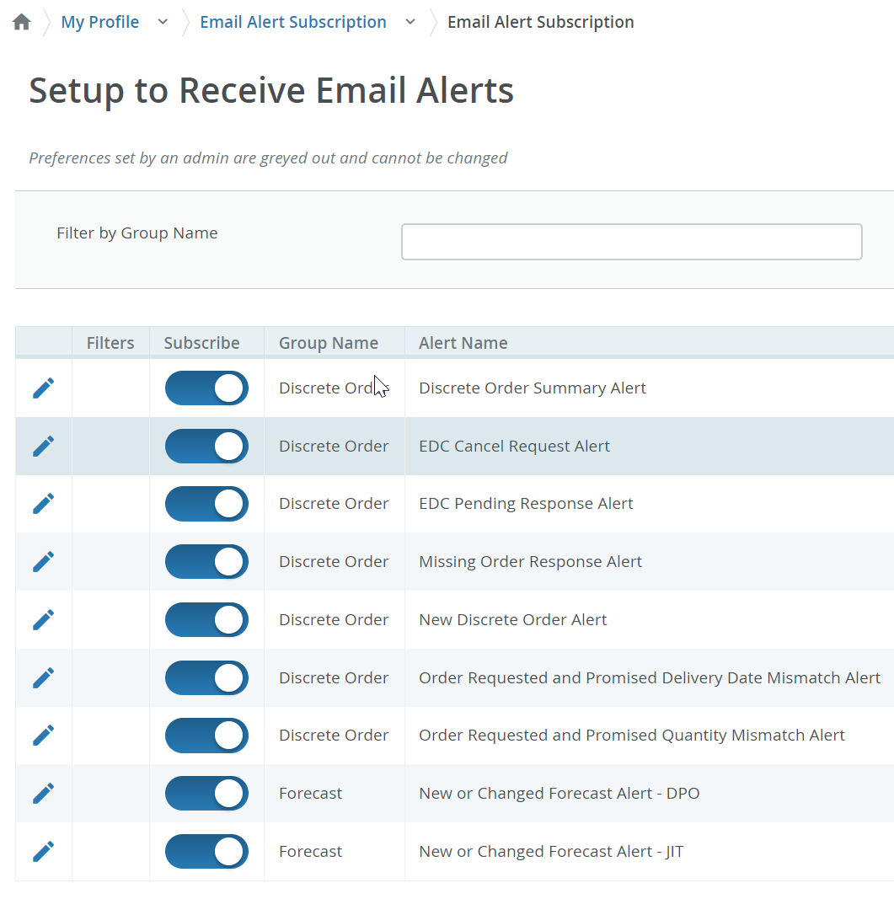
COLLABORATION OPTION DETAILS
SYSTEM ALERTS | Available for PORTAL Supplier | Available for Email-based Supplier | SET UP
New or Changed Forecast Alert DPO New or Changed Forecast Alert JIT | YES | YES | Email-based Suppliers – Alerts are defined in MASTER data – automated – no need any action PORTAL Suppliers – Alerts are optional, Supplier can subscribe/unsubscribe for different Alerts, and be able to Filter the Alerts as well
New Discrete Purchase Order | YES | YES
Summary of Discrete Order Lines | YES | YES
Order Requested and Promised Date Mismatch Alert​ | YES | NO
Order Requested and Promised Quantity Mismatch Alert​ | YES | NO
Missing Order Response Alert | YES | NO
Cancel request Alert | YES | YES
Cancel Pending Response Alert | YES | YES
All above Alerts are available for portal SUPPLIERS– in MY PROFILE > Email alert Subscription menu
System mail address: mailer@services.e2open.com & donotreply@e2open.com
Please ensure you are not blocking these mail addresses!

Slide 7
PO STATE TRANSITIONS IN e2open
START/END | NEW | OPEN | ACCEPT | ACCEPT W/CHANGES (AWC) | NO COMMIT | CLOSED | CANCELLEED
INITIAL SYSTEM | Change (Jabil)
NEW |  | >Change (Jabil) >MRP buyer update | Accept (Supplier) | AWC (Supplier) | No Commit (Suppl) | Close (Jabil) | Cancel (Jabil)
OPEN |  | Change (Jabil) >MRP buyer update >Cancel Response (Accept/No Commit – Suppl) | Accept (Supplier) | AWC (Supplier) | No Commit (Suppl) | Close (Jabil) | Cancel (Jabil)
NO COMMIT |  | >Change (Jabil) >MRP buyer update | Accept (Supplier) | AWC (Supplier) | No Commit (backend sync up only) | Close (Jabil) | Cancel (Jabil)
ACCEPT |  | >Change (Jabil) >MRP buyer update | Accept (backend sync up only) | AWC (Supplier) | No Commit (Suppl) | Close (Jabil) | Cancel (Jabil)
ACCEPT W/CHANGES (AWC) |  | >Change (Jabil) >MRP buyer update | Accept (Supplier) | AWC (backend sync up only) | No Commit (Suppl) | Close (Jabil) | Cancel (Jabil)
CLOSED |  | Change (Jabil) |  |  |  | Close (Jabil) | Cancel (Jabil)
CANCELLED |  | Change (Jabil) |  |  |  | Close (Jabil) | Cancel (Jabil)
START/END | NEW | OPEN | ACCEPT | ACCEPT W/CHANGES (AWC) | NO COMMIT | CLOSED | CANCELLEED
INITIAL SYSTEM | Change (Jabil)
NEW |  | >Change (Jabil) >MRP buyer update | Accept (Supplier) | AWC (Supplier) | No Commit (Suppl) | Close (Jabil) | Cancel (Jabil)
OPEN |  | Change (Jabil) >MRP buyer update >Cancel Response (Accept/No Commit – Suppl) | Accept (Supplier) | AWC (Supplier) | No Commit (Suppl) | Close (Jabil) | Cancel (Jabil)
NO COMMIT |  | >Change (Jabil) >MRP buyer update | Accept (Supplier) | AWC (Supplier) | No Commit (backend sync up only) | Close (Jabil) | Cancel (Jabil)
ACCEPT |  | >Change (Jabil) >MRP buyer update | Accept (backend sync up only) | AWC (Supplier) | No Commit (Suppl) | Close (Jabil) | Cancel (Jabil)
ACCEPT W/CHANGES (AWC) |  | >Change (Jabil) >MRP buyer update | Accept (Supplier) | AWC (backend sync up only) | No Commit (Suppl) | Close (Jabil) | Cancel (Jabil)
CLOSED |  | Change (Jabil) |  |  |  | Close (Jabil) | Cancel (Jabil)
CANCELLED |  | Change (Jabil) |  |  |  | Close (Jabil) | Cancel (Jabil)
Every PO change trigger PO line and PO Schedule line state change in e2open
NEW state > every new PO , not committed before
OPEN state > every PO where we have PO qty, delivery date or price change
ACCEPTED > every PO what Supplier confirmed back and meet fully with Jabil requested date and qty
ACCEPTED w/CHANGES > every PO what Supplier confirmed back BUT not meet fully with Jabil requested date and qty
CLOSED > every PO where we have no more open qty in SAP or buyer put delivery completed indicator flag
CANCELLED > every PO what Buyer cancel from SAP
Please check change MATRIX here!

Slide 8
EMAIL-BASED
SUPPLIERS
Supplier will receive system email notification with Excel attachment about
New Purchase Orders
after Jabil place new PO, two times per day/no repeating Alerts
Open PO Summary
once per week /upon Jabil buyer review and release
New or Changed Forecast
once per week /upon Jabil buyer review and release
PO Cancellation request
once per day/no repeating Alerts
Supplier will be able to send confirmation for
New and Open PO
Forecast
PO Cancel request
in reply email with updated Excel attachment
After 72 hours one-time token will be expired!
EMAIL/EXCEL NOTIFICATION

Slide 9
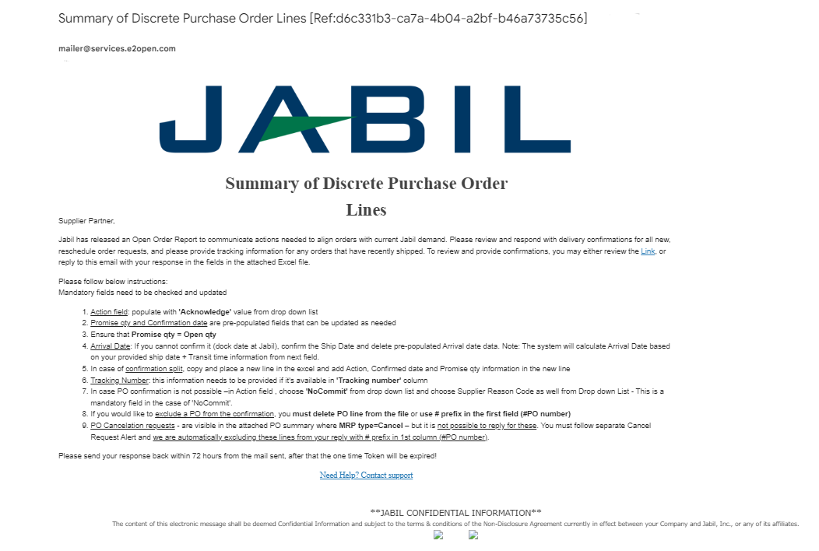
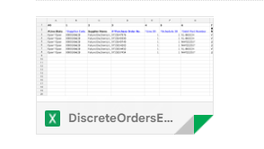
SUPPLIER ALERTS | EXCEL ATTACHMENT NOTIFICATION | STEPS & TIPS
Supplier User receives email notifications WITH Excel attachment
Only one email address per supplier is allowed
The email will arrive from the system email address: mailer@services.e2open.com (1)
IMPORTANT: ensure you are not blocking this mail address!
Email subject will always include reference number (2)– please make sure to not delete this number from your reply back email so we can reference it.
2
1

Slide 10

SUPPLIER RESPONSE | EXCEL ATTACHMENT
You will receive email notification with Excel Attachment.
Only one email address is allowed per supplier code
The notification option is pending from supplier configuration in e2open – and needs to be agreed before we onboard a Supplier in e2open.
Download the Excel file and Open
Update your confirmation in the Excel based on the provided instructions.
Save file and attached into your reply – please do not rename the attachment
Send reply to the original mail address and attach updated Excel file- please do not change Subject
Receive email with Excel attachment:

Slide 11
SUPPLIER RESPONSE | EXCEL ATTACHMENT |RESPONSE OPTIONS
ACKNOWLEDGE
EDIT PROMISE
SPLIT COMMIT
NO COMMIT
Discrete Purchase Orders
PO Cancellation
Request
ACEPT
NO COMMIT
PLANNED ORDERS - COMMIT CONSUMPTION FORECAST (OPTIONAL)
SA – JIT
  FIRM DEMAND COMMIT
  FORECAST COMMIT (ATP – Available To Promise)
Forecast

Slide 12
EMAIL-BASED
SUPPLIERS
Supplier will receive system email notification with simplified UI LINK about:
New Purchase Orders
after Jabil place new PO, two times per day/no repeating Alerts
Open PO Summary
once per week /upon Jabil buyer review and release
New or Changed Forecast
once per week /upon Jabil buyer review and release
PO Cancellation request
once per day/no repeating Alerts
Supplier will be able to send confirmation for
New and Open PO delivery date and quantity
Forecast date and quantity
PO Cancel request
directly in UI with using the LINK from the email
After 72 hours one-time token will be expired!
EMAIL/LINK NOTIFICATION

Slide 13
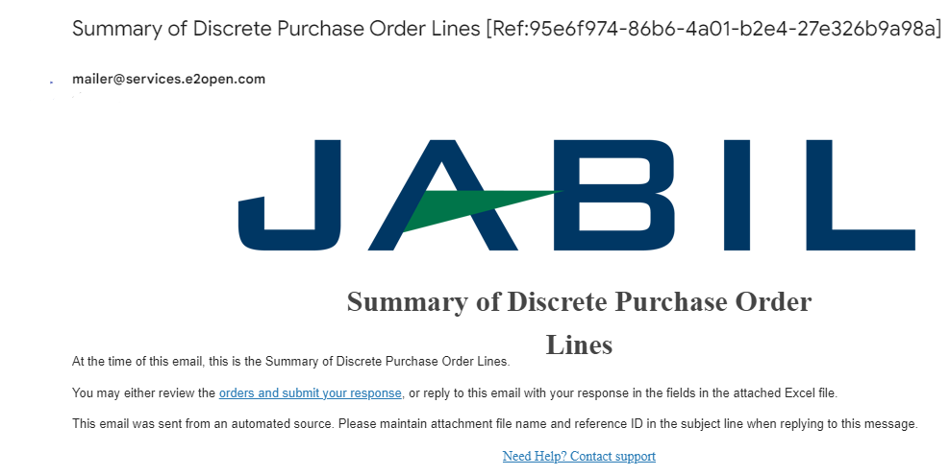
SUPPLIER ALERTS | UI LINK NOTIFICATION | STEPS & TIPS
2
1
Supplier User receives email notifications WITH simplified UI LINK
Only one email address per supplier
System mail address: mailer@services.e2open.com (1)
Please ensure you are not blocking this mail address!
Email subject is always including reference number (2)– please make sure not delete this number from your reply back email!

Slide 14

SUPPLIER RESPONSE | UI LINK RESONSE
You will receive email notification with time sensitive access LINK to the web portal
Only one email address is allowed per supplier code
The notification option is pending from supplier configuration in e2open – and needs to be agreed before we onboard a Supplier in e2open.
Email link is time-sensitive and valid for 72 hours!
Click the link to respond to the collaboration request
Update your confirmation in UI based on the provided instructions.
Save your updates and it will be in sync almost immediately with our ERP system (SAP)
Receive email with UI link:

Slide 15
SUPPLIER RESPONSE | UI LINK | RESPONSE OPTIONS
ACKNOWLEDGE
EDIT PROMISE
SPLIT COMMIT
NO COMMIT
Discrete Purchase Orders
PO Cancellation
Request
ACEPT
NO COMMIT
PLANNED ORDERS - COMMIT CONSUMPTION FORECAST (OPTIONAL)
SA – JIT
  FIRM DEMAND COMMIT
  FORECAST COMMIT (ATP – Available To Promise)
Forecast

Slide 16
EMAIL-BASED
SUPPLIERS
Supplier will receive system email notification with embedded HTML table about
New Purchase Orders
after Jabil place new PO, two times per day/no repeating Alerts
Open PO Summary
once per week /upon Jabil buyer review and release
New or Changed Forecast
once per week /upon Jabil buyer review and release
PO Cancellation request
once per day/no repeating Alerts
Supplier will be able to send confirmation for
New and Open PO delivery date and quantity
Forecast date and quantity
PO Cancel request
with reply to the email by filling out HTML table in the email body
After 72 hours one-time token will be expired!
EMAIL/TEXT NOTIFICATION

Slide 17
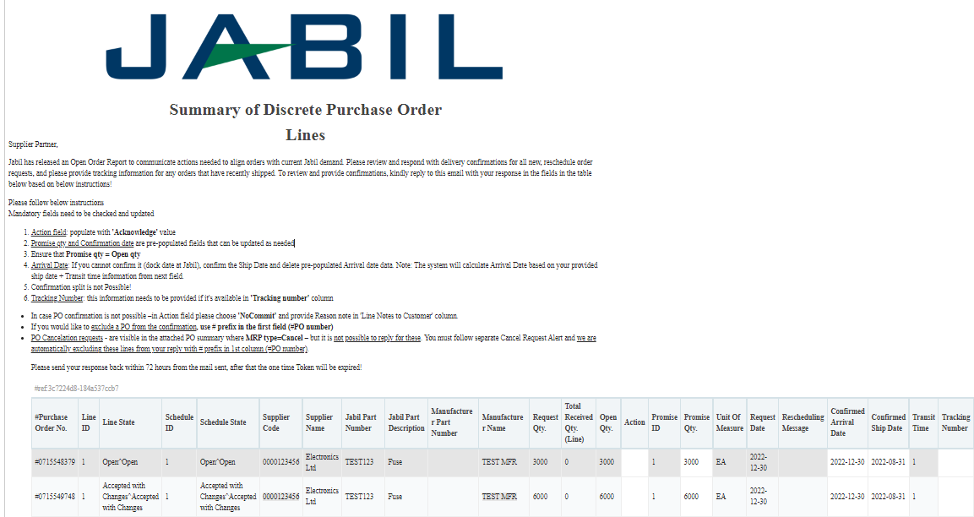
SUPPLIER ALERTS | EMAIL TEXT NOTIFICATION
2
1
Supplier User receives email notifications WITH embedded HTML table in the email body
Only one email address per supplier
System mail address: mailer@services.e2open.com (1)
Please ensure you are not blocking this mail address!
Email subject is always including reference number (2)– please make sure not delete this number from your reply back email!

Slide 18

SUPPLIER ALERTS | EMAIL TEXT NOTIFICATION
You will receive email notifications with embedded HTML table
Only one email address is allowed per supplier code
The notification option is pending from supplier configuration in e2open – and needs to be agreed before we onboard a Supplier in e2open.
Email link is time-sensitive and valid for 72 hours!
Open the email and click Replay to respond to the collaboration request
After Click you will be able to edit the table. Reply to the email by filling out HTML table in the email body . Please follow the instruction from the email
After your updates click Send to release PO confirmation to Jabil.
Do not change Subject!
Receive email with UI link:

Slide 19

SUPPLIER RESPONSE | EMAIL TEXT | RESPONSE OPTIONS
Discrete Purchase Orders
ACKNOWLEDGE
NO COMMIT
PO Cancellation
Request
ACEPT
NO COMMIT

Slide 20
PORTAL SUPPLIERS
Supplier will receive invitation from JABIL to register in e2open system
After registration Supplier will have direct access to e2open Portal
Portal users can log in the UI anytime and review the latest forecast & PO information and Download is also available
Portal users can subscribe for e2open system alerts based on their own preferences
Supplier will be able to edit and provide confirmation for
New and Open PO delivery date and quantity
Forecast date and quantity
PO Cancel request
in PORTAL directly!

Slide 21
PORTAL SUPPLIER AVAILABLE ALERTS | EMAIL LINK NOTIFICATION
Portal Supplier SYSTEM ALERTS | ALERT FREQUENCY
New or Changed Forecast Alert DPO New or Changed Forecast Alert JIT | Sent to subscribers upon buyer’s approval with details of the forecast that are experiencing the exception, and which were not included in the last email alert
New Discrete Purchase Order | Sent to subscribers new PO list which were not included in the last email alert
Summary of Discrete Order Lines | Sent to subscribers upon buyer’s approval with details of the discrete purchase orders that the role has access.​
Cancel request Alert | Alert is triggered when a discrete order schedule has Cancel requests published by the buyers Sent to subscribers once per day with a summary of the affected discrete order request schedules that the role can access and that weren't included in the prior email alert
Cancel Pending Response Alert | This alert is triggered when a discrete order schedule has Cancel change requests published by the buyers, but the supplier hasn't responded and Cancel request published date is EQUAL or HIGHER than 2 days.​​ Sent to subscribers once per day with a summary of the affected discrete order request schedules that the role can access and that weren't included in the prior email alert
Order Requested and Promised Date Mismatch Alert​ | Sent to subscribers once per day with a summary of the discrete orders weren’t included in the last email alert and the promise date on a discrete order promise schedule doesn't match the request date on its request schedule
Order Requested and Promised Quantity Mismatch Alert​ | Sent to subscribers once per day with a summary of the discrete orders weren’t included in the last email alert and the promise quantity on a discrete order promise schedule doesn't match the request quantity on its request schedule
Missing Order Response Alert | This alert is triggered when a supplier doesn't commit to an order or order change within the agreed upon business schedule
Supplier User receives email notifications
Only one email address per supplier
System mail address: donotreply@services.e2open.com
Please ensure you are not blocking this mail address!

