Slide 1
Supplier Order Collaboration
e2open overview email Suppliers

Slide 2
WHY e2open?
AUTOMATED ORDER EXCHANGE – Reduce buyer’s data handling tasks
  Automated open PO Summary communication to our Suppliers based on Buyer review
  Automated Forecast Planned Order and Schedule Agreement forecast and firm demand communication to our Suppliers based on Buyer review
  Automated SAP write back of PO confirmed delivery date & qty
  Automated New PO and PO Cancel request communication to our Suppliers every day
  Automated reminders for PO Cancellation
  Automated alerts for quantity and/or date misalignment - based on Supplier commit (PORTAL users only)
  MORE CONFIRMATION OPTIONS FOR SUPPLIERS – Make PO Commit process more flexible
  Supplier be able to provide Ship date commit, and Arrival date commit too
  Supplier be able to provide Tracking number information
  Supplier can send Forecast commit against to Discrete Orders and Schedule Agreements too and e2o can store it
  Supplier can send Ship date and qty commit against JIT SA – firm demand and e2o store data
DATA MANAGEMENT - Provide timely supply status visibility
  Daily FC data refresh for Planned Orders and weekly FC Data refresh for Schedule Agreements
  Automated & Prioritized Problem list summary view of POs which reqWEBre Buyer action
  Database in e2o for exception Vendor contact – centralized solution
  Full PO History view is available in e2o
For more information, training videos, please visit our portal: https://www.jabil.com/about-us/supplier/supplier-collaboration.html

Slide 3





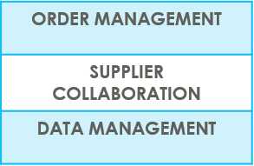
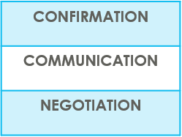

SUPPLIERS IN e2open | OVERVIEW
Supplier Collaboration
Input data
ERP system
Suppliers
Request
System message
Auto Write Back
System message
e2open is Jabil new Collaboration Platform to standardize and digitize our communication, one system for all Suppliers, all Communication methods
Automation of Purchase Order and Reschedule and/or Cancellation System message and Forecast communication to supplier and response write back into ERP system
Improved partnership with our Suppliers thru proactive collaboration
Platform for Suppliers and Buyers for short-term and long-term supply problems to support RISK and Shortage Management
e2open are mapping our Open PO and FC data from our ERP system > summarize it in a user-friendly Interface >then send it out to our Suppliers automatically

Slide 4



SUPPLIERS IN e2open | TYPES OF SUPPLIERS
IN e2open WE HAVE 2 TYPES OF SUPPLIERS
Portal Suppliers
Email-based Suppliers
These suppliers have direct access to the e2open Portal
Jabil sends invitation and registration is reqWEBred
PO Confirmation is located directly in the Portal
The Portal also enables Forecast, PO & Goods Receipts visibility
These are our email-based suppliers – there is no direct access to e2open portal
No need for registration – everything takes place through email
There is a one-time token access
We offer 3 communication options – see more information on the next slide

Slide 5
SUPPLIERS IN e2open | YOUR COLLABORATION OPTIONS
You will be onboarded with email communication: default set up is Excel attachment + WEB Link
Email-based Suppliers
ACCESS
Simplified WEB link | Excel attachment + WEB Link | Email body message
Predefined system email Alerts | Predefined system email Alerts | Predefined system email Alerts
Log in the portal with a simplified WEB link from an automated email | Open excel attachment from system email / same as today with weekly OOR or Log in the portal with a simplified WEB link from the email | Embedded HTML table from the email body text put commit there (date & qty) and send back
NOTIFICATION
REPLY
NOTE : one time token is expiring after 72 hours

Slide 6
YOUR COMMUNICATION DETAILS
Once you are onboarded into e2open – you will receive below consolidated Alerts for your Vendor code from different plants, based on Communication Period and Alert frequency.
Note: Alerts will be including only those POs that weren't included in the prior email alert!
SYSTEM ALERTS | SYSTEM COMMUNICATION PERIOD | ALERT FREQUENCY AT SUPPLIER
New or Changed Forecast Alert DPO (Discrete Purchase Order) | System release every 6 hours (starting at 0:00:00 UTC) based on Buyer approval | You will receive this Alert once per week, based on Buyer approval
New or Changed Forecast Alert JIT (Just in Time Schedule Agreement)
Summary of Discrete Order Lines | YES
New Discrete Purchase Order | System release twice per day 0:00 UTC and 12:00 UTC | You will receive this Alert twice per day (only if Jabil place new PO to you)
System mail address: mailer@services.e2open.com & donotreply@e2open.com
Please ensure you are not blocking these mail addresses!

Slide 7
PO STATE TRANSITIONS IN e2open
START/END | NEW | OPEN | ACCEPT | ACCEPT W/CHANGES (AWC) | NO COMMIT | CLOSED | CANCELLEED
INITIAL SYSTEM | Change (Jabil)
NEW |  | >Change (Jabil) >MRP buyer update | Accept (Supplier) | AWC (Supplier) | No Commit (Suppl) | Close (Jabil) | Cancel (Jabil)
OPEN |  | Change (Jabil) >MRP buyer update >Cancel Response (Accept/No Commit – Suppl) | Accept (Supplier) | AWC (Supplier) | No Commit (Suppl) | Close (Jabil) | Cancel (Jabil)
NO COMMIT |  | >Change (Jabil) >MRP buyer update | Accept (Supplier) | AWC (Supplier) | No Commit (backend sync up only) | Close (Jabil) | Cancel (Jabil)
ACCEPT |  | >Change (Jabil) >MRP buyer update | Accept (backend sync up only) | AWC (Supplier) | No Commit (Suppl) | Close (Jabil) | Cancel (Jabil)
ACCEPT W/CHANGES (AWC) |  | >Change (Jabil) >MRP buyer update | Accept (Supplier) | AWC (backend sync up only) | No Commit (Suppl) | Close (Jabil) | Cancel (Jabil)
CLOSED |  | Change (Jabil) |  |  |  | Close (Jabil) | Cancel (Jabil)
CANCELLED |  | Change (Jabil) |  |  |  | Close (Jabil) | Cancel (Jabil)
START/END | NEW | OPEN | ACCEPT | ACCEPT W/CHANGES (AWC) | NO COMMIT | CLOSED | CANCELLEED
INITIAL SYSTEM | Change (Jabil)
NEW |  | >Change (Jabil) >MRP buyer update | Accept (Supplier) | AWC (Supplier) | No Commit (Suppl) | Close (Jabil) | Cancel (Jabil)
OPEN |  | Change (Jabil) >MRP buyer update >Cancel Response (Accept/No Commit – Suppl) | Accept (Supplier) | AWC (Supplier) | No Commit (Suppl) | Close (Jabil) | Cancel (Jabil)
NO COMMIT |  | >Change (Jabil) >MRP buyer update | Accept (Supplier) | AWC (Supplier) | No Commit (backend sync up only) | Close (Jabil) | Cancel (Jabil)
ACCEPT |  | >Change (Jabil) >MRP buyer update | Accept (backend sync up only) | AWC (Supplier) | No Commit (Suppl) | Close (Jabil) | Cancel (Jabil)
ACCEPT W/CHANGES (AWC) |  | >Change (Jabil) >MRP buyer update | Accept (Supplier) | AWC (backend sync up only) | No Commit (Suppl) | Close (Jabil) | Cancel (Jabil)
CLOSED |  | Change (Jabil) |  |  |  | Close (Jabil) | Cancel (Jabil)
CANCELLED |  | Change (Jabil) |  |  |  | Close (Jabil) | Cancel (Jabil)
Every PO change trigger PO line and PO Schedule line state change in e2open
NEW state > every new PO , not committed before
OPEN state > every PO where we have PO qty, delivery date or price change
ACCEPTED > every PO what Supplier confirmed back and meet fully with Jabil requested date and qty
ACCEPTED w/CHANGES > every PO what Supplier confirmed back BUT not meet fully with Jabil requested date and qty
CLOSED > every PO where we have no more open qty in SAP or buyer put delivery completed indicator flag
CANCELLED > every PO what Buyer cancel from SAP
Please check change MATRIX here!

Slide 8
Email-based SUPPLIERS
Supplier will receive system email notification with Excel attachment about
New Purchase Orders
after Jabil place new PO, two times per day/no repeating Alerts
Open PO Summary
once per week /upon Jabil buyer review and release
including PO Rescheduling and Cancellation requests too
New or Changed Forecast
once per week /upon Jabil buyer review and release
Supplier will be able to send confirmation for
New and Open PO delivery date and quantity
PO Rescheduling & Cancel request
Forecast
in reply email with updated Excel attachment
After 72 hours one-time token will be expired!
EMAIL/EXCEL NOTIFICATION

Slide 9
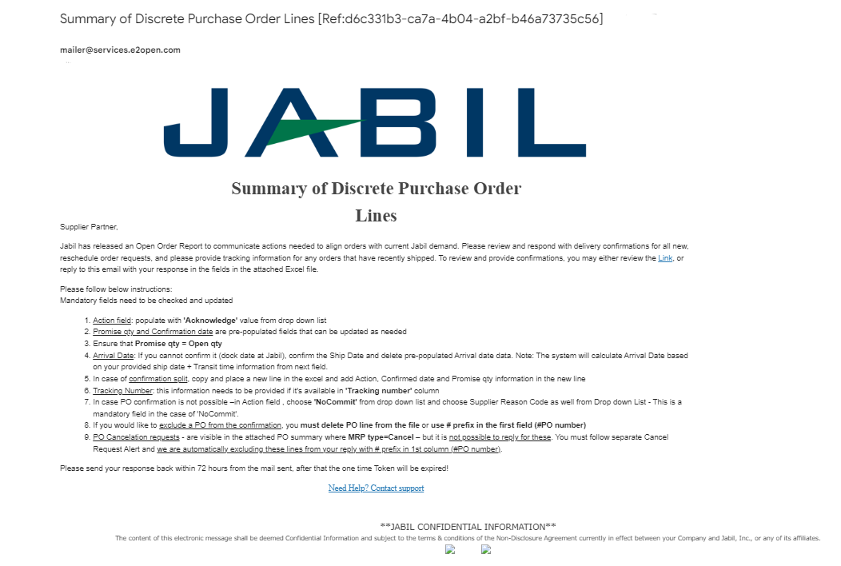
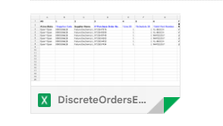
SUPPLIER ALERTS | EXCEL ATTACHMENT NOTIFICATION | STEPS & TIPS
Supplier User receives email notifications WITH Excel attachment
Only one email address per supplier is allowed
The email will arrive from the system email address: mailer@services.e2open.com (1)
IMPORTANT: ensure you are not blocking this mail address!
Email subject will always include reference number (2)– please make sure to not delete this number from your reply back email so we can reference it.
2
1

Slide 10

SUPPLIER RESPONSE | EXCEL ATTACHMENT
You will receive email notification with Excel Attachment.
Only one email address is allowed per supplier code
The notification option is pending from supplier configuration in e2open – and needs to be agreed before we onboard a Supplier in e2open.
Download the Excel file and Open
Update your confirmation in the Excel based on the provided instructions.
Save file and attached into your reply – please do not rename the attachment
Send reply to the original mail address and attach updated Excel file- please do not change Subject
Receive email with Excel attachment:

Slide 11
SUPPLIER RESPONSE | EXCEL ATTACHMENT |RESPONSE OPTIONS
ACKNOWLEDGE
EDIT PROMISE
SPLIT COMMIT
NO COMMIT
Discrete Purchase Orders
PO Cancellation
Request
CANCEL ACCEPTED
CANCEL REJECTED
PLANNED ORDERS - COMMIT CONSUMPTION FORECAST (OPTIONAL)
SA – JIT
  FIRM DEMAND COMMIT
  FORECAST COMMIT (ATP – Available To Promise)
Forecast

Slide 12
Email-based SUPPLIERS
Supplier will receive system email notification with simplified WEB LINK about:
New Purchase Orders
after Jabil place new PO, two times per day/no repeating Alerts
Open PO Summary
once per week /upon Jabil buyer review and release
including PO Rescheduling and Cancellation requests too
New or Changed Forecast
once per week /upon Jabil buyer review and release
Supplier will be able to send confirmation for
New and Open PO delivery date and quantity
PO Rescheduling & Cancel request
Forecast
directly in WEB with using the LINK from the email
After 72 hours one-time token will be expired!
EMAIL/WEB LINK NOTIFICATION

Slide 13
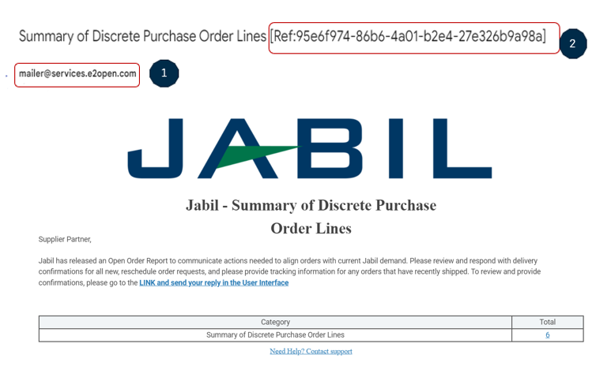
SUPPLIER ALERTS | WEB LINK NOTIFICATION | STEPS & TIPS
Supplier User receives email notifications WITH simplified WEB LINK
Only one email address per supplier
System mail address: mailer@services.e2open.com (1)
Please ensure you are not blocking this mail address!
Email subject is always including reference number (2)– please make sure not delete this number from your reply back email!

Slide 14

SUPPLIER RESPONSE | WEB LINK RESONSE
You will receive an email notification with time-sensitive access LINK to the web portal
Only one email address is allowed per supplier code
The notification option is pending from supplier configuration in e2open – and needs to be agreed upon before we onboard a Supplier in e2open.
Email link is time-sensitive and valid for 72 hours!
Click the link to respond to the collaboration request
Update your confirmation in WEB based on the provided instructions.
Save your updates and it will be in sync almost immediately with our ERP system (SAP)
Receive email with WEB link:

Slide 15
SUPPLIER RESPONSE | WEB LINK | RESPONSE OPTIONS
ACKNOWLEDGE
EDIT PROMISE
SPLIT COMMIT
NO COMMIT
Discrete Purchase Orders
PO Cancellation
Request
CANCEL ACCEPTED
CANCEL REJECETD
PLANNED ORDERS - COMMIT CONSUMPTION FORECAST (OPTIONAL)
SA – JIT
  FIRM DEMAND COMMIT
  FORECAST COMMIT (ATP – Available To Promise)
Forecast

Slide 16
Email-based SUPPLIERS
Supplier will receive system email notification with embedded HTML table about
New Purchase Orders
after Jabil place new PO, two times per day/no repeating Alerts
Open PO Summary
once per week /upon Jabil buyer review and release
including PO Rescheduling and Cancellation requests too
Supplier will be able to send confirmation for
New and Open PO delivery date and quantity
PO Rescheduling & Cancel request
with reply to the email by filling out HTML table in the email body
After 72 hours one-time token will be expired!
EMAIL/TEXT NOTIFICATION

Slide 17
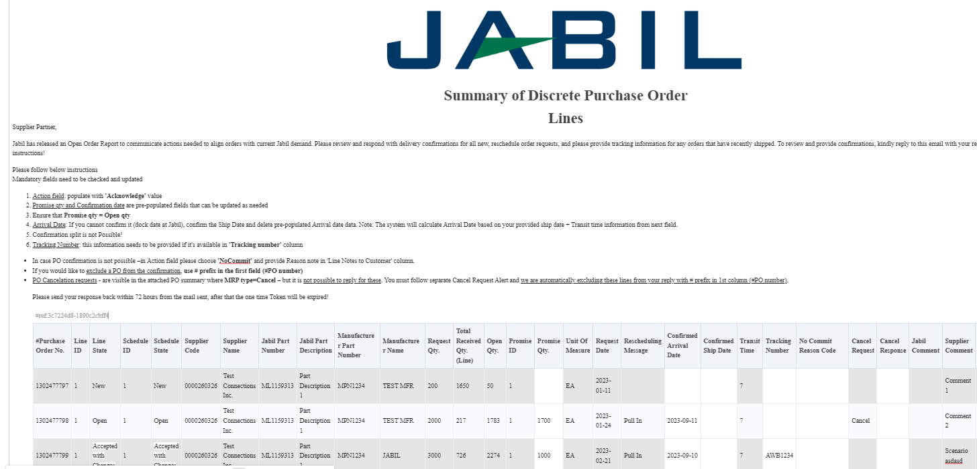
SUPPLIER ALERTS | EMAIL TEXT NOTIFICATION
2
1
Supplier User receives email notifications WITH embedded HTML table in the email body
Only one email address per supplier
System mail address: mailer@services.e2open.com (1)
Please ensure you are not blocking this mail address!
Email subject is always including reference number (2)– please make sure not delete this number from your reply back email!

Slide 18

SUPPLIER ALERTS | EMAIL TEXT NOTIFICATION
You will receive email notifications with embedded HTML table
Only one email address is allowed per supplier code
The notification option is pending from supplier configuration in e2open – and needs to be agreed before we onboard a Supplier in e2open.
Email link is time-sensitive and valid for 72 hours!
Open the email and click Replay to respond to the collaboration request
After Click you will be able to edit the table. Reply to the email by filling out HTML table in the email body . Please follow the instruction from the email
After your updates click Send to release PO confirmation to Jabil.
Do not change Subject!
Receive email with embedded table:

Slide 19

SUPPLIER RESPONSE | EMAIL TEXT | RESPONSE OPTIONS
Discrete Purchase Orders
ACKNOWLEDGE
NO COMMIT
PO Cancellation
Request
CANCEL ACCEPTED​
CANCEL REJECTED

Slide 20
Visit our Supplier Portal for more Information:
https://www.jabil.com/about-us/supplier/supplier-collaboration.html

