Slide 1
Supplier Order Collaboration
e2open Email-based Supplier – email with excel attachment notification

Slide 2





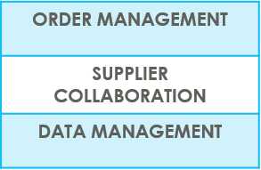
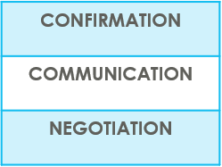

SUPPLIERS IN e2open | OVERVIEW
Supplier Collaboration
Input data
ERP system
Suppliers
Request
System message
Auto Write Back
System message
e2open is Jabil new Collaboration Platform to standardize and digitize our communication, one system for all Suppliers, all Communication methods
Automation of Purchase Order and Reschedule and/or Cancellation System message and Forecast communication to supplier and response write back into ERP system
Improved partnership with our Suppliers thru proactive collaboration
Platform for Suppliers and Buyers for short-term and long-term supply problems to support RISK and Shortage Management
e2open are mapping our Open PO and FC data from our ERP system > summarize it Iin a user-friendly Interface >then send it out to our Suppliers automatically

Slide 3



SUPPLIERS IN e2open | TYPES OF SUPPLIERS
IN e2open WE HAVE 2 TYPES OF SUPPLIERS
Portal Suppliers
Email-based Suppliers
These suppliers have direct access to the e2open Portal
Jabil sends invitation and registration is reqWEBred
PO Confirmation is located directly in the Portal
The Portal also enables Forecast, PO & Goods Receipts visibility
These are our email-based suppliers – there is no direct access to e2open portal
No need for registration – everything takes place through email
There is a one-time token access
We offer 3 communication options – see more information on the next slide

Slide 4
SUPPLIERS IN e2open | YOUR COLLABORATION OPTIONS
You will be onboarded with email communication: setup is Excel attachment + WEB Link
Email-based Suppliers
ACCESS
Simplified WEB link | Excel attachment + WEB Link | Email body message
Predefined system email Alerts | Predefined system email Alerts | Predefined system email Alerts
Log in the portal with a simplified WEB link from an automated email | Open excel attachment from system email / same as today with weekly OOR or Log in the portal with a simplified WEB link from the email | Embedded HTML table from the email body text put commit there (date & qty) and send back
NOTIFICATION
REPLY
NOTE : one time token is expiring after 72 hours

Slide 5
YOUR COMMUNICATION DETAILS
Once you are onboarded into e2open – you will receive below consolidated Alerts for your Vendor code from different plants, based on Communication Period and Alert frequency.
Note: Alerts will be including only those POs that weren't included in the prior email alert!
SYSTEM ALERTS | SYSTEM COMMUNICATION PERIOD | ALERT FREQUENCY AT SUPPLIER
New or Changed Forecast Alert DPO (Discrete Purchase Order) | System release every 6 hours (starting at 0:00:00 UTC) based on Buyer approval | You will receive this Alert once per week, based on Buyer approval
New or Changed Forecast Alert JIT (Just in Time Schedule Agreement)
Summary of Discrete Order Lines | YES
New Discrete Purchase Order | System release twice per day 0:00 UTC and 12:00 UTC | You will receive this Alert twice per day (only if Jabil place new PO to you)
System mail address: mailer@services.e2open.com & donotreply@e2open.com
Please ensure you are not blocking these mail addresses!

Slide 6

Email-based SUPPLIERS
Keyword(s): Business Deal
Supplier Order Collaboration
EMAIL/EXCEL NOTIFICATION

Slide 7
Email-based SUPPLIERS
Supplier will receive system email notification with Excel attachment about
New Purchase Orders
after Jabil place new PO, two times per day/no repeating Alerts
Open PO Summary
once per week /upon Jabil buyer review and release
including PO Rescheduling and Cancellation requests too
New or Changed Forecast
once per week /upon Jabil buyer review and release
Supplier will be able to send confirmation for
New and Open PO delivery date and quantity
PO Rescheduling & Cancel request
Forecast
in reply email with updated Excel attachment
After 72 hours one-time token will be expired!
EMAIL/EXCEL NOTIFICATION

Slide 8

EMAIL | EXCEL ATTACHEMENT NOTIFICATION OUTLINE
1 | SYSTEM ALERTS SUMMARY
2 | DISCRETE ORDER RESPONSE – NEW + OPEN PO ACKNOWLEDGE EDIT PROMISE NO COMMIT
3 | CANCEL REQUEST RESPONSE PROCESS
4 | NEW OR CHANGED FORECAST ALERT COMMIT PROCESS DISCRETE ORDERS COMMIT PROCESS SCHEDULE AGREEMENTS

Slide 9

SUPPLIER ALERTS | TYPES & FREQUENCY
Email-based Supplier SYSTEM ALERTS | ALERT FREQUENCY
New or Changed FORECAST Alert DPO/JIT* | ONCE /WEEK
New Discrete PO | 2 TIMES/DAY Not repeating same PO
Summary of Discrete Order Lines | ONCE /WEEK
*DPO – Discrete Purchase Order
JIT – Just in Time - Schedule Agreement

Slide 10
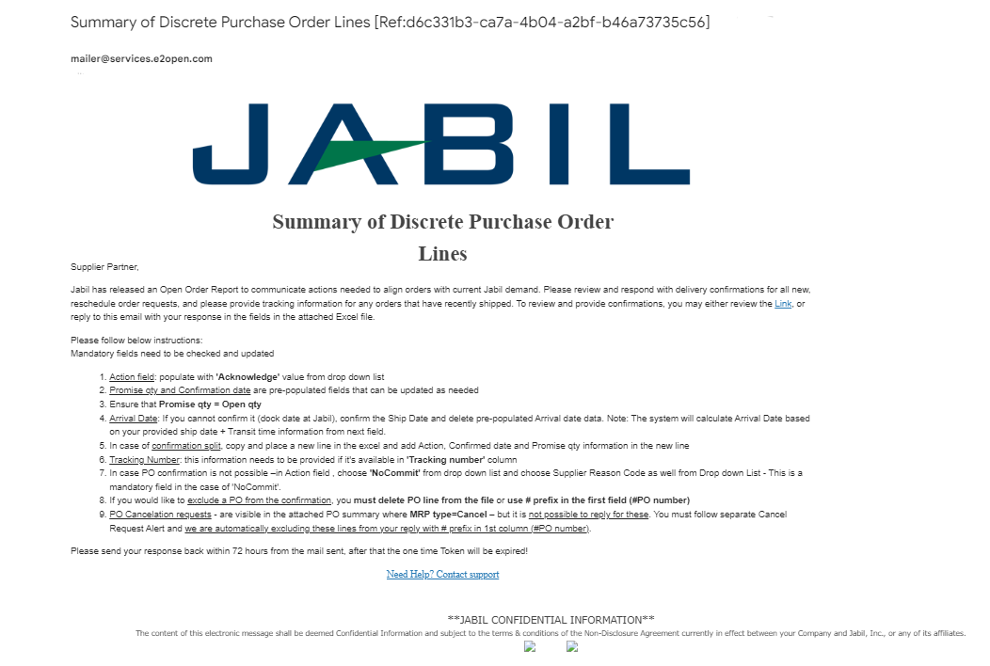
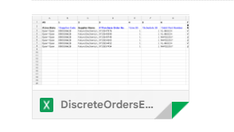
SUPPLIER ALERTS | EXCEL ATTACHMENT NOTIFICATION | STEPS & TIPS
2
Supplier User receives email notifications WITH Excel attachment
Only one email address per supplier is allowed
The email will arrive from the system email address: mailer@services.e2open.com (1)
IMPORTANT: ensure you are not blocking this mail address!
Email subject will always include reference number (2)– please make sure to not delete this number from your reply back email so we can reference it.
1

Slide 11

SUPPLIER RESPONSE | EXCEL ATTACHMENT
You will receive email notification with Excel Attachment.
Only one email address is allowed per supplier code
The notification option is pending from supplier configuration in e2open – and needs to be agreed before we onboard a Supplier in e2open.
Download the Excel file and Open
Update your confirmation in the Excel based on the provided instructions.
Save file and attached into your reply – please do not rename the attachment
Send reply to the original mail address and attach updated Excel file- please do not change Subject
Receive email with Excel attachment:

Slide 12
SUPPLIER RESPONSE | EXCEL ATTACHMENT |RESPONSE OPTIONS
ACKNOWLEDGE
EDIT PROMISE
SPLIT COMMIT
NO COMMIT
Discrete Purchase Orders
PO Cancellation
Request
CANCEL ACCEPTED
CANCEL REJECTED
PLANNED ORDERS - COMMIT CONSUMPTION FORECAST (OPTIONAL)
SA – JIT
  FIRM DEMAND COMMIT
  FORECAST COMMIT (ATP – Available To Promise)
Forecast

Slide 13
PO STATE TRANSITIONS IN e2open
Every PO change trigger PO line and PO Schedule line state change in e2open
NEW state > every new PO , not committed before
OPEN state > every PO where we have PO qty, delivery date or price change
ACCEPTED > every PO what Supplier confirmed back and meet fully with Jabil requested date and qty
ACCEPTED w/CHANGES > every PO what Supplier confirmed back BUT not meet fully with Jabil requested date and qty
CLOSED > every PO where we have no more open qty in SAP or buyer put delivery completed indicator flag
CANCELLED > every PO what Buyer cancel from SAP
Please check change MATRIX here!
START/END | NEW | OPEN | ACCEPT | ACCEPT W/CHANGES (AWC) | NO COMMIT | CLOSED | CANCELLEED
INITIAL SYSTEM | Change (Jabil)
NEW |  | >Change (Jabil) >MRP buyer update | Accept (Supplier) | AWC (Supplier) | No Commit (Suppl) | Close (Jabil) | Cancel (Jabil)
OPEN |  | Change (Jabil) >MRP buyer update >Cancel Response (Accept/No Commit – Suppl) | Accept (Supplier) | AWC (Supplier) | No Commit (Suppl) | Close (Jabil) | Cancel (Jabil)
NO COMMIT |  | >Change (Jabil) >MRP buyer update | Accept (Supplier) | AWC (Supplier) | No Commit (backend sync up only) | Close (Jabil) | Cancel (Jabil)
ACCEPT |  | >Change (Jabil) >MRP buyer update | Accept (backend sync up only) | AWC (Supplier) | No Commit (Suppl) | Close (Jabil) | Cancel (Jabil)
ACCEPT W/CHANGES (AWC) |  | >Change (Jabil) >MRP buyer update | Accept (Supplier) | AWC (backend sync up only) | No Commit (Suppl) | Close (Jabil) | Cancel (Jabil)
CLOSED |  | Change (Jabil) |  |  |  | Close (Jabil) | Cancel (Jabil)
CANCELLED |  | Change (Jabil) |  |  |  | Close (Jabil) | Cancel (Jabil)

Slide 14
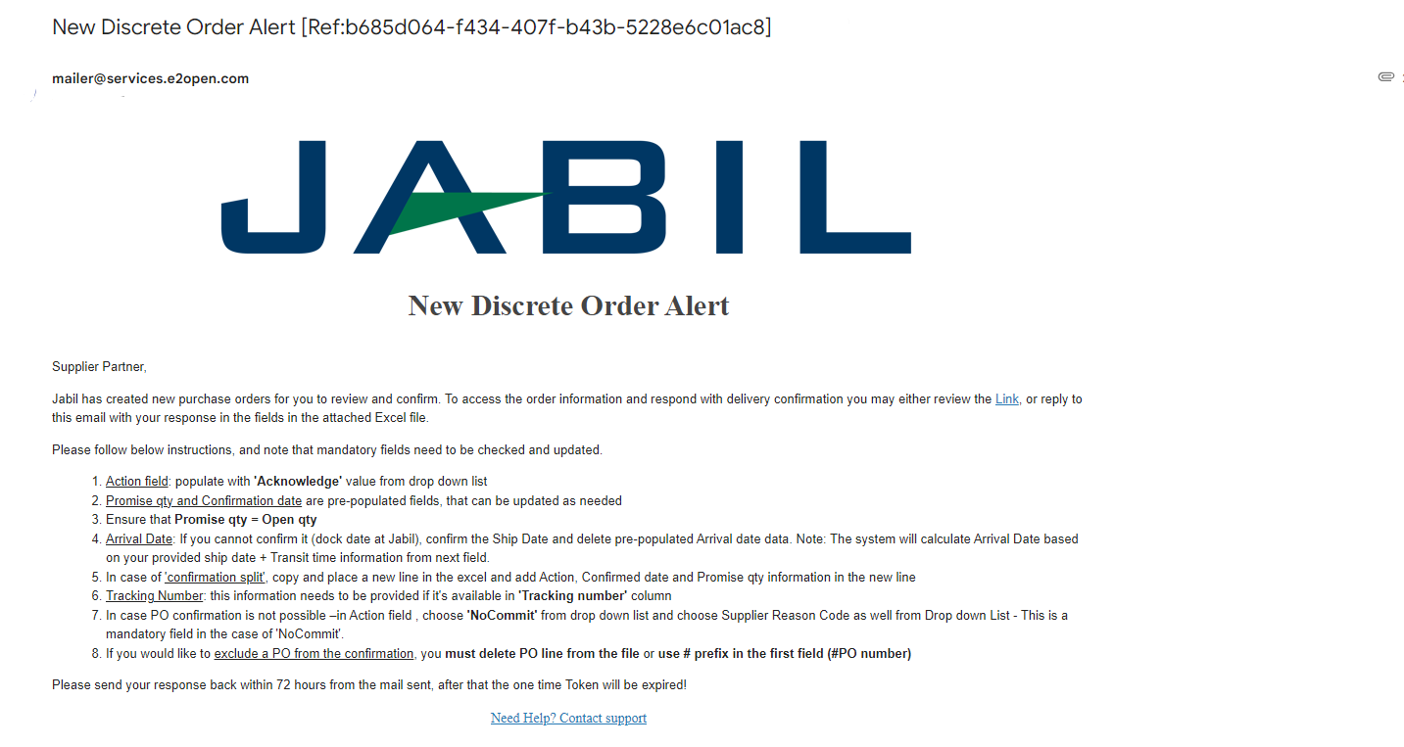

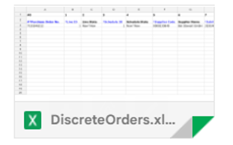
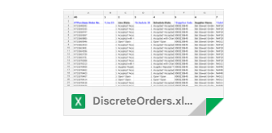
NEW / SUMMARY OF DISCRETE ORDER LINES
ALERT | EXCEL ATTACHMENT

Slide 15

NEW/OPEN ORDER CONFIRMATION | EXCEL ATTACHMENT
You can Download and Open Excel Attachments from the email
You must respond to New and Open (1) Discrete Orders with the following options:
Acknowledge PO with Promise qty and Confirmed Arrival date
Edit Promises - split the Promise Quantity into multiple Promise Dates
No Commit if you leave promise qty and date fields empty
After you populate Confirmation below status change will happen >​
If you confirm the same date and qty what are Jabil’s requests the Discrete Order State transitions into Accepted OR​
If you update the Promise Quantity and/or Confirmed Arrival Data/Confirmed Ship Date if needed and the Discrete Order State transitions into Accepted with Changes ​
If you leave Promise Quantity and/or Confirmed Arrival Data/Confirmed Ship Date empty >> Discrete Order State transitions into No Commit​
1
1
ACKNOWLEDGE
EDIT PROMISE
NO COMMIT
16
17
18

Slide 16
SUPPLIER RESPONSE | ACKNOWLEDGE | EXCEL ATTACHMENT
We need your feedback on every PO and Schedule Line where the status is NEW (recently placed not yet accepted) or OPEN (Jabil made PO Change meanwhile) (1)
To accept a PO please populate the Promise qty and Confirmation date
Ensure that Promise qty (2) = Open qty (3) (Less qty confirmation is allowed but overcommit is not allowed!)
Arrival Date (4) : If you cannot confirm it (dock date at Jabil), you can confirm the Ship Date (5)
Note: You do not need to populate both dates in the file! – as the system will handle that and will calculate the Arrival Date based on your provided ship date + Transit time) information from the next field (6).
Tracking Number (7): if PO is shipped you can provide tracking number in this column
You can share any further note or message with Jabil in the Supplier Comment column! (8) in the attached template
1
1
3
2
4
5
6
7
8
Please send your response back within 72 hours from the mail sent, after that the one-time Token will be expired!

Slide 17
SUPPLIER RESPONSE | EDIT PROMISE | EXCEL ATTACHMENT
In case of 'confirmation split' , copy PO line and place a new line (1) in the Excel and populate Promise qty (2) and Confirmed date (3) information in both lines
Please change Promise ID from 1 to 2...(4)
2
3
1
4
Please send your response back within 72 hours from the mail sent, after that the one-time Token will be expired!

Slide 18
SUPPLIER RESPONSE | EDIT PROMISE | EXCEL ATTACHMENT
In case of 'confirmation split', if the promise qty has been already arrived, please remove old confirmation.
To remove confirmation:
  A) please change quantity to 0 in Promise qty (1) and leave any future date in Confirmed date (2) or
  B) Delete entire row and leave only valid promise ID
A
1
2
B
Please send your response back within 72 hours from the mail sent, after that the one-time Token will be expired!

Slide 19
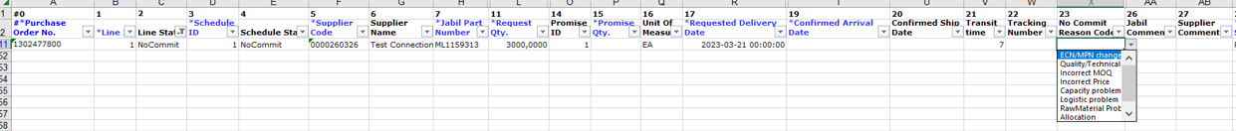
SUPPLIER RESPONSE | NO COMMIT | EXCEL ATTACHMENT
In case PO confirmation is not possible – leave Promise qty and Confirmed date fields empty (1) and choose “No Commit Reason Code” from drop-down list (2)
2
1
1
In case of NoCommit – Please choose No Commit Reason Code from drop down!
Please send your response back within 72 hours from the mail sent, after that the one-time Token will be expired!

Slide 20
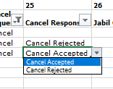
CANCEL REQUEST RESPONSE | EXCEL ATTACHMENT
Download and Open Excel Attachment from the email
Please follow the below instructions and note that mandatory fields need to be checked and updated​.
In the case of a PO Cancel Request published by Jabil the Line and Schedule status changed to ‚OPEN’ (1) and Cancel Request field is = ‚CANCEL’ (2)
Cancel Response Type (3): Please choose from the drop-down list ’Cancel Accepted or Cancel Rejected’ comment
In case of Cancel Accepted– please publish Promise qty (Cancel qty) (4) and ensure that Promise (Cancel qty) qty is less or equal to Open qty (5)
In case of Cancel Rejection – please publish Promise qty (4) and Promise date (6) information too!
You can send notes or messages to Jabil in ‚Supplier Comment’ column (7)!
1
1
5
4
6
2
3
7
3
*NOTE: do not provide Cancel Response against a PO schedule line or promise line where is no Cancel Request!

Slide 21
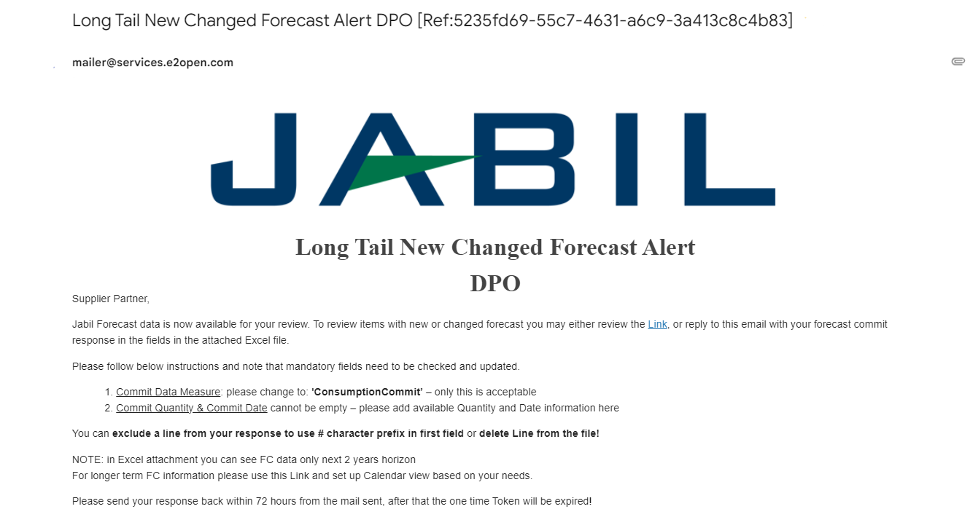
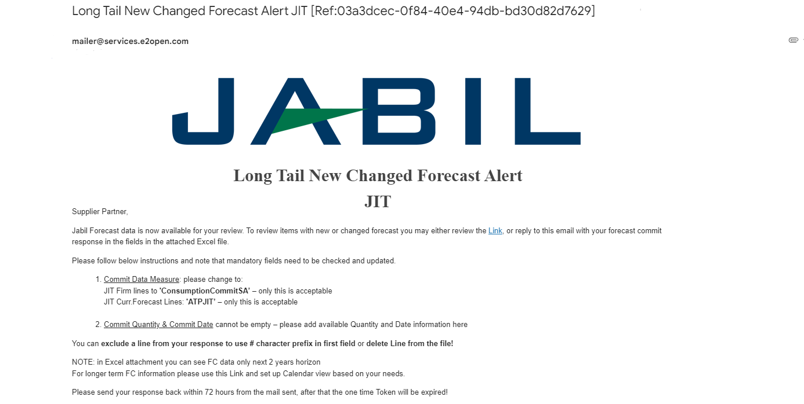
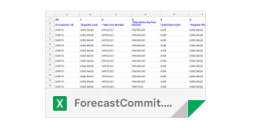
NEW OR CHANGED FORECAST | EXCEL ATTACHMENT+ WEB LINK | DISCRETE ORDERS
1
Both Excel & WEB LINK are available for Forecast checking
In Excel you can download and see static Forecast for next 2 years
In WEB LINK (1) you can see dynamic Forecast for extended horizon

Slide 22
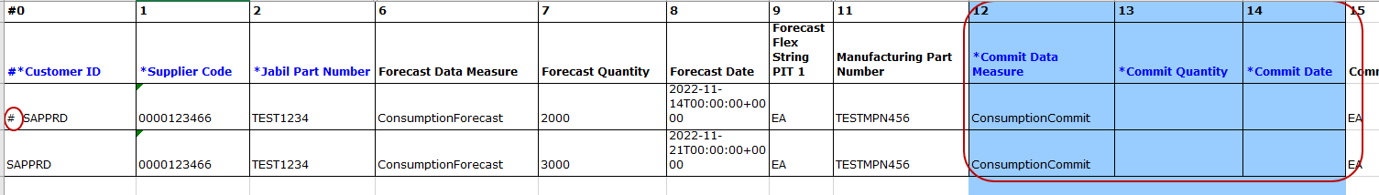
FORECAST RESPONSE | DISCRETE ORDERS | EXCEL ATTACHMENT
Download and Open Excel Attachment from the email!
Please follow below instructions and note that mandatory fields in BLUE need to be checked and updated​:
Commit Data Measure: You can see ConsumptionCommit’ (1) – ONLY this is acceptable, please do not change!
Commit qty & Commit Date (2): cannot be empty – please add available Quantity and Date information here
You can exclude a line from your response to use # character prefix in first field (3) or delete line from the file!
3
1
2
Note: If you would like to send new FC Commit during the same week, please provide full commit by entering 0 on the previously entered buckets!

Slide 23
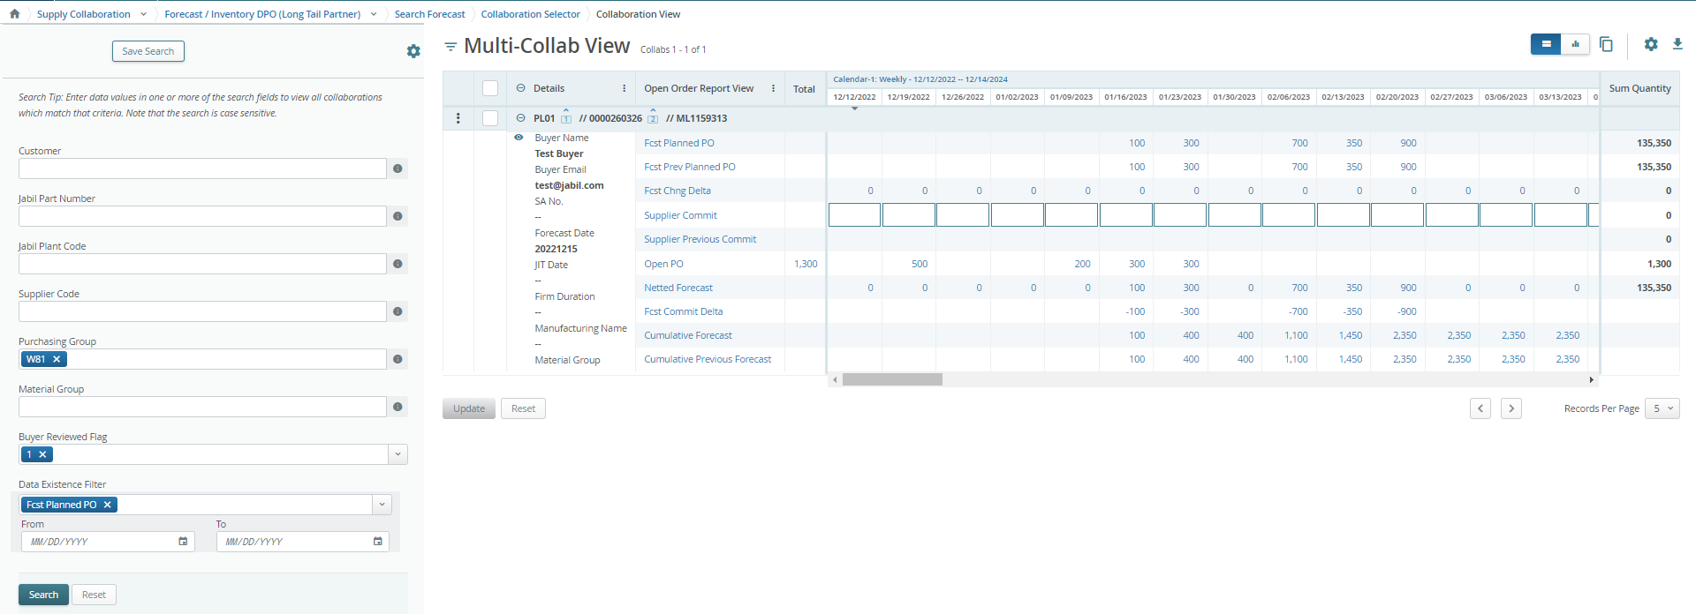
FORECAST RESPONSE | DISCRETE ORDERS | WEB LINK
After click the LINK in the email Alert - >you will drive to the e2o tool – simplified WEB – where you can see all Jabil Part Number Forecast/Planned PO data what Jabil Buyer released to you
Open PO quantity (2) is scheudled in weeklybuckets based on PO requetsed delivery date!
After click the LINK in the email Alert -> you will drive to the e2o tool – simplified WEB – where you can see all Jabil Part Number Forecast/Planned PO data what Jabil Buyer released to you
Open PO quantity (2) is scheduled in weekly buckets based on PO requested delivery date!
Calendar
To change calendar date and view –> click the link (Monthly or QTR-ly view is available too
5
6
4
2
1
3
You can add FC/Planned PO commit data here (1)
Click Open PO number to see open PO details (2) - past due PO data is also including
Netted Forecast = FC Planned PO – Open PO Post FC load (3) – dynamic field – provide actual status update!
Past due demand is consolidated always in the current week Planned PO data (4)
TOTAL is calculated based on full data, independently from Calendar view set up on TOP! (5)
SUM Quantity: is including all demand and PO data based on Calendar view set up on TOP (6)
Click here to open Filter Menu

Slide 24
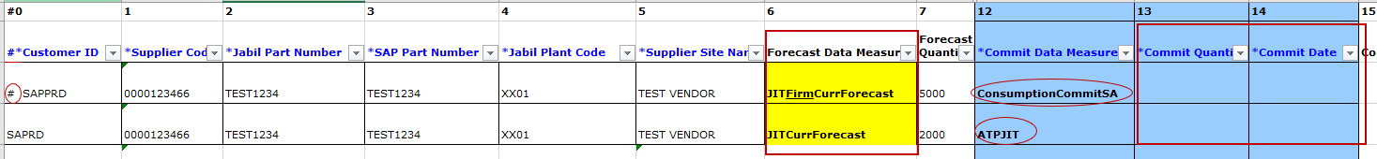
FORECAST RESPONSE | SCHEDULE AGREEMENTS | EXCEL ATTACHMENT
Download and Open Excel Attachment from the email!
Please follow below instructions and note that mandatory fields in BLUE need to be checked and updated​!
Commit Data Measure: you can add against to:
  JIT FirmCurrForecast lines to ‚ConsumptionCommitSA’ (1) – ONLY this is acceptable – Please do not change!
  JIT Curr.Forecast Lines: ‚ATPJIT’(2) – ONLY this is acceptable– Please do not change!
  (ATPJIT means – available to promise Just inTime)
  Commit qty & Commit Date (3): cannot be empty – please add available Quantity and Date information here
You can exclude a line from your response to use # character prefix in first field (4) or delete Line from the file!
3
4
1
2
Note: If you would like to send new FC Commit during the same week, please provide full commit by entering 0 on the previously entered buckets!

Slide 25
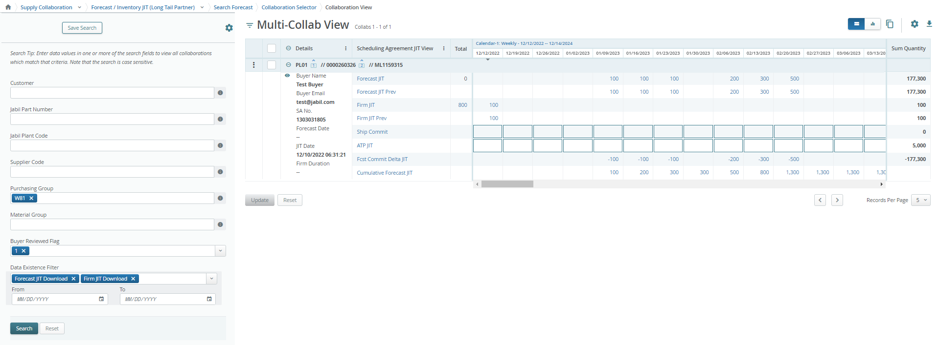
FORECAST RESPONSE | SCHEDULE AGREEMENTS | WEB LINK
After click the LINK in the email Alert -> you will drive to the e2o tool – simplified WEB – where you can see all Jabil Part Number Forecast/Firm SA data what Jabil Buyer released to you
FIRM JIT quantity (1) is scheudled in weekly buckets based on requested delivery date!
Calendar
To change calendar date and view –> click the link (Monthly or QTR-ly view is available too
5
6
4
1
2
3
SHIPcommit please provide ship quantity confirmation here (2)
ATP JIT (Available to promise –( information about possible available qty in case of demand increase) please populate data here (3)
Click FIRM JIT QTY number to see Firm details (4) - past due PO data is also including
Past due demand is consolidated always in the current week
TOTAL is calculated based on full data, independently from Calendar view set up on TOP! (5)
SUM Quantity: is including all demand and PO data based on Calendar view set up on TOP (6)
Click here to open Filter Menu

Slide 26
Visit our Supplier Portal for more Information:
https://www.jabil.com/about-us/supplier/supplier-collaboration.html

