Slide 1
Supplier Order Collaboration
e2open email-based Supplier – email text notification with embedded table

Slide 2





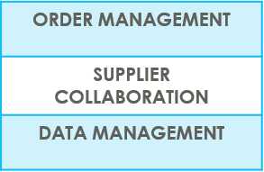
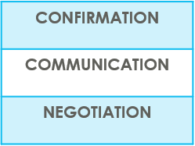

SUPPLIERS IN e2open | OVERVIEW
Supplier Collaboration
Input data
ERP system
Suppliers
Request
System message
Auto Write Back
System message
e2open is Jabil new Collaboration Platform to standardize and digitize our communication, one system for all Suppliers, all Communication methods
Automation of Purchase Order and Reschedule and/or Cancellation System message and Forecast communication to supplier and response write back into ERP system
Improved partnership with our Suppliers thru proactive collaboration
Platform for Suppliers and Buyers for short-term and long-term supply problems to support RISK and Shortage Management
e2open are mapping our Open PO and FC data from our ERP system > summarize it Iin a user-friendly Interface >then send it out to our Suppliers automatically

Slide 3



SUPPLIERS IN e2open | TYPES OF SUPPLIERS
IN e2open WE HAVE 2 TYPES OF SUPPLIERS
Portal Suppliers
Email-based Suppliers
These suppliers have direct access to the e2open Portal
Jabil sends invitation and registration is required
PO Confirmation is located directly in the Portal
The Portal also enables Forecast, PO & Goods Receipts visibility
These are our email-based suppliers – there is no direct access to e2open portal
No need for registration – everything takes place through email
There is a one-time token access
We offer 3 communication options – see more information on the next slide

Slide 4
SUPPLIERS IN e2open | COLLABORATION OPTIONS
Portal Suppliers
Email-based
Suppliers
ACCESS
Portal Registration
Based on Supplier Alert’s Subscription (Filters are available)
Directly on the PORTAL
Simplified UI link | Excel attachment + UI Link | Email body message
Predefined system email Alerts | Predefined system email Alerts | Predefined system email Alerts
Log in the portal with a simplified UI link from an automated email | Open excel attachment from system email / same as today with weekly OOR or Log in the portal with a simplified UI link from the email | Embedded HTML table from the email body text put commit there (date & qty) and send back
NOTIFICATION
REPLY
NOTE : one time token is expiring after 72 hours

Slide 5
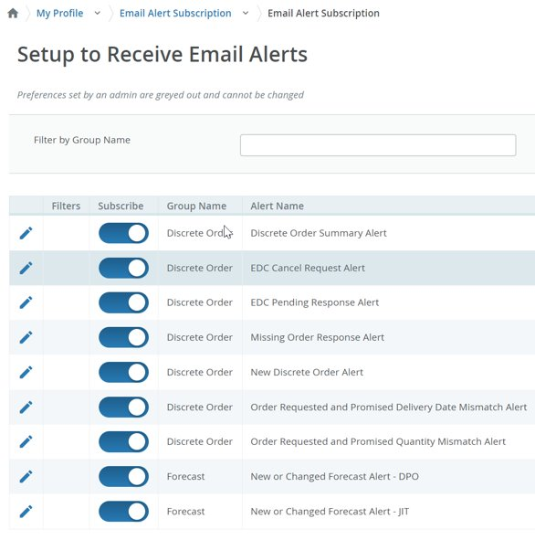
COLLABORATION OPTION DETAILS
SYSTEM ALERTS | Available for PORTAL Supplier | Available for Email-based Supplier | SET UP
New or Changed Forecast Alert DPO New or Changed Forecast Alert JIT | YES | YES | Email-based Suppliers – Alerts are defined in MASTER data – automated – no need any action PORTAL Suppliers – Alerts are optional, Supplier can subscribe/unsubscribe for different Alerts, and be able to Filter the Alerts as well
New Discrete Purchase Order | YES | YES
Summary of Discrete Order Lines | YES | YES
Order Requested and Promised Date Mismatch Alert​ | YES | NO
Order Requested and Promised Quantity Mismatch Alert​ | YES | NO
Missing Order Response Alert | YES | NO
Cancel request Alert | YES | YES
Cancel Pending Response Alert | YES | YES
All above Alerts are available for portal SUPPLIERS– in MY PROFILE > Email alert Subscription menu
System mail address: mailer@services.e2open.com & donotreply@e2open.com
Please ensure you are not blocking these mail addresses!

Slide 6
PO STATE TRANSITIONS IN e2open
START/END | NEW | OPEN | ACCEPT | ACCEPT W/CHANGES (AWC) | NO COMMIT | CLOSED | CANCELLEED
INITIAL SYSTEM | Change (Jabil)
NEW |  | >Change (Jabil) >MRP buyer update | Accept (Supplier) | AWC (Supplier) | No Commit (Suppl) | Close (Jabil) | Cancel (Jabil)
OPEN |  | Change (Jabil) >MRP buyer update >Cancel Response (Accept/No Commit – Suppl) | Accept (Supplier) | AWC (Supplier) | No Commit (Suppl) | Close (Jabil) | Cancel (Jabil)
NO COMMIT |  | >Change (Jabil) >MRP buyer update | Accept (Supplier) | AWC (Supplier) | No Commit (backend sync up only) | Close (Jabil) | Cancel (Jabil)
ACCEPT |  | >Change (Jabil) >MRP buyer update | Accept (backend sync up only) | AWC (Supplier) | No Commit (Suppl) | Close (Jabil) | Cancel (Jabil)
ACCEPT W/CHANGES (AWC) |  | >Change (Jabil) >MRP buyer update | Accept (Supplier) | AWC (backend sync up only) | No Commit (Suppl) | Close (Jabil) | Cancel (Jabil)
CLOSED |  | Change (Jabil) |  |  |  | Close (Jabil) | Cancel (Jabil)
CANCELLED |  | Change (Jabil) |  |  |  | Close (Jabil) | Cancel (Jabil)
START/END | NEW | OPEN | ACCEPT | ACCEPT W/CHANGES (AWC) | NO COMMIT | CLOSED | CANCELLEED
INITIAL SYSTEM | Change (Jabil)
NEW |  | >Change (Jabil) >MRP buyer update | Accept (Supplier) | AWC (Supplier) | No Commit (Suppl) | Close (Jabil) | Cancel (Jabil)
OPEN |  | Change (Jabil) >MRP buyer update >Cancel Response (Accept/No Commit – Suppl) | Accept (Supplier) | AWC (Supplier) | No Commit (Suppl) | Close (Jabil) | Cancel (Jabil)
NO COMMIT |  | >Change (Jabil) >MRP buyer update | Accept (Supplier) | AWC (Supplier) | No Commit (backend sync up only) | Close (Jabil) | Cancel (Jabil)
ACCEPT |  | >Change (Jabil) >MRP buyer update | Accept (backend sync up only) | AWC (Supplier) | No Commit (Suppl) | Close (Jabil) | Cancel (Jabil)
ACCEPT W/CHANGES (AWC) |  | >Change (Jabil) >MRP buyer update | Accept (Supplier) | AWC (backend sync up only) | No Commit (Suppl) | Close (Jabil) | Cancel (Jabil)
CLOSED |  | Change (Jabil) |  |  |  | Close (Jabil) | Cancel (Jabil)
CANCELLED |  | Change (Jabil) |  |  |  | Close (Jabil) | Cancel (Jabil)
Every PO change trigger PO line and PO Schedule line state change in e2open
NEW state > every new PO , not committed before
OPEN state > every PO where we have PO qty, delivery date or price change
ACCEPTED > every PO what Supplier confirmed back and meet fully with Jabil requested date and qty
ACCEPTED w/CHANGES > every PO what Supplier confirmed back BUT not meet fully with Jabil requested date and qty
CLOSED > every PO where we have no more open qty in SAP or buyer put delivery completed indicator flag
CANCELLED > every PO what Buyer cancel from SAP
Please check change MATRIX here!

Slide 7

EMAIL-BASED SUPPLIERS
Keyword(s): Business Deal
Supplier Order Collaboration
Email text notification with embedded table

Slide 8
EMAIL-BASED
SUPPLIERS
Supplier will receive system email notification with embedded HTML table about
New Purchase Orders
after Jabil place new PO, two times per day/no repeating Alerts
Open PO Summary
once per week /upon Jabil buyer review and release
New or Changed Forecast
once per week /upon Jabil buyer review and release
PO Cancellation request
once per day/no repeating Alerts
Supplier will be able to send confirmation for
New and Open PO delivery date and quantity
Forecast date and quantity
PO Cancel request
with reply to the email by filling out HTML table in the email body
After 72 hours one-time token will be expired!
EMAIL/TEXT NOTIFICATION

Slide 9

EMAIL/TEXT NOTIFICATION
OUTLINE
1 | SYSTEM ALERTS SUMMARY
2 | DISCRETE ORDER RESPONSE – NEW + OPEN PO ACKNOWLEDGE EDIT PROMISE NO COMMIT
3 | CANCEL REQUEST RESPONSE PROCESS

Slide 10

SUPPLIER ALERTS | EMAIL TEXT NOTIFICATION
Email-based Supplier SYSTEM ALERTS | ALERT FREQUENCY
New or Changed FORECAST Alert | NOT AVAILABLE*
New Discrete PO | 2 TIMES/DAY Not repeating same PO
Summary of Discrete Order Lines | ONCE /WEEK
Cancel request Alert | ONCE /DAY Not repeating same PO
Cancel Pending Response Alert | ONCE /DAY
* ONLY EXCEL TABLE + UI LINK OPTION IS AVAILABLE

Slide 11
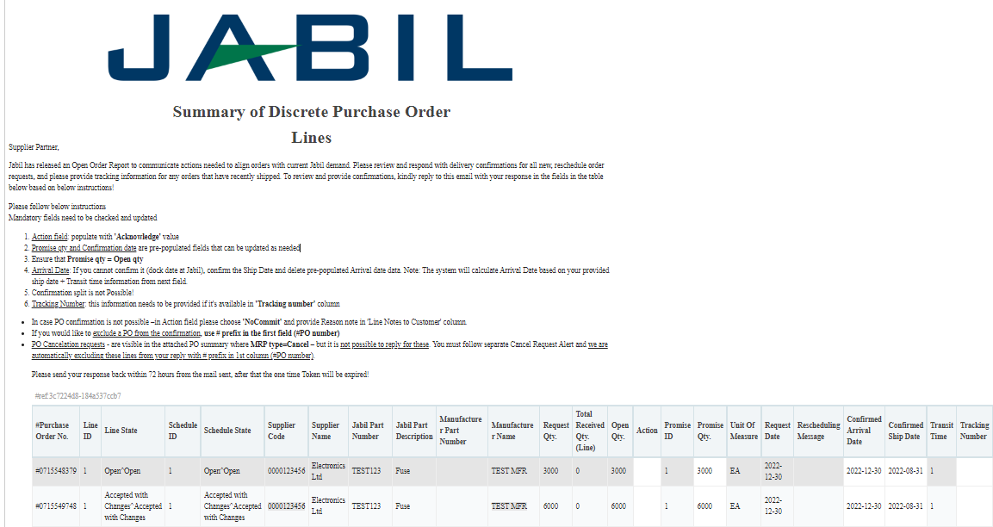
SUPPLIER ALERTS | EMAIL TEXT NOTIFICATION
2
1
Supplier User receives email notifications WITH embedded HTML table in the email body
Only one email address per supplier
System mail address: mailer@services.e2open.com (1)
Please ensure you are not blocking this mail address!
Email subject is always including reference number (2)– please make sure not delete this number from your reply back email!

Slide 12

SUPPLIER ALERTS | EMAIL TEXT NOTIFICATION
You will receive email notifications with embedded HTML table
Only one email address is allowed per supplier code
The notification option is pending from supplier configuration in e2open – and needs to be agreed before we onboard a Supplier in e2open.
Email link is time-sensitive and valid for 72 hours!
Open the email and click Replay to respond to the collaboration request
After Click you will be able to edit the table. Reply to the email by filling out HTML table in the email body . Please follow the instruction from the email
After your updates click Send to release PO confirmation to Jabil.
Do not change Subject!
Receive email with UI link:

Slide 13

SUPPLIER RESPONSE | EMAIL TEXT | RESPONSE OPTIONS
Discrete Purchase Orders
ACKNOWLEDGE
NO COMMIT
PO Cancellation
Request
ACEPT
NO COMMIT

Slide 14
PO STATE TRANSITIONS IN e2open
Every PO change trigger PO line and PO Schedule line state change in e2open
NEW state > every new PO , not committed before
OPEN state > every PO where we have PO qty, delivery date or price change
ACCEPTED > every PO what Supplier confirmed back and meet fully with Jabil requested date and qty
ACCEPTED w/CHANGES > every PO what Supplier confirmed back BUT not meet fully with Jabil requested date and qty
CLOSED > every PO where we have no more open qty in SAP or buyer put delivery completed indicator flag
CANCELLED > every PO what Buyer cancel from SAP
Please check change MATRIX here!
START/END | NEW | OPEN | ACCEPT | ACCEPT W/CHANGES (AWC) | NO COMMIT | CLOSED | CANCELLEED
INITIAL SYSTEM | Change (Jabil)
NEW |  | >Change (Jabil) >MRP buyer update | Accept (Supplier) | AWC (Supplier) | No Commit (Suppl) | Close (Jabil) | Cancel (Jabil)
OPEN |  | Change (Jabil) >MRP buyer update >Cancel Response (Accept/No Commit – Suppl) | Accept (Supplier) | AWC (Supplier) | No Commit (Suppl) | Close (Jabil) | Cancel (Jabil)
NO COMMIT |  | >Change (Jabil) >MRP buyer update | Accept (Supplier) | AWC (Supplier) | No Commit (backend sync up only) | Close (Jabil) | Cancel (Jabil)
ACCEPT |  | >Change (Jabil) >MRP buyer update | Accept (backend sync up only) | AWC (Supplier) | No Commit (Suppl) | Close (Jabil) | Cancel (Jabil)
ACCEPT W/CHANGES (AWC) |  | >Change (Jabil) >MRP buyer update | Accept (Supplier) | AWC (backend sync up only) | No Commit (Suppl) | Close (Jabil) | Cancel (Jabil)
CLOSED |  | Change (Jabil) |  |  |  | Close (Jabil) | Cancel (Jabil)
CANCELLED |  | Change (Jabil) |  |  |  | Close (Jabil) | Cancel (Jabil)

Slide 15
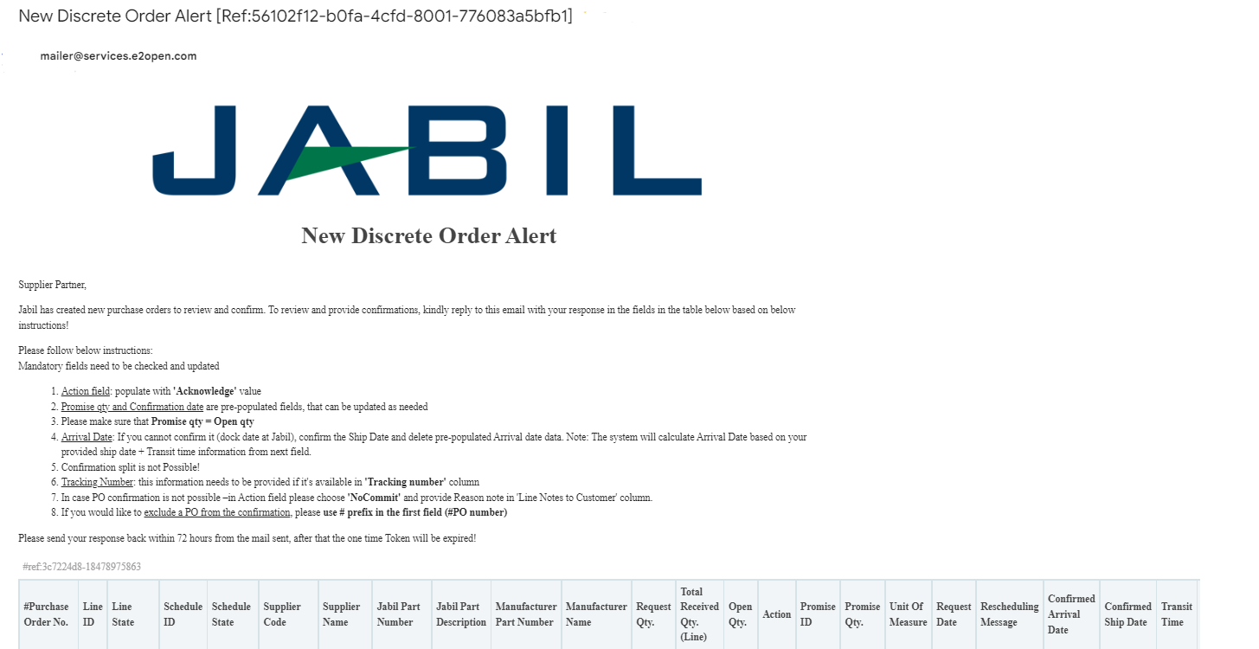
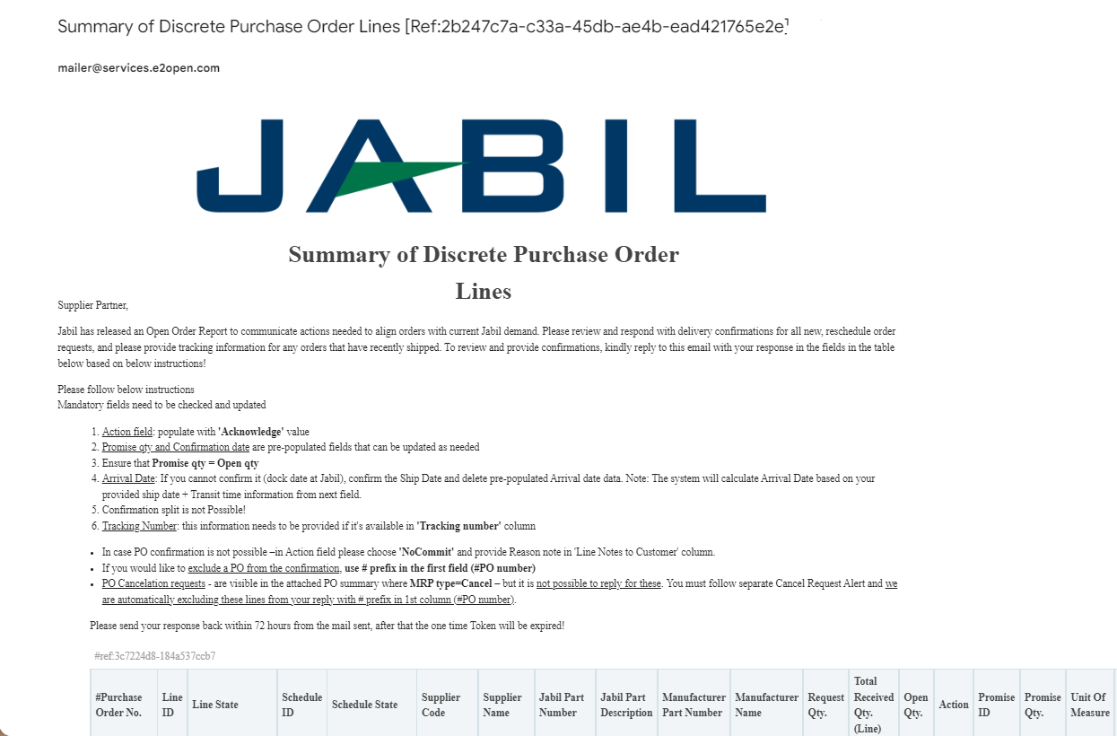
NEW / SUMMARY OF DISCRETE ORDER LINES ALERT | EMAIL TEXT RESPONSE

Slide 16
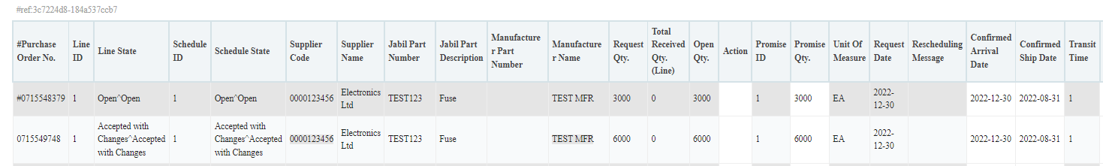
NEW/OPEN ORDER CONFIRMATION | EMAIL TEXT
After click REPLY to the the email you will be abel to edit data in the HTML tabel.
You must respond to New and OPEN Discrete Orders (1). You will have following options:
Acknowledge
No Commit
After populate Acknowledge >​
Leave the details as they are and the Discrete Order State transitions into Accepted OR​
Update the Promise Quantity and/or Confirmed Arrival Data/Confirmed Ship Date if needed and the Discrete Order State transitions into Accepted w/ Changes ​
After you populate NoCommit >​
Discrete Order State transitions into No Commit​
1
1
ACKNOWLEDGE
NO COMMIT
17
18

Slide 17
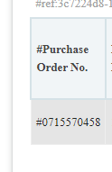
SUPPLIER RESPONSE | ACKNOWLEDGE | EMAIL TEXT
New and Open PO details are available in email body text!
Please follow below instructions and provide confirmation for all NEW (recently placed) and OPEN (Jabil made PO changes meanwhile) PO lines (1)
Mandatory fields needs to be checked and updated​
Action field: populate with 'Acknowledge' value (2)
Promise qty (3) and Confirmation date (4) are pre-populated fields –that can be updated as needed​
Please make sure that Promise qty = Open qty(Less qty confirmation is allowed but overcommit is not allowed!)
Arrival Date (5) : If you cannot confirm it (dock date at Jabil), confirm the Ship Date (4) and delete pre-populated Arrival date data. Note: if you keep both date in the file - the system will calculate and overwrite Arrival Date based on your provided ship date + Transit time (6) information from next field.
Confirmation split is not Possible!
Tracking Number: this information needs to be provided if it's available in 'Tracking number' column (7)
If you would like to exclude a PO from the confirmation, please use # prefix in the first field (#PO number)​ (8)
You can send message to Jabil Buyer with put note into Line Notes to Customer field (9)
Please send your response back within 72 hours from the mail sent, after that the one-time Token will be expired!
8
1
1
2
3
4
5
6
7
9

Slide 18
SUPPLIER RESPONSE | NO COMMIT | EMAIL TEXT
In case PO confirmation is not possible –in Action field please choose 'NoCommit' and provide Reason note in 'Line Notes to Customer' column.
1
2
After you populate Acknowledge >
Leave the details as they are and the Discrete Order State transitions into Accepted OR
Update the Promise Quantity and/or Confirmed Arrival Data/Confirmed Ship Date if needed and the Discrete Order State transitions into Accepted w/ Changes
After you populate NoCommit >
Discrete Order State transitions into No Commit

Slide 19
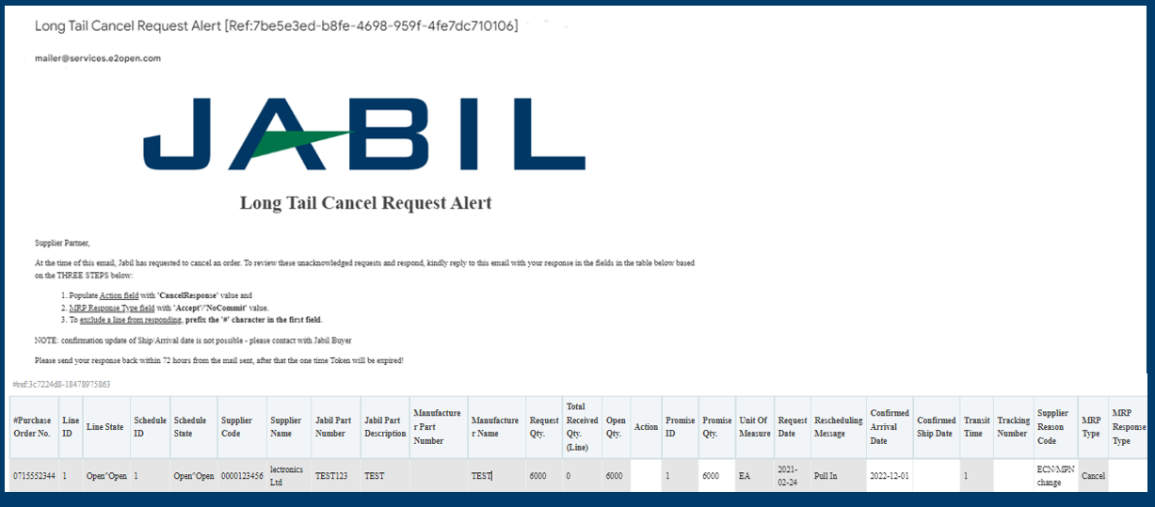
CANCEL REQUEST ALERT | EMAIL TEXT

Slide 20
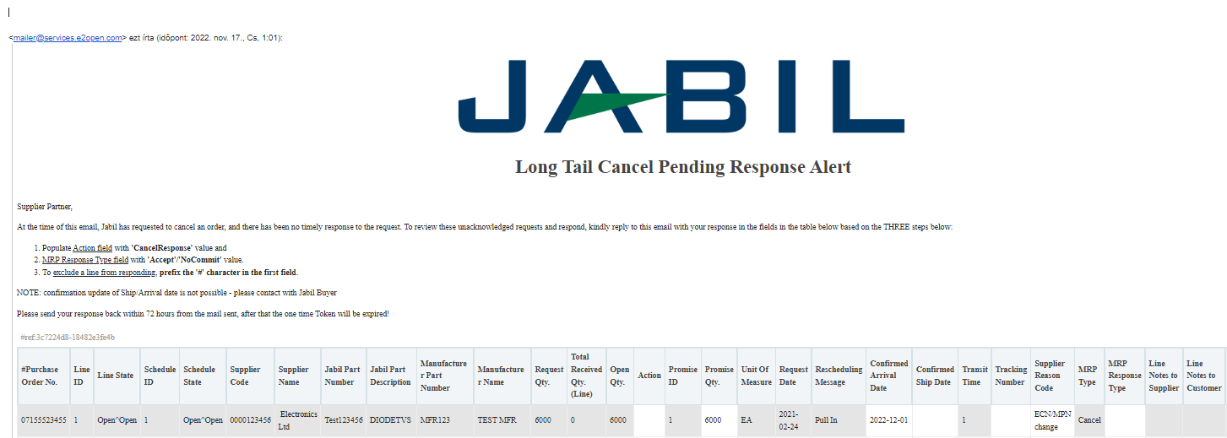
CANCEL REQUEST PENDING RESPONSE ALERT | EMAIL TEXT

Slide 21
CANCEL REQUEST RESPONSE | EMAIL TEXT
Jabil PO requests are available in embedded table in the email text kindly reply to this email with your response in the fields in the table below based on the THREE STEPS below:
Action field: populate with 'CancelResponse' value(1)
MRP Response Type field with 'Accept'/'NoCommit' value.(2)
To exclude a line from responding, prefix the '#' character in the first field.(3)
NOTE: confirmation update of Ship/Arrival date is not possible - please contact with Jabil Buyer
Promise qty and date are mandatory fields – please do not remove data from here
You can send notes or messages to Jabil in in Line Notes to Customer column (4)!
1
2
4
3

Slide 22
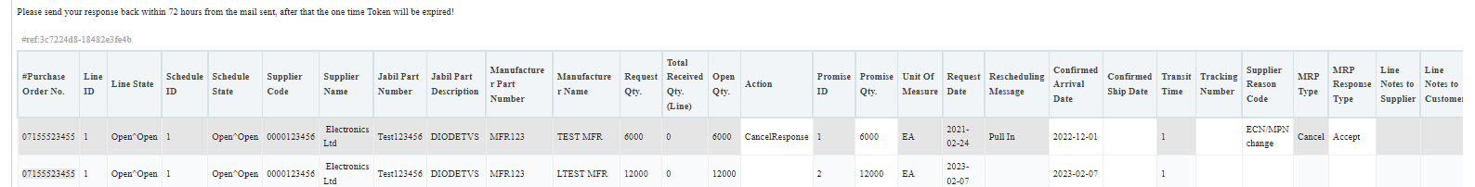
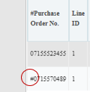
PARTIAL CANCEL REQUEST RESPONSE | EMAIL TEXT
In case you have multiple confirmation against one PO Line (1) and partial cancellation request against some of them, you can provide Cancelation response only against of those Confirmation lines where you can see the Cancel request: MRP type = Cancel (2)
In column MRP Type the Buyer cancellation request is visible
Please provides the response by updating the field MRP Response Type with ‚Accept’ or ‚NoCommit’ (3) and save.
*NOTE: you cannot provide Cancel Response against a PO schedule line or promise line where is no Cancel Request in MRP type column! Please exclude this line from your response to use # character prefix in first (PO nr.) field or delete the line from your file. (4)
1
2
3
4

